Slide 1
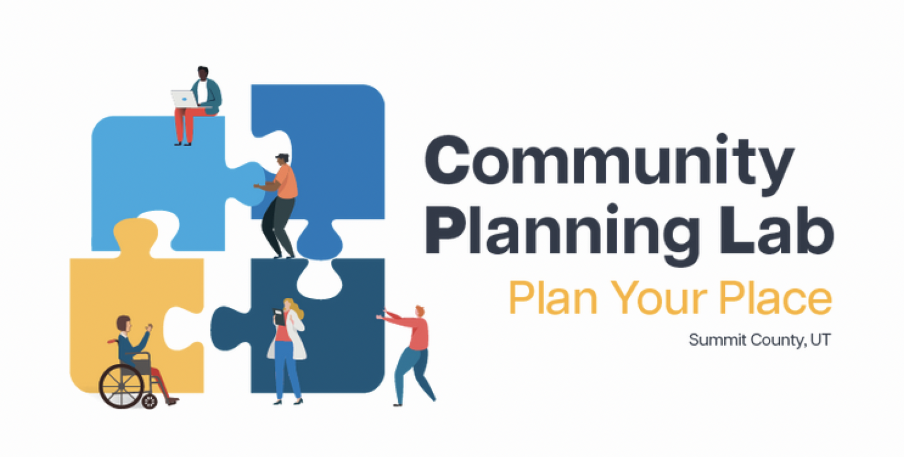
Summit County Community Planning Lab
Sustainable Development
April 29, 2024

Slide 2
Agenda
Review
Guest Speaker:
Emily Quinton: Sustainability Program Manager, Summit County
Break
Activity
Final Project Work
Wrap Up
For Next Class

Slide 3
Review
What is a ‘GNAR’? What are some opportunities and threats associated with GNAR communities?
Based on what you read, what is one connection you can make between sustainability and planning?
ROLE PLAY: You and your tablemates are members of a local planning commission and are reviewing the results of a recent community survey. One question asked about how the community should prioritize its time and resources.
24% want a new playground
30% want more housing options
46% want to preserve open space
Acting as the planning commission, decide how to proceed.
Based on what you know and what you read, how might land use decisions impact public health and sustainability?

Slide 4

Community Planning Lab Week 8 Sustainable Development
April 29, 2024
Emily Quinton, Sustainability Program Manager

Slide 5
Learning Objectives
Outline
Participants will be able to…
Define sustainability and sustainable development
Articulate the interconnections between sustainable development and public health
Analyze the impact of land use decisions and planning processes on sustainability
Understand risks Summit County faces in relation to climate change and how those risks are influenced by land use decisions
Practice applying tools to integrate a sustainability lens into decision making
About Summit County sustainability
Setting the stage: what is sustainable development?*
Sustainable development in Summit County code
Intersections of sustainable development*
Sustainable development toolbox
Decision-making tools
Land use tools*
*There will be individual/group activities during these topics

Slide 6


Vision
Summit County is a vital community that is renowned for its natural beauty, quality of life, and economic diversity, that supports a healthy, prosperous, and culturally-diverse citizenry.​
Summit County is a community where people can live a positive, healthy lifestyle through public health efforts focused on awareness, education, and preparedness.​
Mission​
To be a trusted and innovative public health organization focused on defining and implementing strategies and services that address:​
Health equity​
Community health and engagement​
Community and individual resilience​
Environmental stewardship​
Sustainability
We provide excellent and inclusive services that support the health, safety, and welfare of the community, making Summit County the best place to live for present and future generations. ​

Slide 7
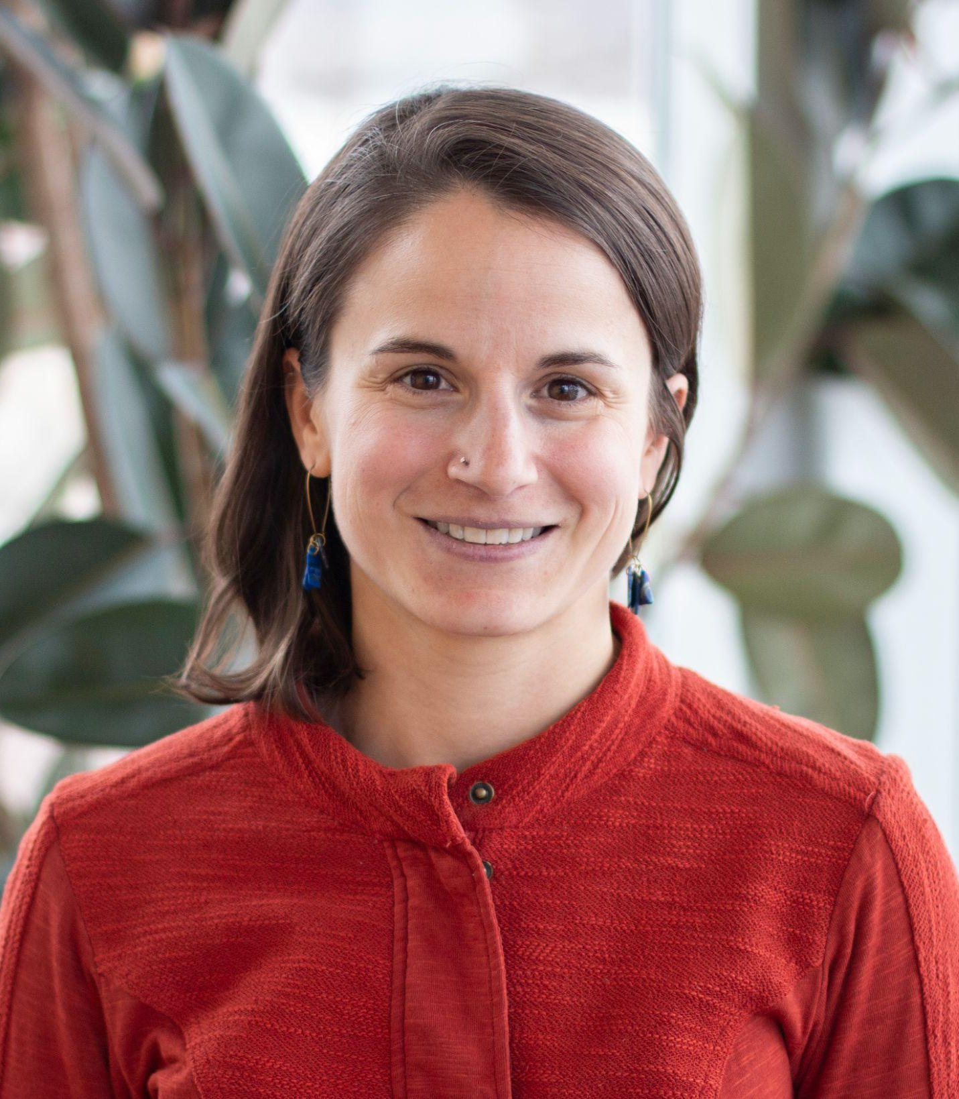
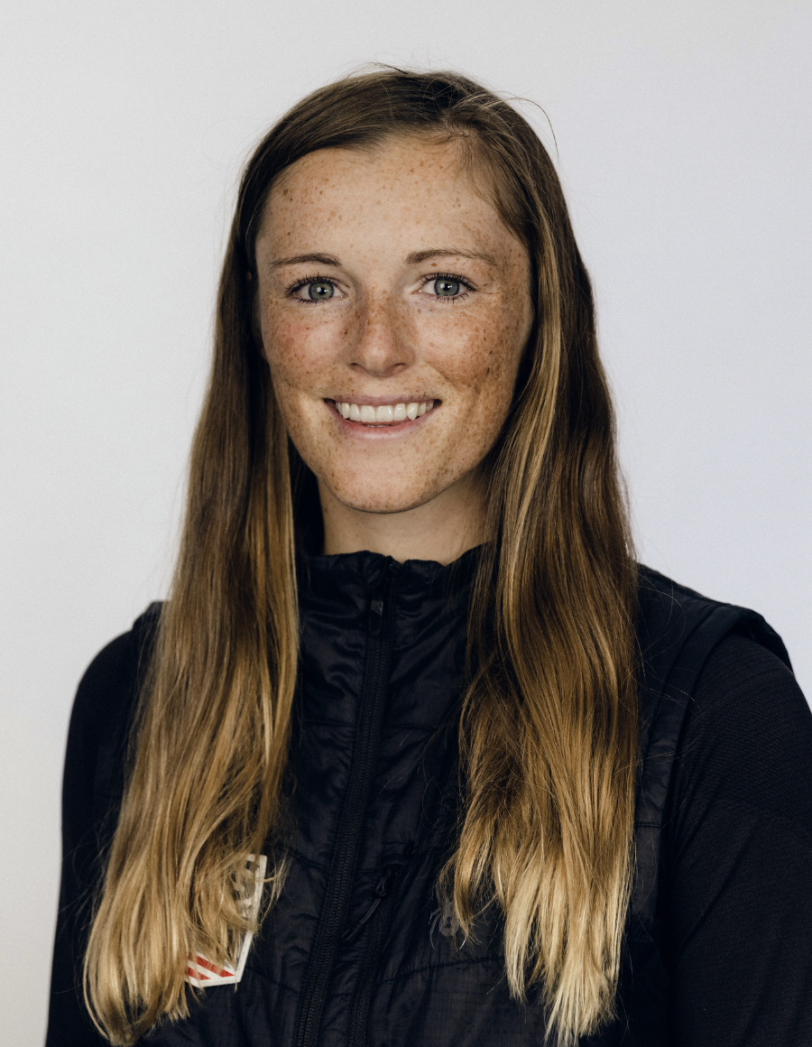
About the Sustainability division
The Sustainability Division shapes, implements, and supports goals and initiatives to demonstrate what a sustainability community means for Summit County.
Our work is focused on:
Achieving Summit County climate change action and environmental stewardship goals.
Aligning policies and processes with local government sustainability and climate change action best practices
We do this by:
Emphasizing collaboration, systems thinking, responsible resource use, life cycle considerations, and health equity
Envisioning a future with resilient and healthy built and natural environments for everyone that lives, works, and plays in Summit County
Emily Quinton
Sustainability Program Manager
equinton@summitcounty.org
Renewable energy initiatives
Climate change & public health speaker series
EV chargers
Megan Nick
Sustainability Analyst
mnick@summitcounty.org
Green Business Program
Greenhouse gas emissions inventories
Sustainability metrics tracking
Some key projects include:

Slide 8

Council goals
Greenhouse gas emissions reduction goals
Government operations: 80% below 2016 level by 2040
County-wide: 80% below 2014 level by 2050
Major sources of GHG emissions:
Strategies include:
Net-100% renewable electrical energy for County operations & available community wide
Widely available and efficient public transit, alternative transportation modes
Electrification of the County vehicle fleet
Emphasis on energy efficiency in County facilities
General plans and codes that emphasize sustainable development principles
Utility and legislative collaboration
Key documents
2015 Climate Action Plan
Resolution 2019-29

Slide 9
Why?
Summit County established a sustainability program and over a decade ago and moved the division under the Health Department in 2018.
From Resolution 2019-29:
“WHEREAS, because long-term consequences of energy derived from fossil-fuels will be devastating to Summit County and its agricultural, tourist and recreation-based economies and quality of life, it is critical that energy consumers and the utilities serving them work actively to reduce greenhouse gas emissions”
“WHEREAS, in addition to mitigating climate impacts, such actions will provide a range of other community benefits including improved air quality, enhanced public health, increased national and energy security, local energy-efficiency and renewable energy related jobs, reduced reliance on finite resources, and myriad other positive outcomes”

Slide 10
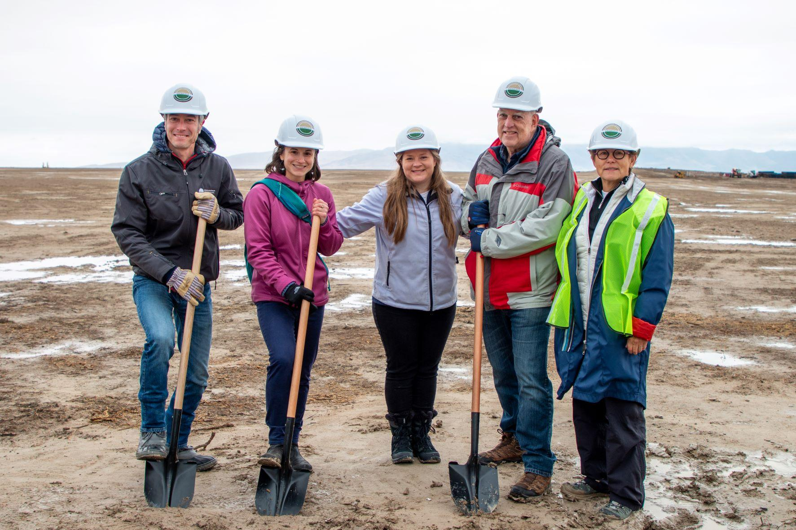
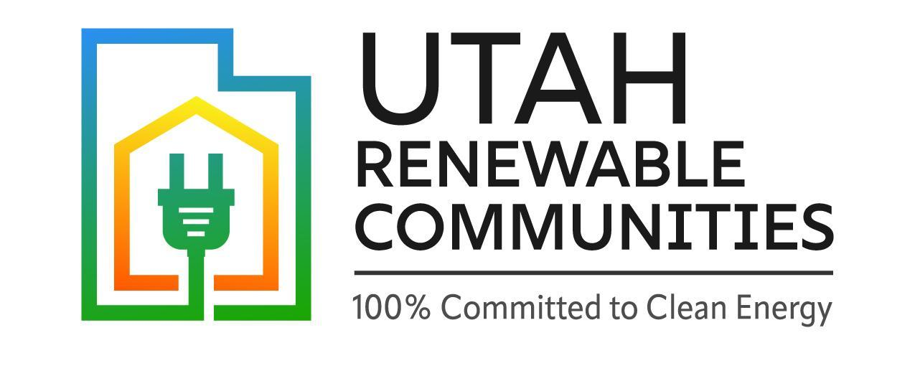
Highlight: renewable energy initiatives
Elektron Solar
Utah Renewable Communities
18 communities working to launch a default net-100% renewable electricity option for customers of Rocky Mountain Power in their respective communities
Status: filing program resource solicitation documents with Public Service Commission in May
80-MW solar farm in Tooele County
6 customers will purchase the output through RMP for our operational electricity use
Status: online any day now!

Slide 11

Highlight: Green Business Program
The Green Business Program supports local businesses integrating sustainability practices into their operations and customer offerings.
Program benefits include a resource library, quarterly lunch and learns, e-newsletter, annual awards, and more!
Action categories:
Energy efficiency & renewables
Water conservation
Transportation
Thriving community & equity
Materials and waste
Coming in fall 2024: new program website!

Slide 12
How do you define sustainability?
How do you define sustainable development?
Activity time: think-post-share
Write key words, phrases, or full sentences on big sticky notes
Put your sticky notes up
Ask for volunteer: read off posted sticky notes

Slide 13
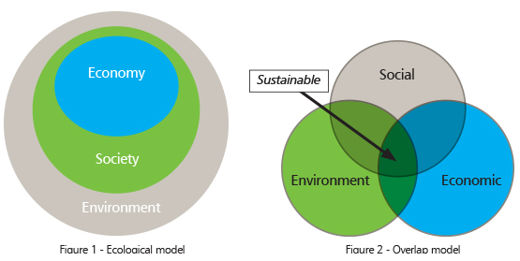
“sustainability” is the result of conscious and intentional strategies designed to secure a balance between human beings and the natural world and to preserve that balance for the benefit of future generations. Indigenous Peoples and Sustainability Policy: Exploring the Politics and Practice of “Indigenous Sustainability” from ASU
Sustainability is based on a simple principle: Everything that we need for our survival and well-being depends, either directly or indirectly, on our natural environment. To pursue sustainability is to create and maintain the conditions under which humans and nature can exist in productive harmony to support present and future generations. - US EPA
Image from Sustainable San Antonio

Slide 14
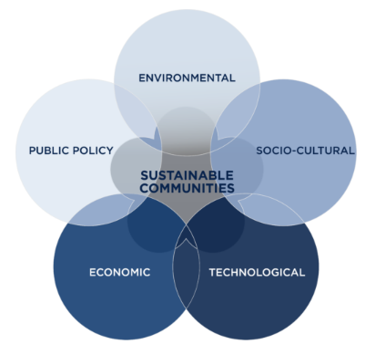
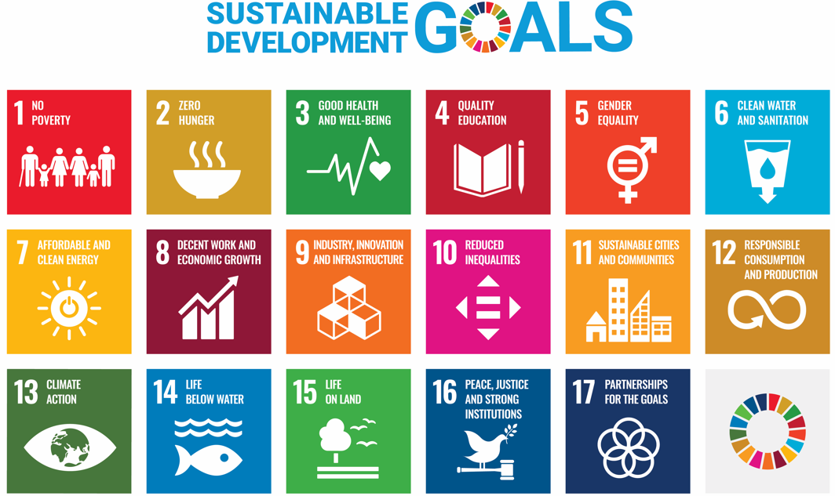
Image from Colorado School of Mines
UN Sustainable Development Goals
Smart growth can be defined as a policy framework that promotes an urban development pattern characterized by high population density, walkable and bikeable neighborhoods, preserved green spaces, mixed-use development (i.e., development projects that include both residential and commercial uses), available mass transit, and limited road construction.
Urban Sprawl, Smart Growth, and Deliberative Democracy

Slide 15
Sustainable development in Summit County code

Slide 16
Resolution 2019-29, Goal 6 Community Design
Emphasis shall be given to the form and location of future development in Summit County. General Plans and Development Codes shall focus new growth towards compact in-fill within existing developed areas where sustainable infrastructure, multi-modal transportation, walkability, and the preservation of the natural environment can be better achieved.
While all the goals in Resolution 2019-29 have a connection to land use, goal 6 is most explicitly related to planning and zoning guidelines and processes

Slide 17
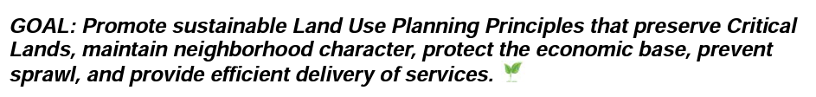

Sustainable development elements are present in the Eastern Summit County & Snyderville Basin General Plans

Slide 18
Eastern Summit County Development Code Lighting Regulations
Snyderville Basin Development Code Landscaping Regulations
11-6-20: LIGHTING REGULATIONS
A. Purpose: The purpose of this section is:
1. To prevent the degradation of the nighttime visual environment by production of unsightly and dangerous glare;
2. To create lighting practices that promote the health and safety of Summit County's citizens and visitors;
3. To prevent unnecessary waste of energy and resources in the production of excessive light or wasted light;
4. To prevent interference in the use or enjoyment of property which is not intended to be illuminated at night and the loss of the scenic view of the night sky due to increased urban sky-glow.
10-4-20: LANDSCAPING
A. Purpose: The purpose of these landscape regulations is to promote water conservation and prevent water waste through the implementation of xeriscape landscaping principles to ensure that the quality and character of the landscaping in the Snyderville Basin reflects the high desert nature of the area. Landscaping should protect and enhance the community's environmental, economic, recreational, and aesthetic resources by promoting efficient use of water, reducing water waste, and establishing a structure for the design, installation, and maintenance of xeriscape landscaping areas. Where possible, it is encouraged that native vegetation areas be protected during construction and retained thereafter. The use of turf should be limited to the greatest extent possible.
Other examples include: language around rooftop and ground mount solar and coming soon, EV readiness language. Also, concurrency program in Health Code

Slide 19
Sustainable development is about a lot more than individual buildings AND buildings are really important too
When it comes to building code, there is no home rule in Utah
This means that the state sets building code
Residential: a version of the 2015 International Energy Conservation Code (IECC)
Commercial: a version of the 2021 International Energy Conservation Code (IECC)
Sustainability and clean energy advocates would like to see the residential code updated and studies indicate positive environmental and economic outcomes of doing so
The Economics of All-Electric New Construction in Utah
Impacts of Model Building Energy Codes

Slide 20
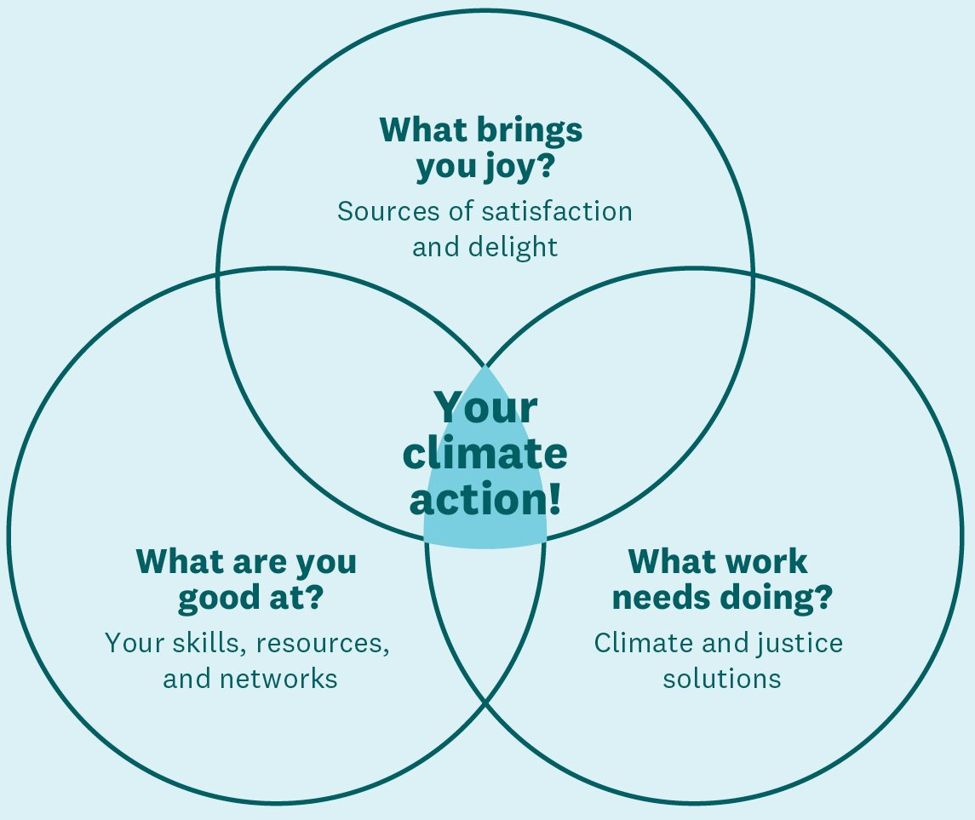
Opportunities
Scan through Summit County code and you will see sustainable development come to life in many ways. AND there are lots of opportunities to better integrate and reframe around sustainable development values and principles.
If this is something you care about and want to explore more:
As a final Community Planning Lab project you could…
Explore recommending a code amendment
Present a case study from another community
Develop and evaluate existing code against a sustainable development scorecard
Listen to Planning Commission and Council meetings. Consider how discussions support or hinder sustainable development
Prepare a public comment to share your priorities for sustainable development and/or reflect how a particular development proposal impacts sustainability
Climate Venn from Dr. Ayana Elizabeth Johnson: website and Ted Talk

Slide 21
BREAK

Slide 22
Intersections with sustainable development
Housing
Public health
Transportation
Waste
Climate resilience
Water
Accessibility
Social equity
Energy
Food security
Local economy

Slide 23
Intersections with sustainable development
Activity time: group brainstorm & discussion
With a partner or at your table, pick 2-3 topics
Discuss: how might you consider these various intersections when reviewing future proposed projects? How might you explain these intersections to other members of the community?
Report out to the group
Housing
Energy
Food security
Climate resilience
Social equity
Transportation
Local economy
Waste
Public health
Water
Accessibility

Slide 24
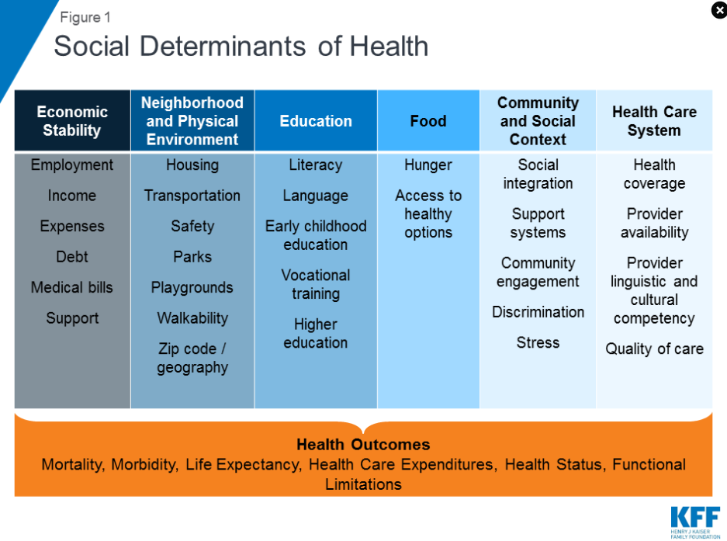
Intersections: public health
Development and land use decisions impact:
How we move around
Access to essential services
Access to economic and social life
Exposure to pollutants
And so much more
Upstream “social determinants of health” helps us to understand the intersection of sustainable development and public health
An intersection to consider:
Environmental racism - proximity of low income housing to polluting activities - quality of housing - exposure to pollutants indoors…
>>How can we make healthy indoor and outdoor environments for those in affordable housing?

Slide 25
Intersections: climate change risks
For several years, a transition has been underway in the fields of planning and sustainability in relation to climate change - to expand beyond mitigation (reducing our contribution to global climate change) to include adaptation and resilience. Key steps to do this include:
Understanding climate change risks (for example: wildfire, drought, water scarcity, vector-born disease, extreme weather events, heat)
Evaluating exposure to and vulnerabilities to these risks
Adding a public health lens, social determinants of health can drive vulnerabilities
Exploring strategies to reduce vulnerabilities
Implementing prioritized strategies to enhance community resilience
Local risk assessments have looked at climate risks such as changing snowpack, drought, water scarcity, wildfire, and more. Each of these risks pose threats to community and human health.
Potential Impacts of Climate Change for U.S. Wasatch Range Ski Areas: Projections for Park City Mountain Resort in 2030, 2050, and 2075, completed by Stratus Consulting, 2010
Climate Change and Utah Ski Resorts: Impacts, Perceptions, and Adaptation Strategies from USU, 2021
Weber River Basin Climate Vulnerability Assessment by Western Water Assessment, University of Utah, and USU
Climate Risk Assessment, Summit County: completed by the Woodwell Climate Research Center, 2022

Slide 26
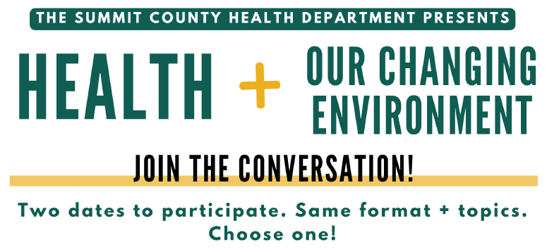
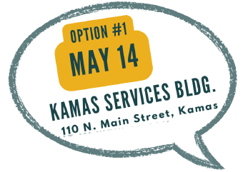
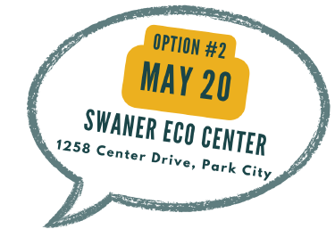
Speaking of climate…quick pitch for upcoming events!

Slide 27
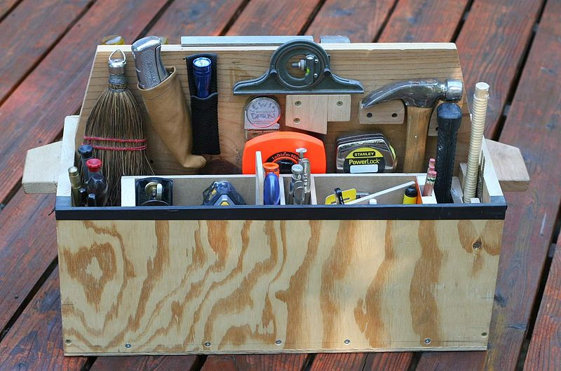
Sustainable development toolbox - strategies for integrating and implementing a sustainable development

Slide 28
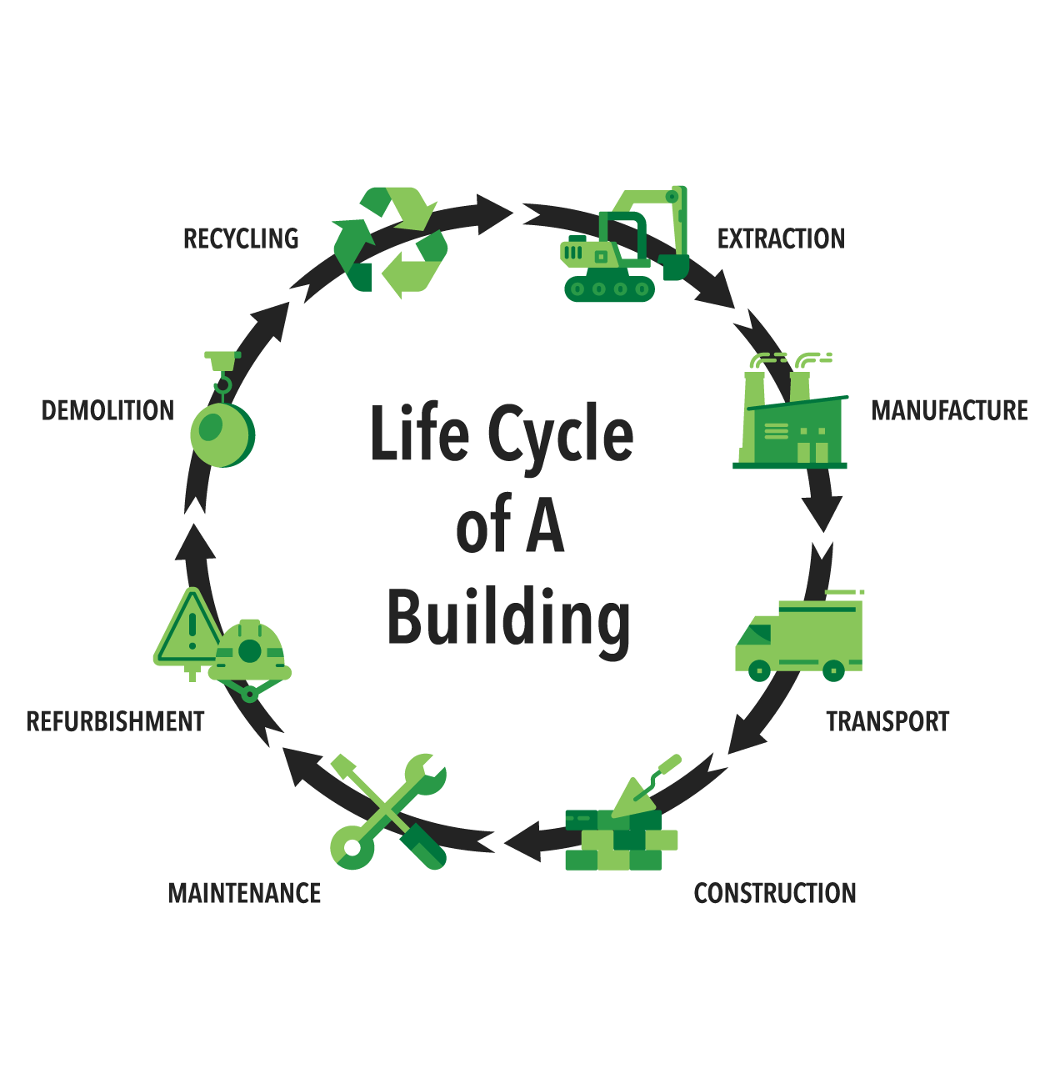
Decision making tools
Life cycle analysis
Life cycle cost: upfront cost v. long term savings
Life cycle carbon: what emissions will result from business as usual v. an alternative? Such as conventional HVAC or all-electric
Multi-criteria decision analysis
Using more than cost to inform decisions
Weight/prioritize criteria based on stakeholder input
Systems mapping/thinking
How will this decision impact other parts of the system?
Equity lenses
How are benefits and harms distributed?
Work to ensure historical injustices are not reinforced, better yet, are reversed
Valuation of ecosystem services
Putting ecosystem services like clean air, clean water, provisioning of food, aesthetic quality, etc, into economic terms for comparison and evaluation

Slide 29
Decision making tools - links to examples
Life cycle-related analysis
Economics of All–Electric New Construction in Utah by E3
New Jersey Meadowlands Commission Life Cycle Costing and Environmental Life Cycle Assessment performed by the Rutgers Center for Green Building
Life Cycle Assessment of Buildings: A Practice Guide from The Carbon Leadership Forum
Equity lens
Sustainability Through an Equity Lens, an Introduction by By Dawn Ashbacher, Sustainability Program Manager, Frederick County, MD, Government and Alisha Reis, Deputy County Manager, Adams County, Colorado
Equity in Sustainability initiative from City of Providence
Climate Equity Index from City of San Diego

Slide 30
Land use tools
Zoning
How can zoning be used to promote smart, transit-oriented, climate resilient communities?
Maximize benefits for people while minimizing harm to the environment
Stretch codes
Voluntary codes can encourage adoption of best practices
Stretch codes are used in places like Utah where local government does not set building code, and in places with home rule to push for stricter and more ambitious standards
Development incentives
Often paired with stretch codes to further push voluntary adoption of best practices
Neighborhood and building certification programs
Green and sustainable building and development certification programs offer an opportunity to clearly define expectations using a third-party verified system
Climate risk and vulnerability assessments
Includes geospatial tools to identify vulnerable communities and infrastructure
Information on risk can then be used to inform land use and other decisions

Slide 31
Land use tools: examples
Zoning approaches
West Valley City Residential Sustainability (RS) Zone
Food Retail Expansion to Support Health (FRESH) zoning and tax incentive program from NYC
City of Boston Zero Net Carbon Building Zoning Initiative
4 Zoning Changes That Boost Local Food Security by Gina Harvey from the APA
Models for Mitigation Wildfire Hazards Through Zoning by Jim Schwab & Stuart Meck for APA
Land use planning can reduce wildfire risk to homes and communities from Headwaters Economics
Code approaches
Net-Zero Stretch Code proposed for Park City: Staff report presented to the Park City Planning Commission 3/8/23
Resilient Building Codes Toolkit from the U.S. Department of Housing and Urban Development
Rebuilding Better from Boulder County - sort of serves like a stretch code for rebuilding after the 2021 Marshall Fire
About Stretch Codes from the New Buildings Institute
Neighborhood and building certification programs
For a brief overview of several programs see Yale Experts Explain Green Building Certifications. Includes info on:
LEED (has a program for buildings and neighborhood development)
WELL | WELL Community Standard
Living Building Challenge | Living Community Standard
ENERGY STAR Building Certification
Enterprise Green Communities
Climate risk and vulnerability assessments
Kansas City Metro Climate Risk and Vulnerability Assessment (CRVA)
City of Bloomington Climate Risk and Vulnerability Assessment

Slide 32
Exploring the toolbox
Activity time: review & reflect
Explore and learn more about land-use sustainable development tool from the previous slide:
Pick a tool and click the link provided
Read, review, and reflect (individual, pair, or group)

Slide 33
One last pitch - get involved in reducing food waste
Park City Community Foundation is leading the creation and roll out of the Zero Food Waste 2030 goal, which plans to eliminate and divert all food waste from our Summit County landfill by 2030.
Why food waste? Diverting and eliminating food waste from our landfills is a high-impact and achievable goal that will reduce methane emissions, protect our water sources from contamination, and has rippling economic benefits. Roughly 80% of the solid waste that reaches our local landfill could be diverted, with 40-60% of that being food waste.
As a first step to the rollout of the Zero Food Waste Strategic Plan, Park City Community Foundation will soon be rolling out a residential compost program that will allow residents in the greater Park City area to opt into a curbside composting program. This means residents can get all of their food waste - including meat, fat, oils, everything - picked up once a week, just like our trash is picked up.
Get the latest news about this effort by signing up for the Climate Newsletter at: parkcitycf.org/enews-signup/

Slide 34
Thank you
Emily Quinton
Sustainability Program Manager equinton@summitcounty.org
435-333-1522

Slide 35


Slide 36
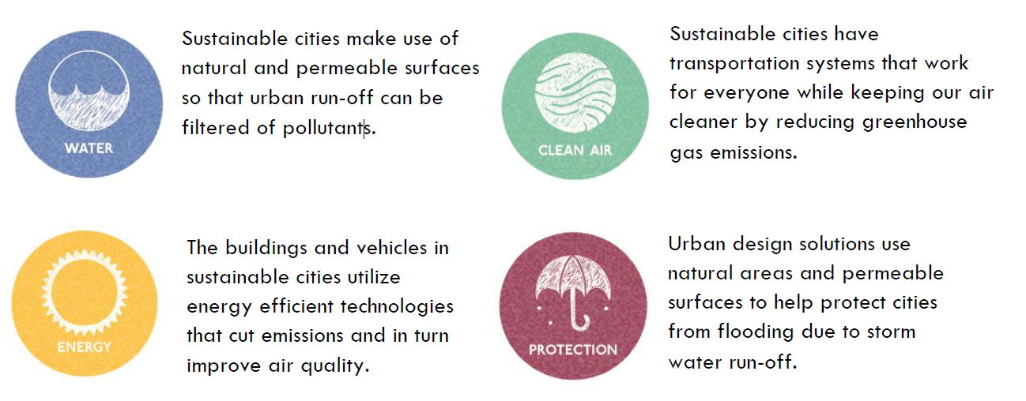

Slide 37
Activity: Sustainable Communities
Perform a SWOT Analysis of your community in relation to what we have learned this semester.
Strengths: The good things about the design and functionality of the existing community (What’s good about what you see on the map?)
Weaknesses: The bad things about the design and functionality of the existing community (What’s bad about what you see on the map?)
Opportunities: What could be improved on or brought into the community?
Threats: What are the pressures that could negatively impact the new design? (Either as a result of the new design, or threats from outside the community boundaries)
1. Create a list with at least 3 strengths and 3 weaknesses of the existing community design. Consider urban design, housing types, transportation, sustainability, etc.
2. After identifying the strengths and weaknesses, identify at least 5 opportunities to improve the community, while keeping in mind the existing character of the community. Indicate these opportunities on your map by drawing, using sticky notes, using the building-related cards, and/or the building blocks.
3. After altering your map, think critically about your new design. Identify at least 3 threats to the community.
4. Emily shared a sustainable design toolbox. Try to identify at least 3 tools from the toolbox that you used in your redesign.

Slide 38
Activity: Sustainable Communities
Key features of Urban Sustainability:
a. Accessible public transport
b. Walking and cycling are safe
c. New construction is energy efficient
d. Existing structures use energy-saving measures where appropriate
e. Open space areas are present and safe, accessible
f. Affordable housing is present
g. Cultural and social resources available to all
h. Waste is recycled whenever possible with a focus on re-use and reduction
i. Renewable resources used where possible
j. Healthy food choices are accessible to all
k. Water management solutions are in place to address flooding and run-off
l. Resources and services accessible to all (hospitals, libraries, etc.)
Also consider urban design strategies including Places for People, Enrich the Existing, Make Connections, Work With the Landscape, Mix Uses and Forms, Manage the Investment, and Design for Change

Slide 39
Wrap Up
What are the benefits to planning with sustainability in mind?
What are the potential connections between sustainable development and transportation options?
Can elements of sustainable development be incorporated into your final project?
REMINDER OF LEARNING OBJECTIVES: Participants will be able to…
Define sustainability and sustainable development.
Articulate the interconnections between sustainable development and public health.
Analyze the impact of land use decisions and planning processes on sustainability.
Understand risks Summit County faces in relation to climate change and how those risks are influenced by land use decisions.
Practice applying tools to integrate a sustainability lens into decision making

Slide 40
Final Project Outline
Example Presentation Outline for Projects:
Lead In
State the Issue – problem or opportunity
Show a photo or short video
Context
Where does it come from?
Are there known causes or contributors?
Does it have a long history?
Value
Why does it matter? What’s at stake?
Are people suffering because of it, or not getting something of value?
Who are these people? Tell a story about one.
Solutions
What can be done about it?
Are there alternative ways to address it?
Which is best? Why?
Show photos of examples of the best approach.
Connection
Explain how doing that will solve the problem or take advantage of the opportunity
Tie the solution to the story

Slide 41
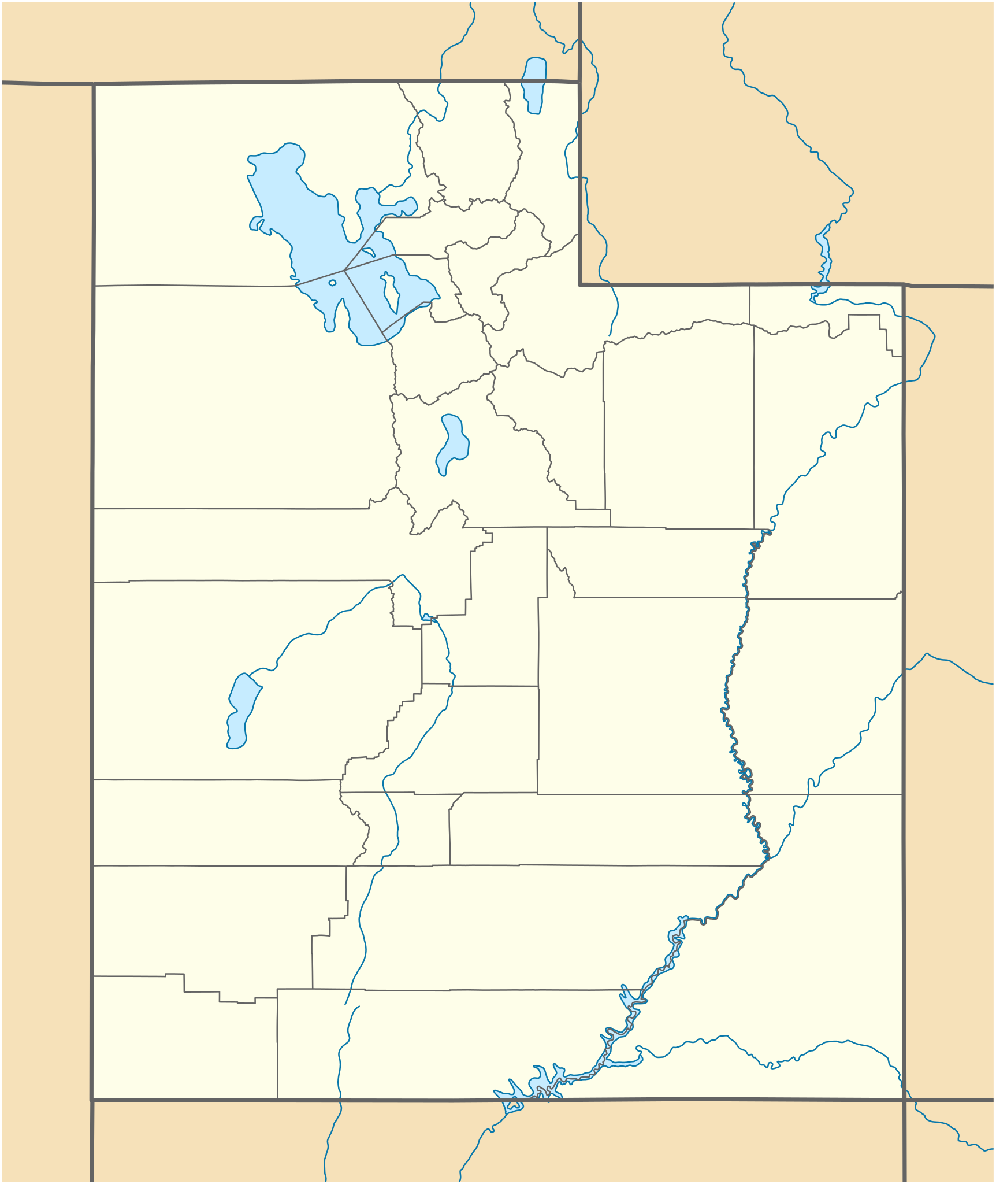
Context
TITLE or QUESTION
(Lead in)
Solutions
Value
Connection

Slide 42
For Next Class
Ledges Event Center in Coalville
REVIEW (videos from ULCT):
What is property tax?
What is sales tax?
What is an impact fee?
READ:
Background to Budgets slide deck from the ULCT
The State of Utah’s Travel & Tourism Industry 2022 Report from Gardner Institute

