Slide 1

Summit County Community Planning Lab
Transportation Planning
April 15, 2024

Slide 2
Agenda
Overview from last session & questions
Guest Speakers:
Carl Miller: Transportation Planning Director, Summit County
Break
Final Project Work
Wrap up
For next class

Slide 3
Review
What dp firmitas, utilitas, and venustas mean?
Explain the rural-to-urban transect and how it relates to design decisions.
What is ‘cluster development’ and why might it be a useful tool for Summit County?
How could changes in zoning impact housing affordability? How could you, as a community member, get involved in the process of changing zoning? (can you use administrative, legislative, or quasi-judicial in your response?)
What is a transit oriented development (TOD) and how does it relate to housing affordability?
What is the difference between housing affordability and affordable housing?
What is an ADU? Do you think they could be used as an effective housing affordability tool?

Slide 4
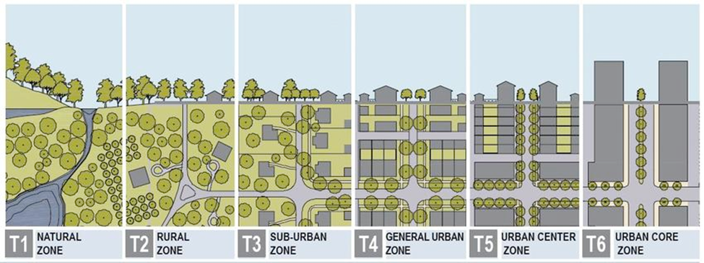
Rural to Urban Transect

Slide 5
Learning Objectives
Participants will be able to…
Define transportation planning.
Explain the connection between transportation and land use.
Articulate the importance of each mode of transportation and how they work together for an effective system.
Describe the relationship between Summit County and various transportation stakeholders.
Know how to participate in shaping the future of transportation in Summit County.

Slide 6


Slide 7
Final Project Work
What is the purpose of the final project?
What planning related improvements would you like to see made in your community? The purpose of the final project is to learn more about a planning related topic and influence future planning in your community.
Identify an area of interest or concern
Explore how to gather information about that subject
Discover where decisions about that subject are made, who is responsible for that area, and how they make those decisions
Develop effective methods to communicate your idea to those decision-makers
Facilitate a connection between yourself and that agency/decision-maker

Slide 8
Final Project Work
Example Presentation Outline for Project
Lead In
State the Issue – problem or opportunity
Show a photo or short video
Context
Where does it come from?
Are there known causes or contributors?
Does it have a long history?
Value
Why does it matter? What’s at stake?
Are people suffering because of it, or not getting something of value?
Who are these people? Tell a story about one.
Solutions
What can be done about it?
Are there alternative ways to address it?
Which is best? Why?
Show photos of examples of the best approach.
Connection
Explain how doing that will solve the problem or take advantage of the opportunity
Tie the solution to the story

Slide 9
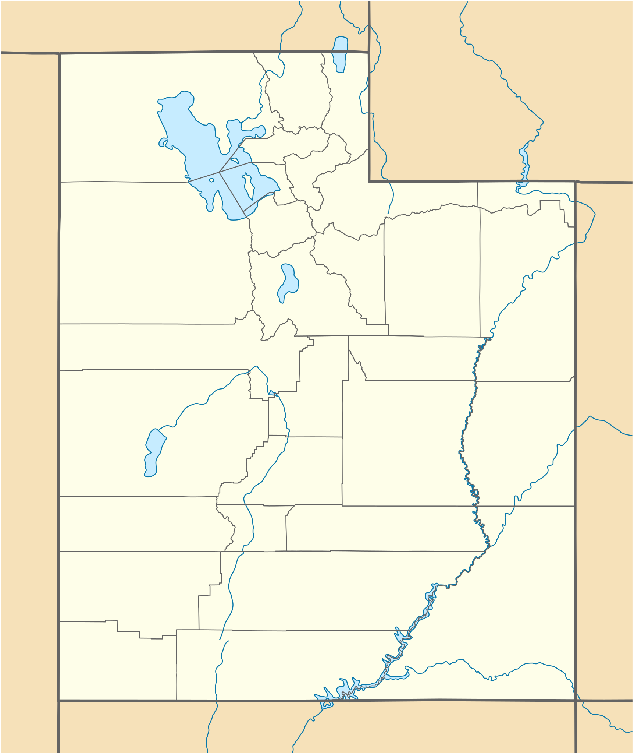
Context
TITLE or QUESTION
(Lead in)
Solutions
Value
Connection

Slide 10
Wrap Up
How can transportation planning address problems or maximize opportunities?
How can you, as a community member, get involved in transportation planning?
Describe three of the qualities of great streets.
REMINDER OF LEARNING OBJECTIVES: Participants will be able to…
Define transportation planning.
Explain the connection between transportation and land use.
Articulate the importance of each mode of transportation and how they work together for an effective system.
Describe the relationship between Summit County and various transportation stakeholders.
Know how to participate in shaping the future of transportation in Summit County.

Slide 11
For Next Class
REVIEW:
Summit County Sustainable Tourism Plan
Rail Trail Corridor Plan
GNAR Report Highlights
Rural Gentrification and the Spillover Effect
Final Project:
Complete your Final Project Outline by April 29

