Slide 1

Summit County Community Planning Lab
Urban Design
April 8, 2024

Slide 2
Agenda
Overview from last session & questions
Rapid Fire Review
Guest Speaker: Peter Barnes, Planning Director
Break
Place Check review
Final project Work
Wrap Up
For next class

Slide 3
Review
There are several barriers to creating affordable housing. Describe two.
What are some strategies for increasing affordable housing?
How might these shapes relate to housing in Summit County?
Based on what you read and what you may have learned previously, what is urban design?
Why might urban design principles be useful in Summit County, even in areas that are not stereotypically urban?
In your own words, describe tactical urbanism.

Slide 4


RAPID FIRE
How many General Plans does Summit County have?
What is zoning? (FOUR WORDS )
What is always the answer?
A conditional use permit is an example of what type of process?
When is the best time to get involved in a project?
Housing on which the occupant is paying no more than 30% of their monthly income (including utilities) is known as …
Instead of AMI, Park City uses WFW which stands for…

Slide 5
Learning Objectives
Participants will be able to…
Define urban design and understand the various ways it is used
Understand how built environments impact our lives
Describe design elements that contribute to community cohesion
Identify areas within Summit County that may benefit from Urban Design thinking

Slide 6


Slide 7
Place Check
Review:
Based on what you learned this evening, are there any answers on your Place Check you want to revise?
Discussion Questions
Where did you visit for your Place Check?
What did you notice about this place?
From what you observed, what design elements might be the most appropriate for Summit County as a whole and your community specifically?

Slide 8
Project Work
We’ll spend some time chatting with those who submitted similar or related ideas. You do not need to work as a group, but it would be beneficial to consider collaboration when possible.
Code Amendments or General Plan / Open Space
Jan
Rachael
Angie
Housing Affordability and Community Building
Theodore
Toria
Research and Analysis / Transportation
Tracy
James
Need Ideas?
See next

Slide 9
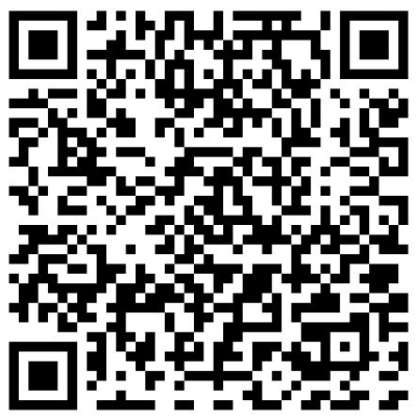
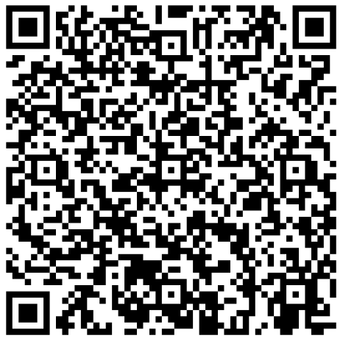
Need an Idea
I need an idea!
You Care About Subdivision Regulations, You Just Don’t Know It (Yet)

Slide 10
Final Project
Discussion Questions:
What is your initial project idea or area of interest?
What do you already know and what do you need to know?
Have you watched any of the example videos? If not, you should! (HINT: Look at the Final Project document)
What story can be told to interest others in this topic?
If you were to boil your project idea down into one sentence or question, what would it be?
Explore opportunities for collaboration!

Slide 11
Final Project Outline
Example Presentation Outline for Projects:
Lead In
State the Issue – problem or opportunity
Show a photo or short video
Context
Where does it come from?
Are there known causes or contributors?
Does it have a long history?
Value
Why does it matter? What’s at stake?
Are people suffering because of it, or not getting something of value?
Who are these people? Tell a story about one.
Solutions
What can be done about it?
Are there alternative ways to address it?
Which is best? Why?
Show photos of examples of the best approach.
Connection
Explain how doing that will solve the problem or take advantage of the opportunity
Tie the solution to the story

Slide 12

Wrap Up
OPTION 1: Consider the Qualities of Character and Legibility:
Draw a flag for your ideal community
OR
Write a slogan for your ideal community
OPTION 2: Jot down 3 Qualities or Aspects of Built Form you will notice the next time you take a walk. Wy do these 3 stand out to you?

Slide 13
For Next Class
REVIEW:
Utah's Unified Transportation Plan
Summit County's Long Range Transportation Plan
Utah's Transportation Vision
Optional, but highly recommended:
A Citizen's Guide to Better Streets
A Resident's Guide for Creating Safer Communities for Walking and Biking

