Slide 1

Summit County Community Planning Lab
How to Make an Impact: Public Hearings and Meaningful Engagement
March 18, 2024

Slide 2
Agenda
Overview from last session & questions
Session Learning Objectives
Guest Speakers: Bridget Conway, Deputy Director Communication and Public Engagement; Jennifer Leslie, County Planner
~ Break ~
Case Study
Wrap up
Final Project
Next course session

Slide 3
Review Questions
Discuss any lingering questions you have from previous sessions or the readings.
REVIEW: What is the difference between a zoning map and a future land use map?
Describe the following processes: administrative, legislative, and quasi-judicial.
What should be included in public comment for an administrative review?
What is the “Utah Public Clamor Doctrine?”
How can you, as a community member, prepare for a public hearing?
Do you have feedback on the SC Public Hearing Handbook??? I WOULD LOVE TO HEAR IT.

Slide 4

RAPID FIRE
How many planning districts does Summit County have?
How many General Plans?
How many development codes?
Are the development codes the same?
What is zoning? (FOUR WORDS)
What is always the answer?

Slide 5
Learning Objectives
Participants will be able to…
Participate and meaningfully engage in public hearings, public meetings, and other engagement opportunities
Understand the policies of public noticing in Summit County and Utah
Articulate what happens at different public meetings (ex. Planning commission vs City/County Council)
Identify the distinctions between administrative, legislative, and quasi-judicial processes
Identify the legal structures behind decision making

Slide 6
There are mandatory rules for Procedures for meetings of public bodies by the State of Utah… OPMA
Open & Public Meetings Act Title 52, Chapter 4
Notes:
All meetings are open to the public, unless specific criteria
Government needs to conduct business openly & share thoughts openly

Slide 7



OPMA Big Picture
The premise of the Open Public Meetings Act is:
All meetings are open to the public, with limited and specific exceptions.
Governments exists to aid in the conduct of the people’s business, and they should take their actions openly and conduct their deliberations openly.
Notes:
delete

Slide 8
OPMA U.C.A. 52-4
The Utah Open & Public Meetings Act Prescribes
What bodies are subject to the act;
What meetings must be open to the public;
When meetings of public officials can be closed;
Meeting notice requirements;
Agenda requirements;
Minutes and recording requirements; and
Penalties for violations
Notes:
Quick. Jenn - make notes sheet

Slide 9
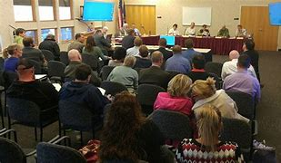
Public Meeting
Posted and Noticed
Open to the public
Agenda with items listed
Public input not required

Slide 10
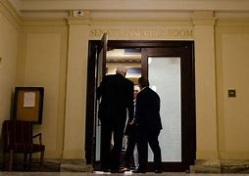
Closed Meeting
Councils cannot simply hold a “Closed Meeting”, they must “close” an open meeting, and only for one of the specific reasons enumerated in statute. The pertinent land use reasons are:
Discuss the character, professional competence, or physical/mental health of an individual.
Discuss pending or reasonably imminent litigation.
Discuss the purchase, exchange, lease or sale of real property.
A SITE VISIT IS NOT A REASON FOR A CLOSED MEETING!

Slide 11
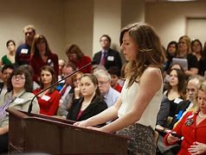
Public Hearing
Posted and Noticed
Happens within a public meeting on a specific agenda item
Input required – anyone can comment
Can limit time of input – must be uniform (due process)
Can accept written comments
Can continue to another night

Slide 12

Other State Law Requirements
Utah Government Records Access Management Act: grants citizens access to public documents
Utah Public Officials Ethics & Disclosure Laws: conflict of interest etc.

Slide 13
Summit County Notice Rules
Public Hearings for County Council, County Manager, and Commissions
“Reasonable notice”
Min. 10 days posted, published, mailed
Subdivisions and site plan approvals require mailed notices to property owners within 1000ft
Agenda items that are not a public hearing
Min. 10 days posted and published
Snyderville Basin 10-9-18
Eastern Summit County 11-6-1

Slide 14
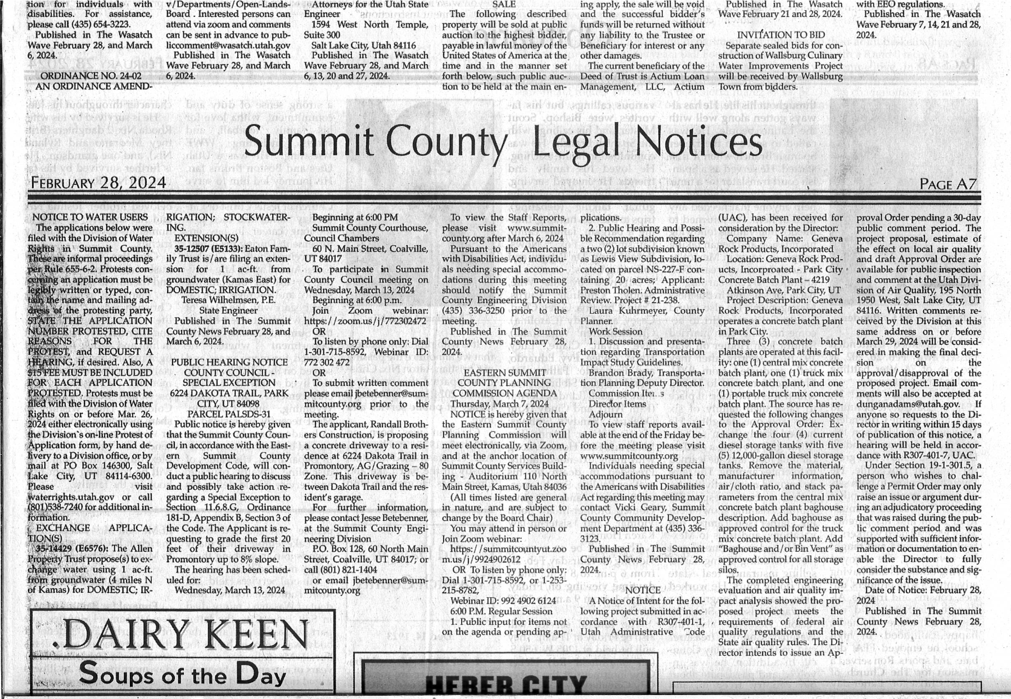

Slide 15
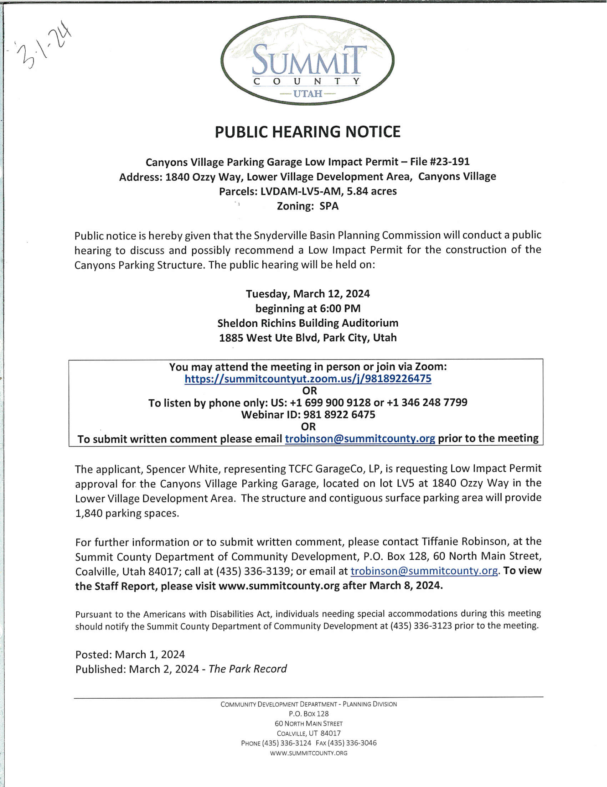
Notes:
Covid changed the law to allow zoom & video
Need anchor location

Slide 16
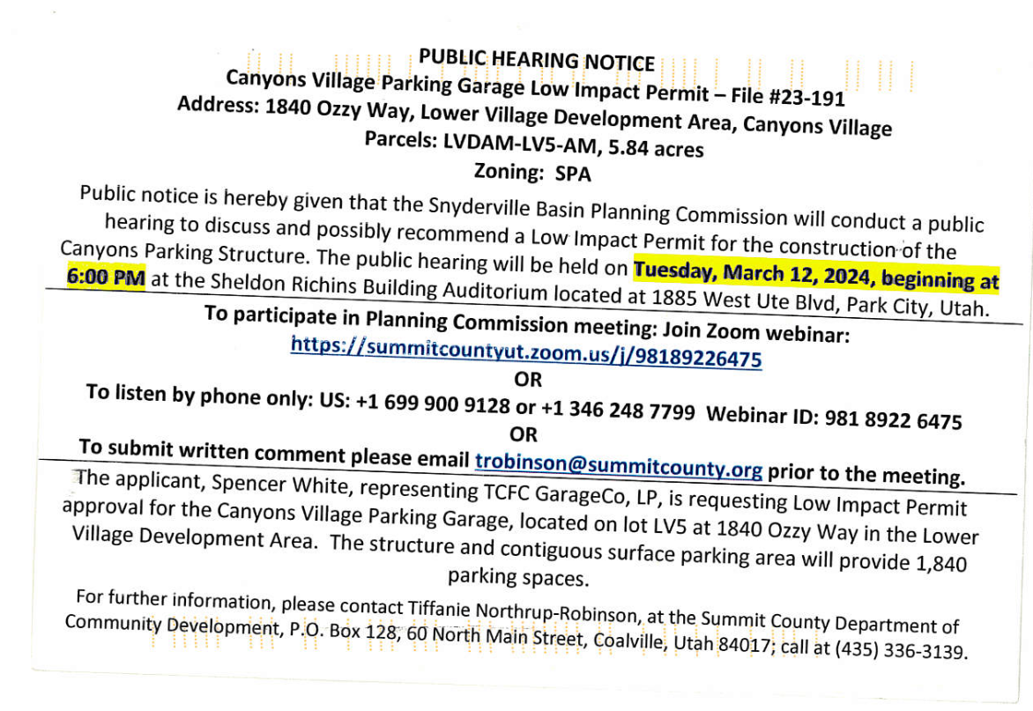

Slide 17
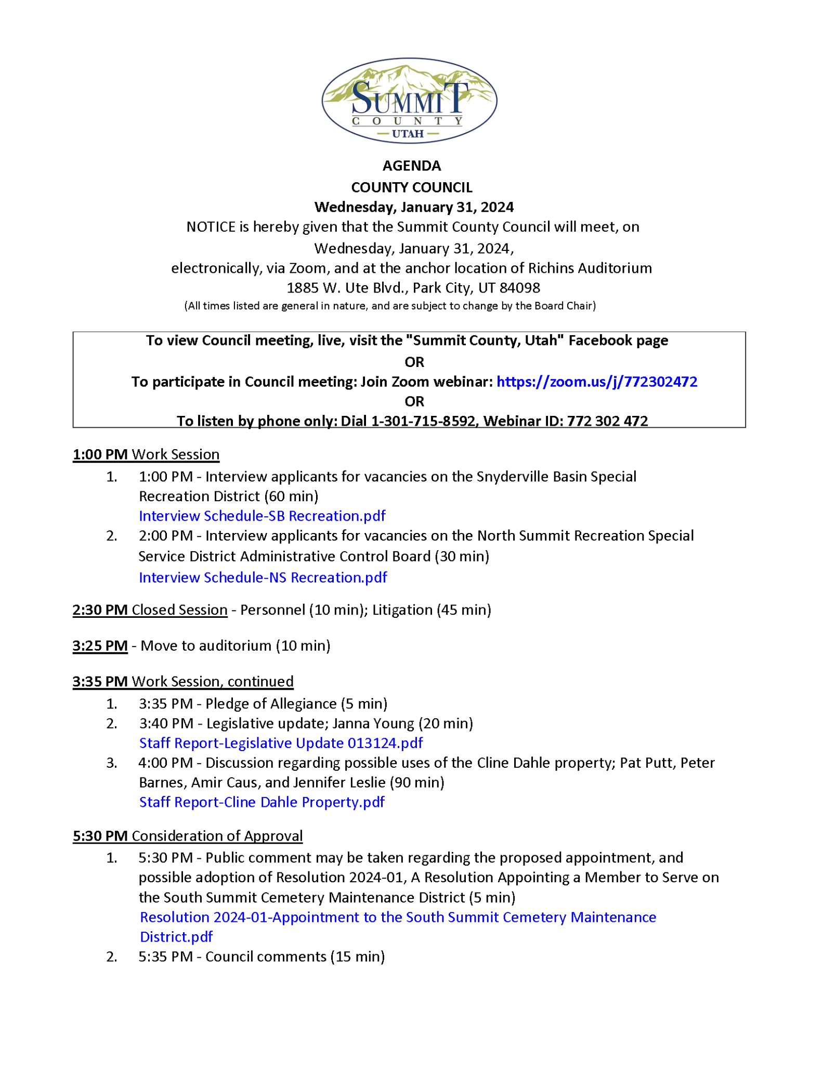
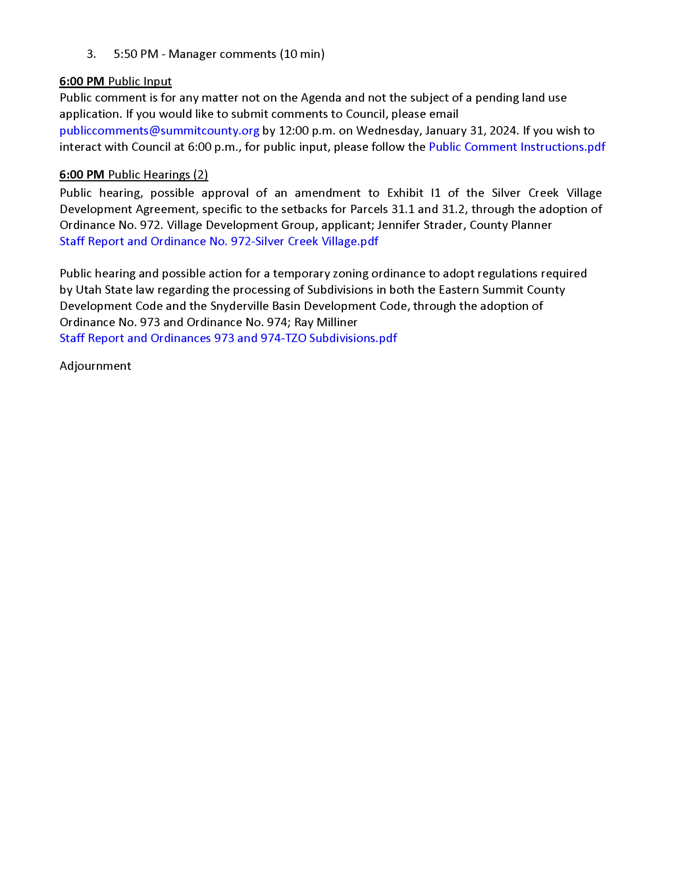
Notes:
PRINT OUT THE AGENDA, discuss with class. Change to a Council agenda w/ and w/o public hearings
Bridgette will pull up the website to find, sign up for emailed agendas
Explain exhibits. Describe what you would find in the exhibits. When staff reports come up on the website.

Slide 18
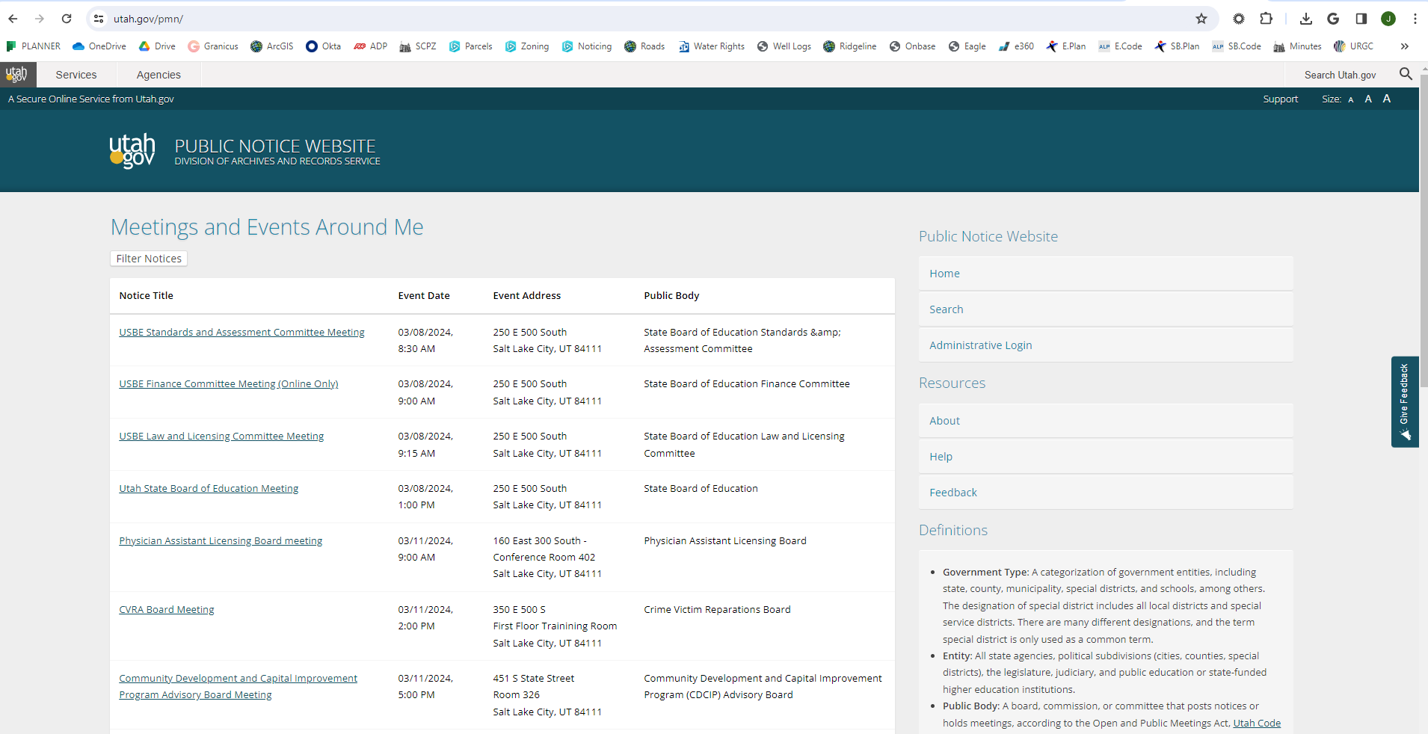
Utah Public Notice Website
Notes:
How do you actually sign up for specific agendas?

Slide 19
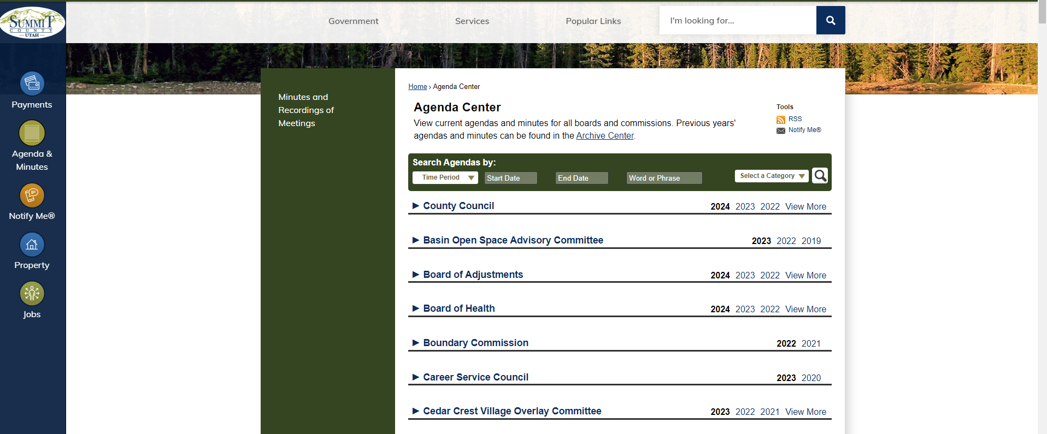
Summit County Agenda Center
Notes:
You can sign up for specific agendas to be emailed to you

Slide 20
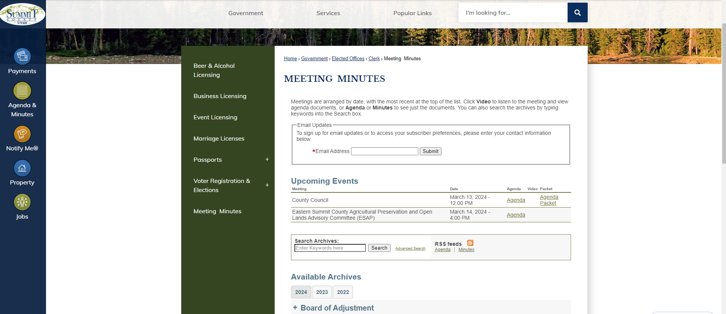
Summit County Meeting Minutes
Notes:
How do you actually sign up for specific agendas? - Maybe Bridget can briefly explain how this is the new landing page

Slide 21
Informal noticing
Connect with Summit County!
Questions? We’re always here to help!
Derek Siddoway | dsiddoway@summitcounty.org
Bridget Conway| bconway@summitcounty.org
SUMMITCOUNTYALERTS.ORG
Receive critical alerts & information for a variety of emergency situations via home, mobile or business phones, email, or text.
SPANISH ALERTS
Manténgase informado. Inscribirte para el Sistema de Alerta de Emergencia del Condado de Summit. Enviar SUMMITALERTA al 888777 para actualizaciones en español.
WILDFIRE INFO
Text SCFIREINFO to 888777 for texts about fire conditions (red flag warnings), prescribed burns, and active fire updates.
COUNTY WEBSITE
The “News” section on the homepage of the County website always has the four most important news stories in the county listed. You can also always visit summitcounty.org/engage for all upcoming public engagement opportunities.
SUMMIT IN SIX
Get weekly county news on the Summit in Six podcast at summit6.org and on Apple + Spotify. Special episodes = more in-depth*
COUNTY E-NEWSLETTER
Subscribe for monthly news updates + upcoming engagement opportunities at summitcounty.info/countynews.
SOCIAL MEDIA
Stay in touch with all county news on social media @summitcountyut on Facebook, Twitter and Instagram. The county also has a NextDoor account you can subscribe to (nextdoor.com/pages/summit-county?init_source=copy_link_share).

Slide 22
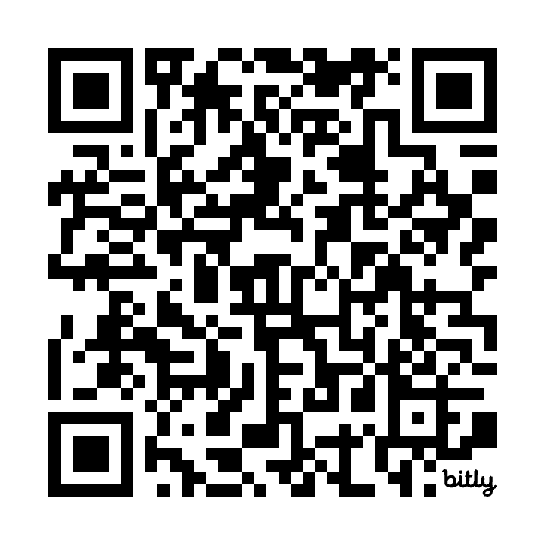
Planning Project Pipeline: easy access, early.
Identified Problem: information gap; perceived lack of transparency; community getting “engaged” too late in the process.
Proposed Solution(s):
Online Dashboard
Can include a list of active development applications in the County with key details associated with them (location, type, key notes from application, etc.)
Can include ESCPC and SBPC calendars/agenda center links
Can include general education tools (e.g. how development process works, types of projects, how to give helpful comment, etc.)
Monthly YouTube Show
Currently being developed by students in the PCCAPS program.
Idea is to be a version of the dashboard, but more alive + engaging.
Class Feedback: summitcounty.info/projpipeline
(only three questions!)
Notes:
Easy access to information, early in the process.

Slide 23
How can you make effective public comment?
Depends on the type of decision
Legislative | Administrative | Quasi-Judicial
Notes:
Relates to what can be considered during the decision making process.
Make class fill in the worksheet chart as we go

Slide 24
Legislative Decisions
Types of Actions
New ordinance
Amendments to an existing ordinance
Adoption of a general plan
Amendment to a general plan
Amendment to the zoning map
Creation of an official policy, rule, or code of general community-wide application
Decision-Making Body
Elected officials - County Council (gets recommendation from Planning Commission)
Broad Summary
Establish policies for future application
Notes:
Legislative actions can be broad- only requirements is that they can’t break federal/state laws and must be shown to advance the general purpose of the state Land Use, Development and Management Act

Slide 25
Legislative Decisions
Can’t break federal/state laws
Decision should advance purpose of state Land Use, Development, and Management Act
Types of Actions
New ordinance
Amendments to an existing ordinance
Adoption of a general plan
Amendment to a general plan
Amendment to the zoning map
Creation of an official policy, rule, or code of general community-wide application
Decision-Making Body
Elected officials - County Council (gets recommendation from Planning Commission)
Broad Summary
Establish policies for future application
Notes:
Legislative actions can be broad- only requirements is that they can’t break federal/state laws and must be shown to advance the general purpose of the state Land Use, Development and Management Act

Slide 26
Administrative Decisions
Types of Actions
Conditional Use Permits
Low Impact Permits
Temporary Use Permits
Sign Permits
Subdivisions
Building Permits
Decision-Making Body
County commissions, County staff, County boards
Broad Summary
Application of specific policies in a specific area

Slide 27
Administrative Decisions
Must be supported by substantial evidence
Record of decision
Types of Actions
Conditional Use Permits
Low Impact Permits
Temporary Use Permits
Sign Permits
Subdivisions
Building Permits
Decision-Making Body
County commissions, County staff, County boards
Broad Summary
Application of specific policies in a specific area

Slide 28
LEGISLATIVE AND ADMINISTRATIVE DECISIONS NEED TO BE CONSISTENTLY APPLIED IN YOUR ENTIRE ORDINANCE
State Law actually says that Administrative land use applications, “shall be approved”.
This means that conditional uses, site plans, and subdivision plats are not discretionary. You have to process them with what you have in your ordinances.

Slide 29
Legislative vs. Administrative
Action Type | Legislative | Administrative
Making Laws | X
Generally applicable | X
Weighing of broad or open-ended policy considerations | X
Public Hearing | X | X
Evidence (facts relevant to the decision) |  | X
Unbiased decision maker |  | X
Written determination |  | X
Opinions (clamor) | X
Referable to voters | X
Notes:
Have class guess decision making body & types of projects

Slide 30
Legislative vs. Administrative
Action Type | Legislative | Administrative
Making Laws | X
Generally applicable | X
Weighing of broad or open-ended policy considerations | X
Public Hearing | X | X
Evidence (facts relevant to the decision) |  | X
Unbiased decision maker |  | X
Written determination |  | X
Opinions (clamor) | X
Referable to voters | X
Public Comment for Administrative decisions should be evidence-based and related to Code criteria
Notes:
Have class guess decision making body & types of projects

Slide 31
Legislative vs. Administrative
Public Comment for Legislative decisions can include clamor, but strong comments are framed in terms of existing plans and future land use maps.
Action Type | Legislative | Administrative
Making Laws | X
Generally applicable | X
Weighing of broad or open-ended policy considerations | X
Public Hearing | X | X
Evidence (facts relevant to the decision) |  | X
Unbiased decision maker |  | X
Written determination |  | X
Opinions (clamor) | X
Referable to voters | X
Notes:
Have class guess decision making body & types of projects

Slide 32
Quasi-Judicial Decisions
Types of Actions
Zoning Variances
Appeals
Decision-Making Body
Board of Adjustment, County Council
Notes:
District court considers quasi-judicial decisions as administrative; however, we consider our BOA to be Quasi-Judicial

Slide 33
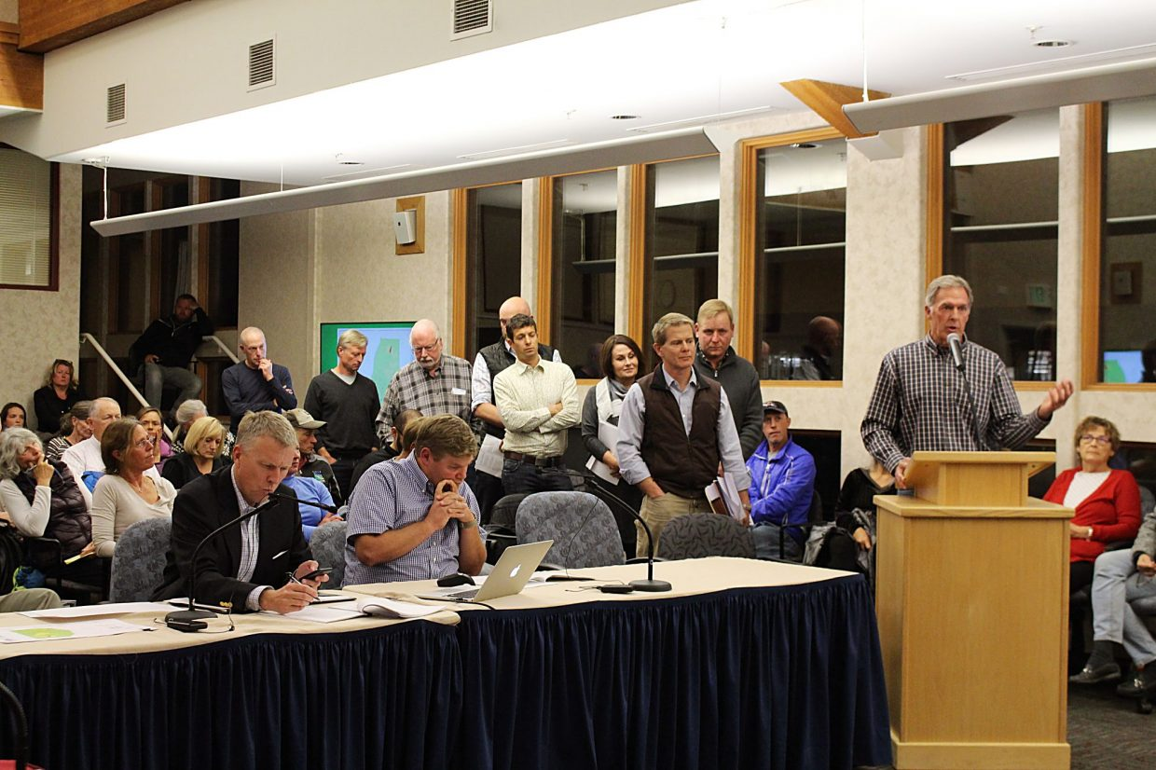
Tips for Public Comment
State name, where you live
Be polite
Be concise
Clearly state what you hope the decision body does (approve, deny, include a condition of approval, etc.)
Provide evidence
Cite specific, measurable impacts
Avoid hearsay
Provide comment early in the process
Notes:
For written comment or for comment during public hearing. Can also call and talk with planner assigned to project.

Slide 34
MOST >>>>>>>>>>>>>>>>>>>>NOT MUCH >>>>>>>>>>>>>>>>>>>>> LEAST
Legislative Administrative Quasi-Judicial
ADOPTING ORDINANCES/ GENERAL PLAN/
REZONES/ANNEXATION/ DEVELOPMENT AGREEMENTS
CONDITIONAL USES/SITE PLANS
SUBDIVISIONS
BUILDING PERMITS
VARIANCES
/APPEALS

Slide 35
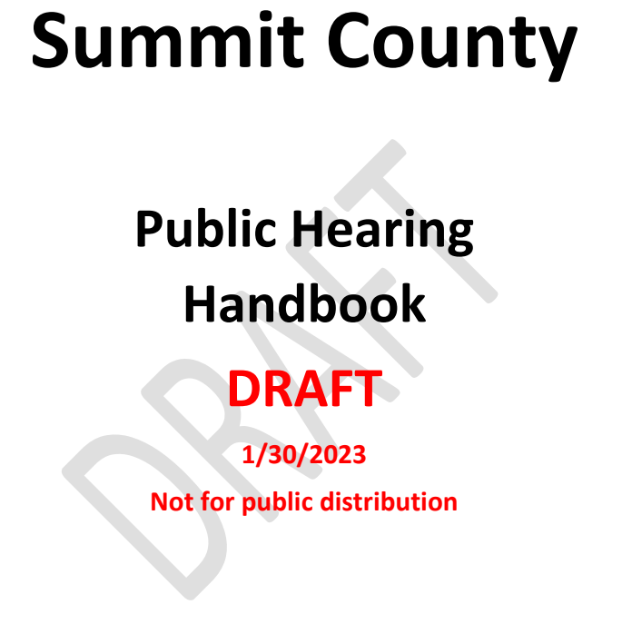
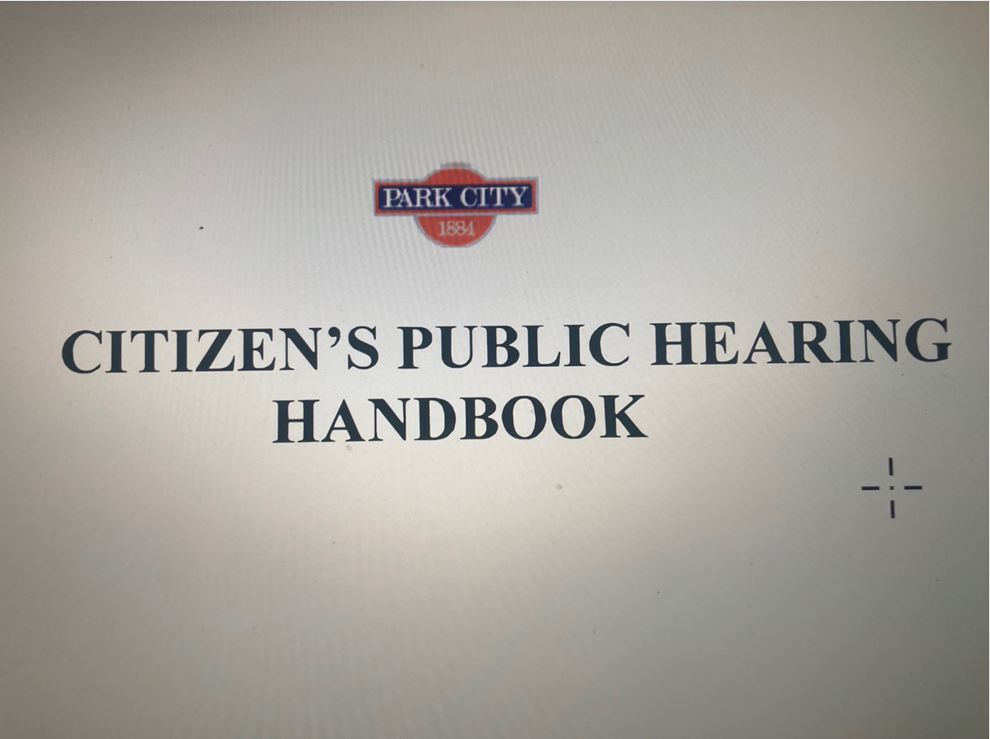
Other resources:
Notes:
After this, time check. Either: take break and return to activity OR walk though how to read a staff report/the code.

Slide 36
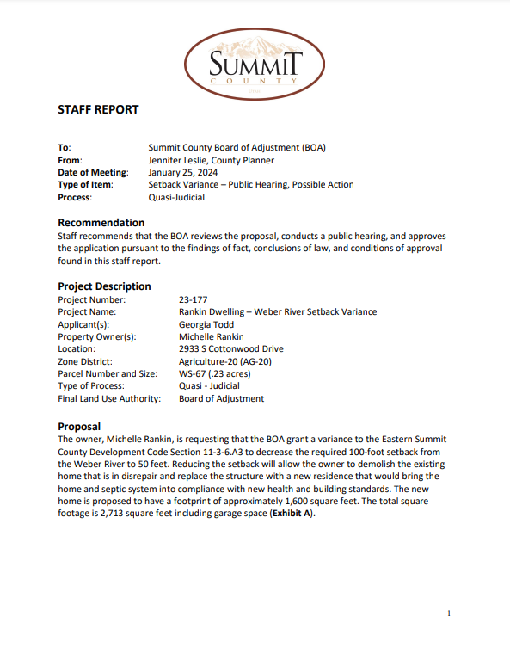
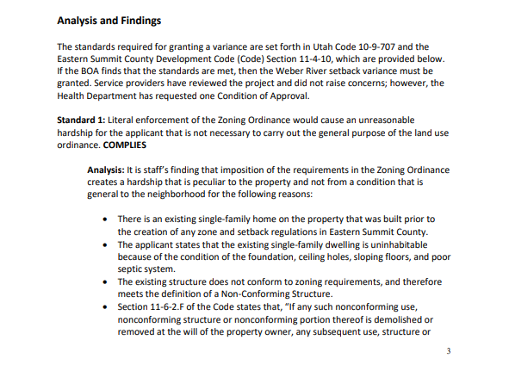
Notes:
Activity/walk through about how to look through staff reports
Staff reports outline how the project meets or doesn’t meet the code

Slide 37
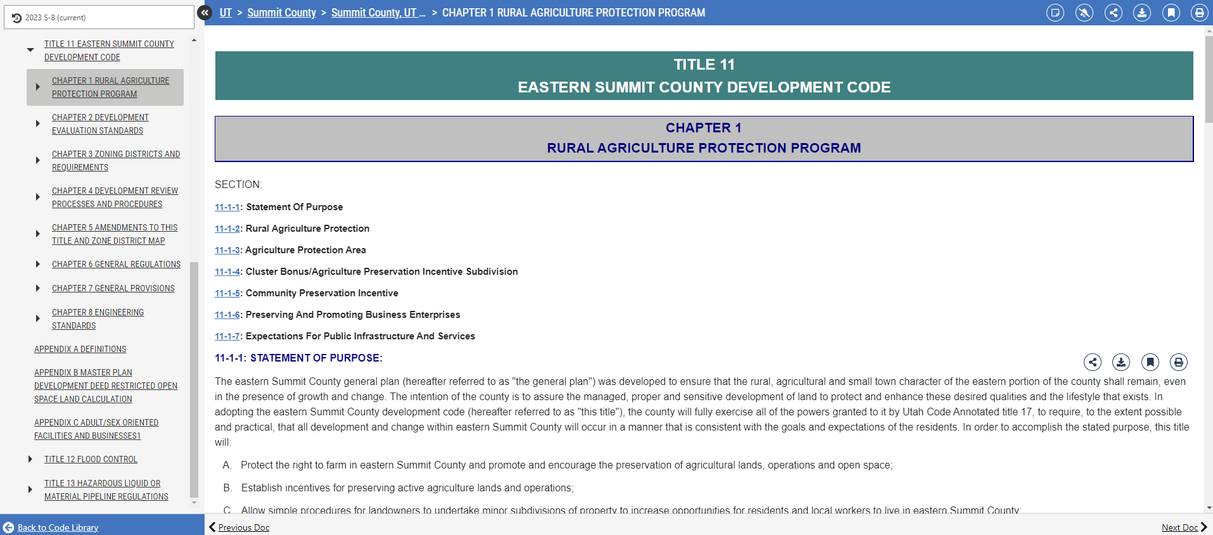
Eastern Summit County Code
Snyderville Basin Code
Notes:
Development code is where you find the criteria used in the analysis of staff reports

Slide 38
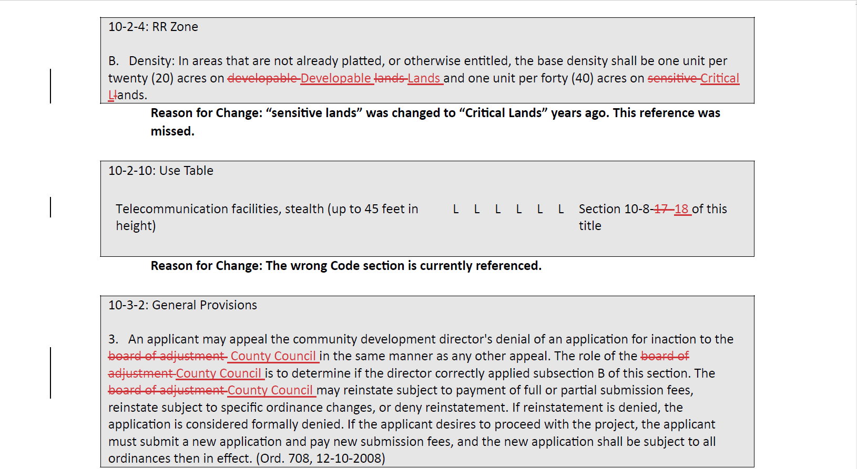

Slide 39
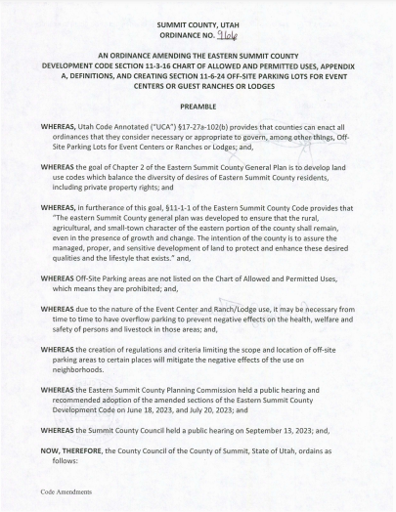
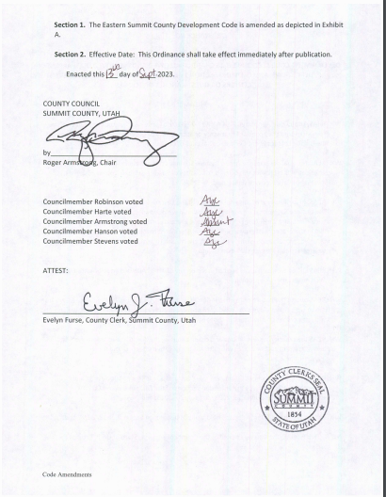
Notes:
Code amendments (legislative item) get adopted by ordinance

Slide 40
What you learned today:
What rules govern public bodies?
What is a public meeting?
What is a public hearing?
Agenda’s and how to use it
Administrative and Legislative items and how to treat them in public comment

Slide 41

Notes:
Activity/handout: Little checklist for how to provide public comment. Reference Section 6 of draft public hearing handbook

Slide 42
Case Studies
Read the first case study. Take notes on what decisions were made and how.
Discuss the questions at the end.
Move on to the second case study.
Notes:
If we need to adjust these after new slides are added/new time.

Slide 43
Case Study
What did you learn about legislative and administrative decisions?
When should you get involved in the process?
Back to litigated decisions… how do we avoid this?
Processes that are:
Clear
Consistent
Predictable

Slide 44

Wrap Up
Why is “access the answer” in the case of public involvement?

Slide 45
Final Project
What planning related improvements would you like to see made in your community? The purpose of the final project is to learn more about a planning related topic and influence future planning in your community.
Identify an area of interest or concern
Explore how to gather information about that subject
Discover where decisions about that subject are made, who is responsible for that area, and how they make those decisions
Develop effective methods to communicate your idea to those decision-maker
Facilitate a connection between you and that agency/decision-maker
Final Project idea emailed to me by October 16 at 9:00am

Slide 46
For Next Class
READ:
Housing Affordability: What are best practices and why are they important?
Blog: Reflections on Affordability in Utah’s Housing Market
REVIEW:
Summit County Moderate Income Housing Slides
Summit County AMI Income Limits
PLAN AHEAD: Due April 8
PlaceCheck requires you to visit at least one location. On the website, click Week 4 and then “PlaceCheck” to see the instructions”
Final Project idea emailed to me by 9:00am

Slide 47
Feedback
Feedback is vital!
Please complete this short survey by Thursday, March 21 at 8:00pm
Via the link: https://forms.gle/cGrpPdUznBBBwydWA

