Slide 1

Summit County Community Planning Lab
Planning and Zoning: History and Interaction, Types of Plans and Zoning Ordinances
May 11, 2024

Slide 2
Agenda
Overview from last session & questions
Session Learning Objectives
Guest Speaker: Laura Hansen: State Planning Coordinator: UT Governor’s Office of Planning & Budget
~ Break ~
Great Communities Activity
Lingering Questions
Discussion of final project
Next course session
Wrap up

Slide 3
Review Questions
Discuss any questions you may have about the syllabus, the first session, or the readings for this session.
Using the readings, explain the importance and purpose of comprehensive plans (aka general plans).
Thinking back to Pat’s description of Summit County, what are some potential issues with our comprehensive (general) plans?
Based on what you read, what is the purpose of gathering public/community feedback?
Discuss the meaning of the following: “Planning is not this document. Planning is dynamic. Planning is a verb.”
Notes:
How do you feel about terms like NIMBY or BANANA?

Slide 4
Learning Objectives
Participants will be able to…
Articulate the basic impacts of land use and zoning decisions
Identify the difference between planning and zoning
Identify various types of plans and state what plans have been implemented locally, regionally, etc.
Recognize types of decision making processes

Slide 5
Community Planning
Lab
Laura Hanson, AICP

Slide 6
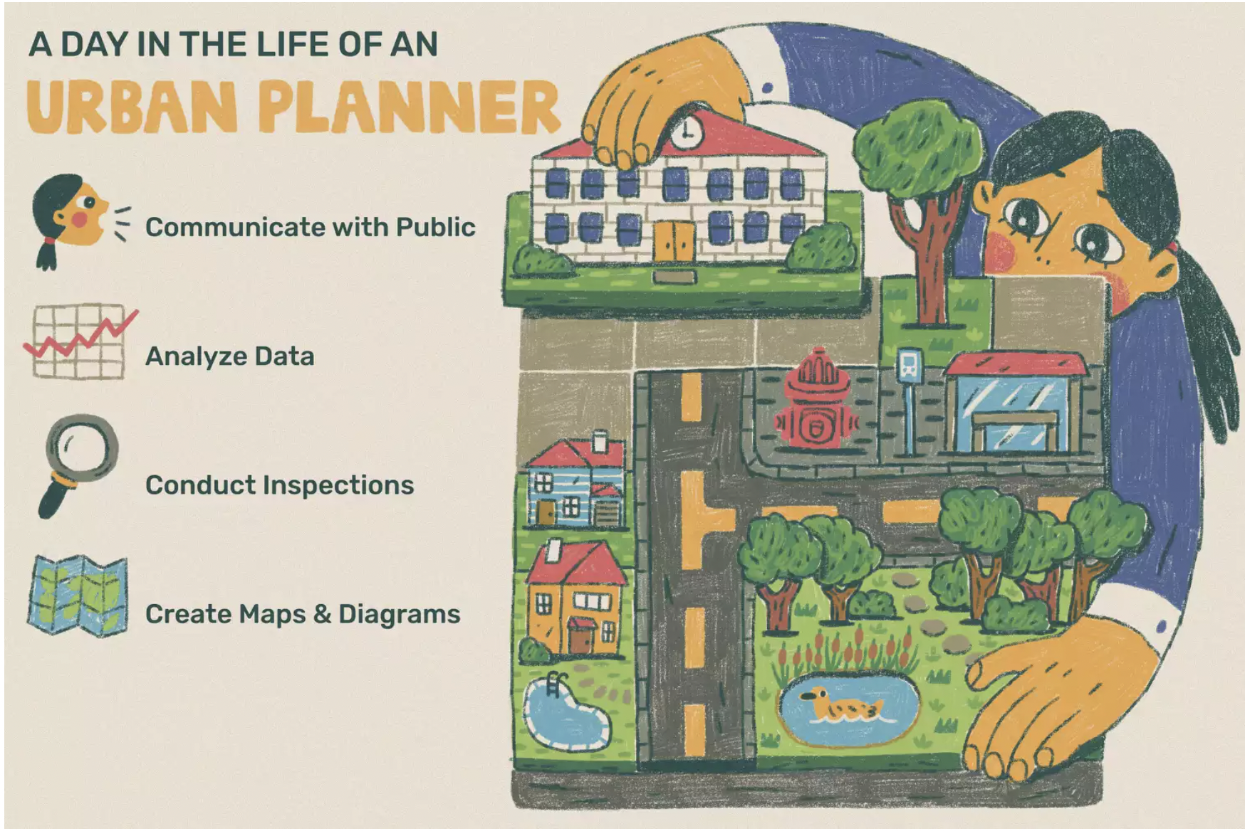
Introduction to Planning
The goal of planning is to guide the development of a city or town so that it furthers the welfare of its current and future residents by creating convenient, equitable, healthful, efficient, and attractive environments.
APA Planning History Timeline

Slide 7

State Code Governing Planning
Land Use, Development, and Management Act (LUDMA)
Municipalities (MLUDMA )
Counties (CLUDMA )
Delegates authority to local govts
Establishes mandatory requirements
Establishes the legal framework for local zoning decisions, ordinance enactment, and planning

Slide 8

Planning Toolbox
General Plan
Zoning Ordinance
Subdivision Regulations
Developer Agreements
Design Guidelines
Community Reinvestment Areas
More (e.g. HTRZs, SAPs)
Notes:
Also called a comprehensive plan.

Slide 9

The Planning Process
Analysis & Evaluation
What are the existing conditions of our community?
Are our current planning tools delivering the right outcomes?
05
Plan Implementation
Application of the plan goals and strategies through ordinances, regulation, and projects.
01
04
Plan Adoption
Formal approval of the plan as a guiding document for the community.
Visioning and Goal Development
What do we want our community to look like in 30 years?
02
03
Plan Development
What strategies, or strategic investments are going to advance our vision and goals?
Public engagement opportunities exist at all steps in the process

Slide 10
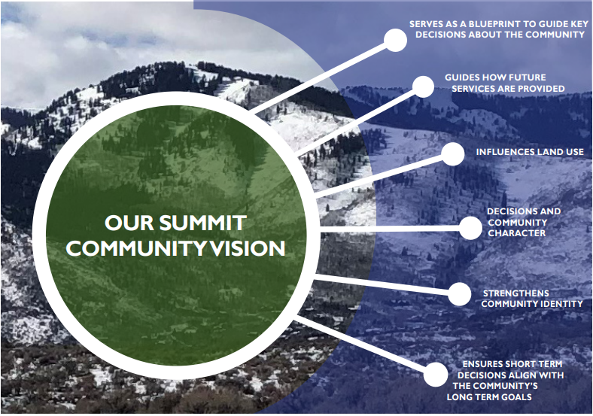
Visioning
Where/how should we grow?
What should the character of the community look like?
Where should jobs or housing be located?
What open spaces should be protected and preserved?
What should our transportation network look like?
https://oursummitcounty.com/
Notes:
Also called a comprehensive plan.

Slide 11
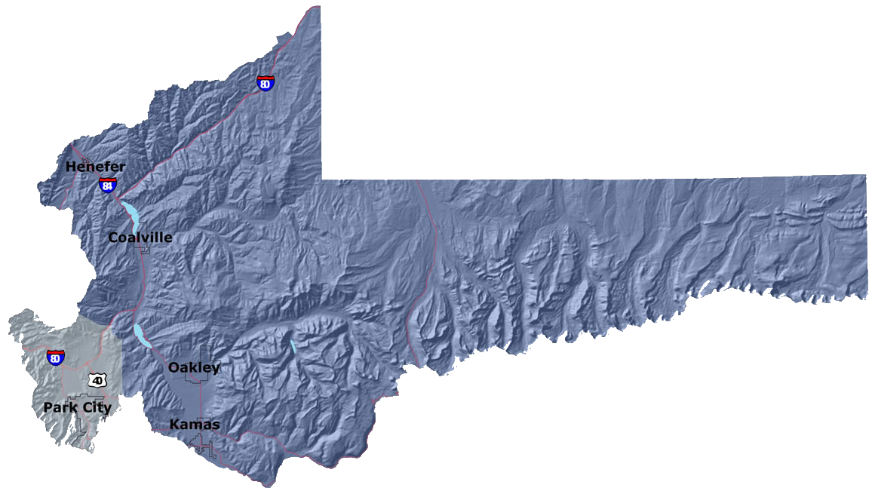
General Plan
Four Required Elements:
Land Use
Transportation
Moderate Income Housing
Water Use and Conservation
Other Common Elements:
Parks, Recreation, Open Space
Economic Development
Natural Resources and Hazards
Snyderville Basin General Plan
Eastern Summit County General Plan
Notes:
Also called a comprehensive plan.

Slide 12
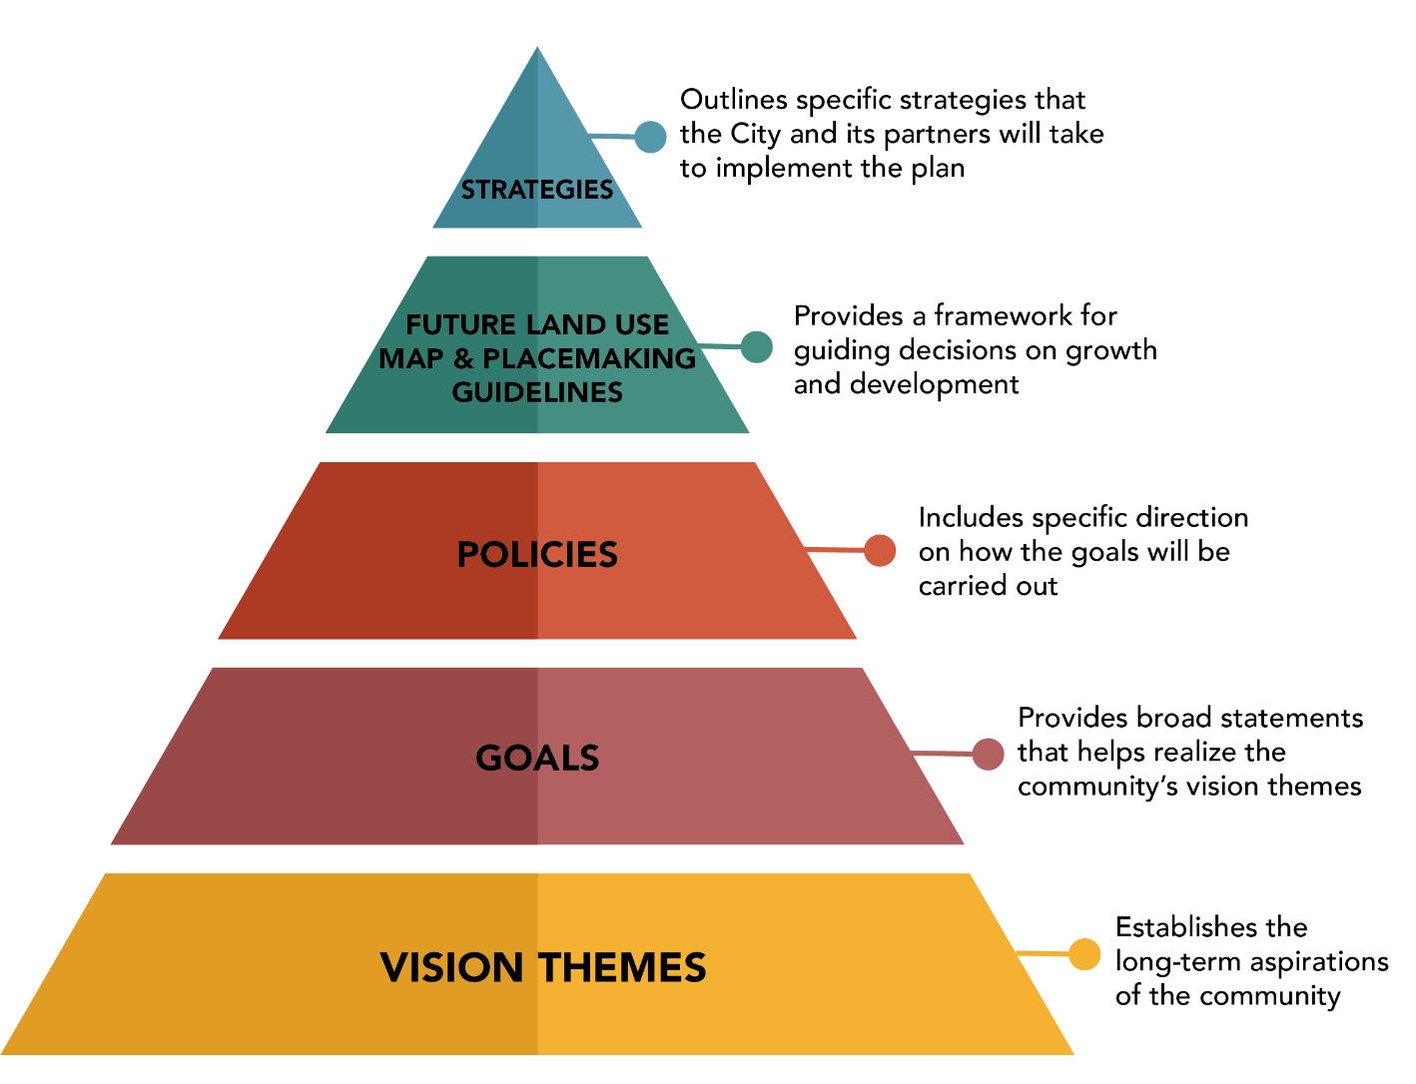
General Plan
30-year horizon
Non-binding
Purpose is to guide future decision making
Provides an opportunity to consider how topics impact or affect another - e.g. transportation and land use
Snyderville Basin General Plan
Eastern Summit County General Plan
Notes:
It is very possible that you will hear a question about "Policy 2.3" which is a statement in the Snyderville Basin General Plan. This phrase has been used as a reason for denying development in the area. The fact that general plans are non-binding might be news to participants.
GOAL: Promote sustainable Land Use Planning Principles that preserve Critical Lands, maintain neighborhood character, protect the economic base, prevent sprawl, and provide efficient delivery of services.
OBJECTIVE A: Encourage the creation of highly-livable neighborhoods and mixed use areas that are connected by open spaces and multi-modal transportation systems.
Policy 2.3: Do not approve any new entitlements beyond those permitted by the Development Code until such time that existing entitlements are significantly exhausted, unless the County legislative body first determines that:
a. a compelling countervailing public interest, specifically identified in the General Plan exists and cannot be reasonably satisfied without expanding one or more entitlement(s);
b. such new entitlement(s) do not simply result in an incidental benefit to the public interest, but rather such entitlement(s) are intended primarily to promote such compelling countervailing public interest; and
c. any new entitlement(s) are consistent with the Neighborhood Planning Area Plans and the Snyderville Basin General Plan’s Future Land Use Maps, as amended.

Slide 13
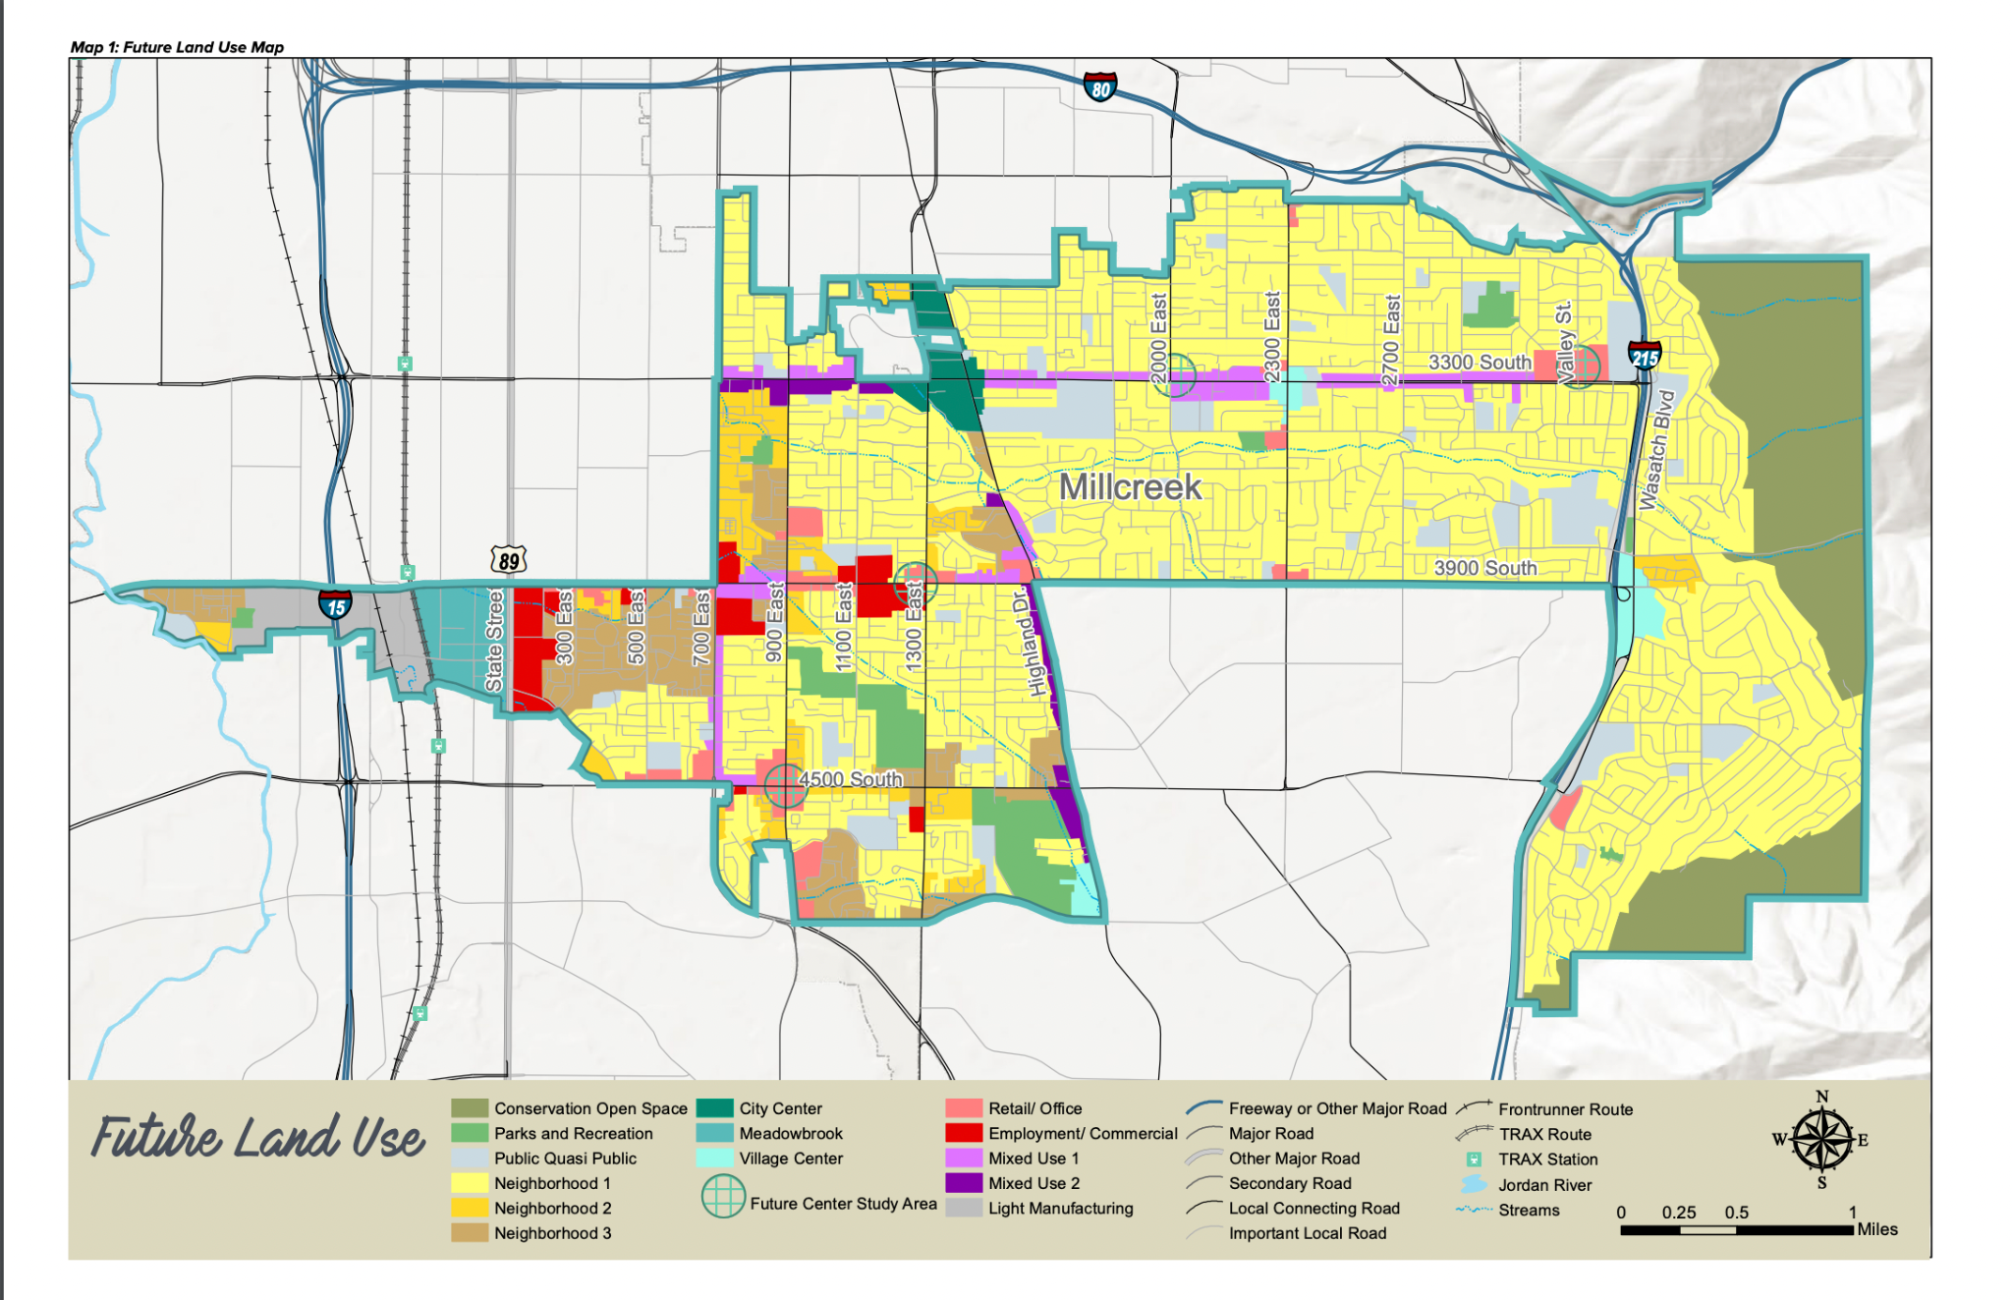
How to Read a Future Land Use Map
Lower Density Residential
Higher Density Residential
Mixed Use
Commercial
Public / Utility
Industrial
Parks / Open Space
Some variations exist

Slide 14
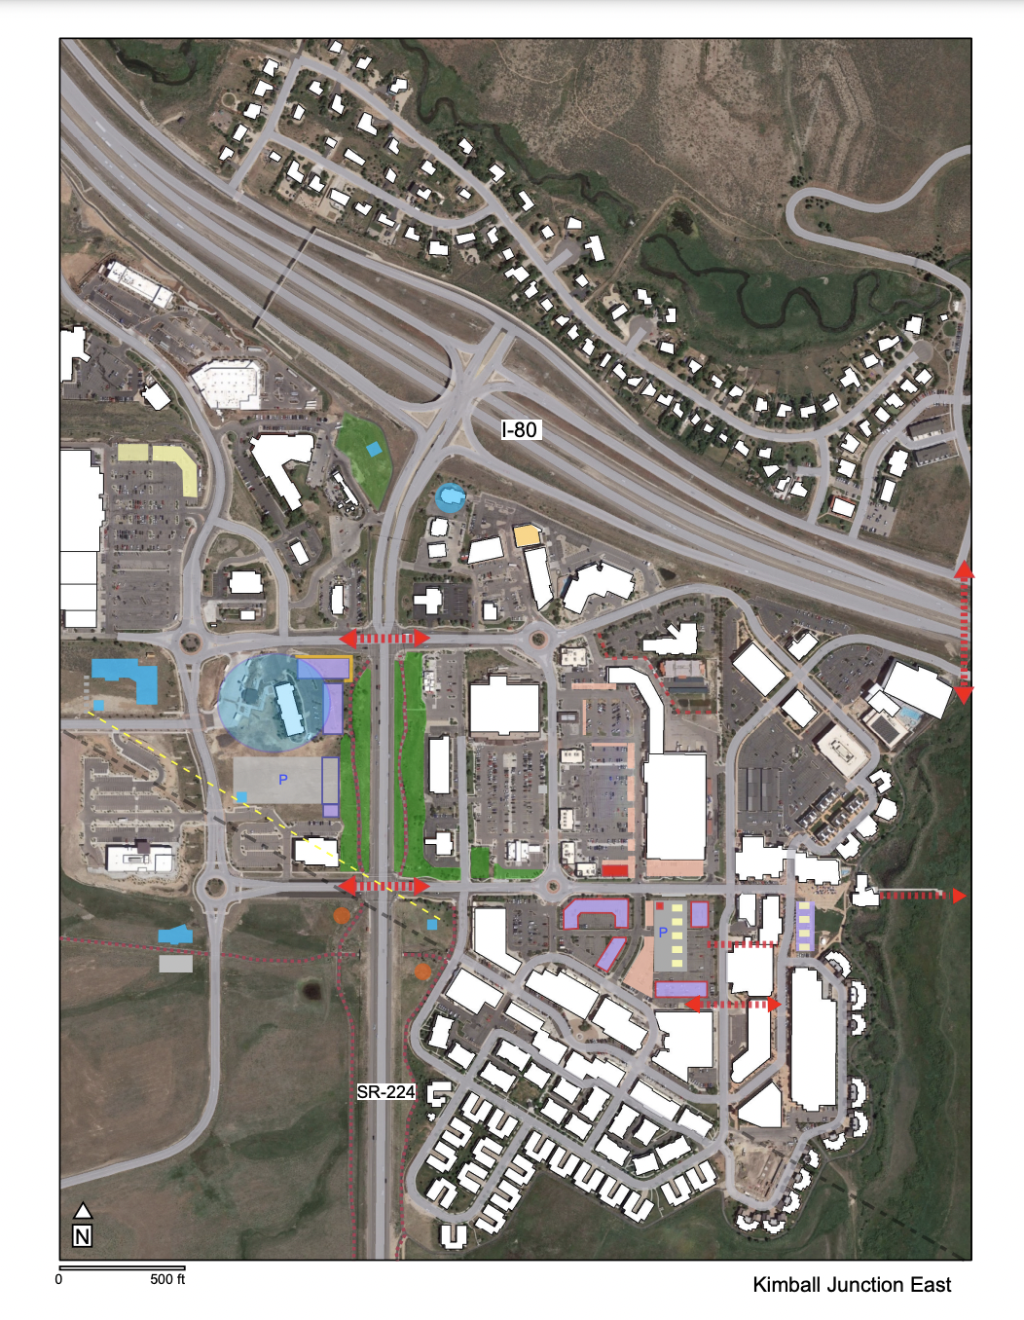
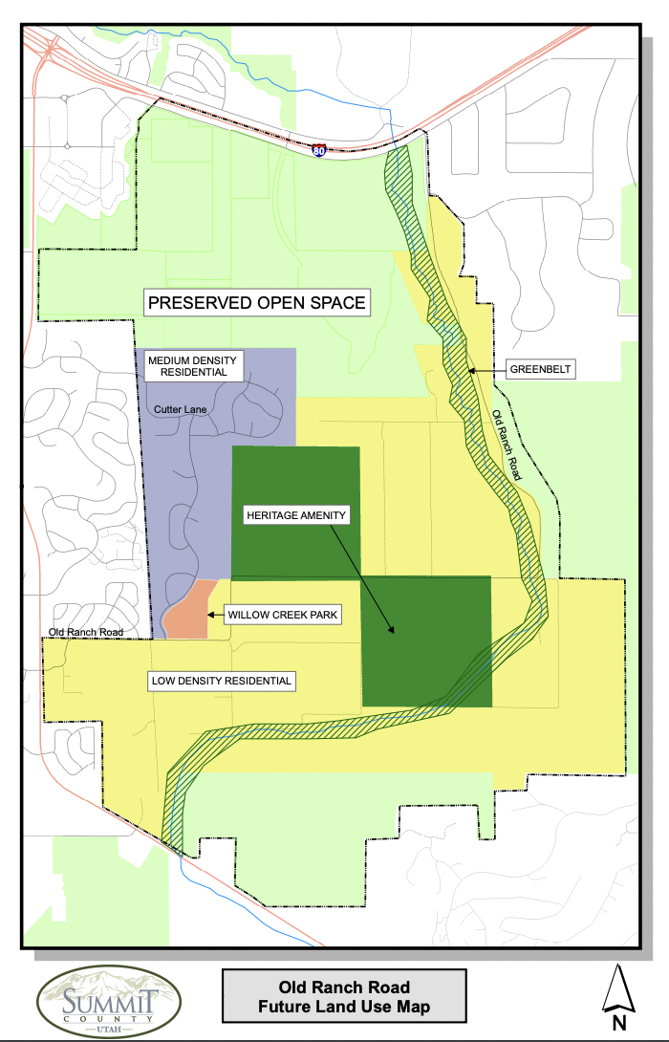
Summit County: Neighborhood Approach

Slide 15
Implementing the Plan
Vision
General Plan
Local Code
Individual Applications
Advisory, identifies an aspirational goal for the future
Advisory, sets a strategic direction, looks out 30 years
Legally binding, applies to all decisions made today
Building permits, subdivisions, master planned communities, redevelopment areas
Notes:
General plan can also be called a Comprehensive Plan

Slide 16
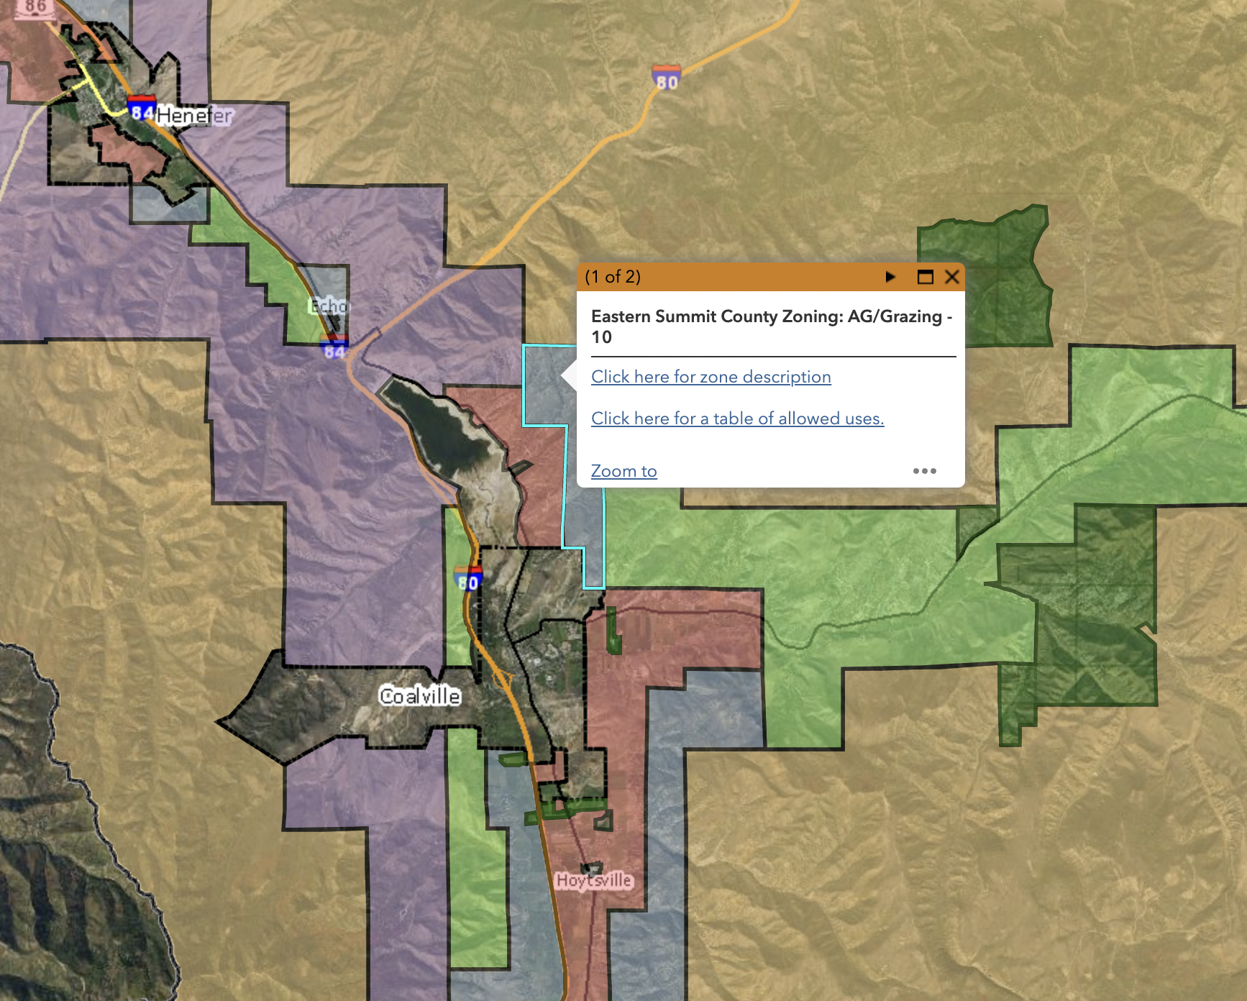
Zoning Map
Identifies which parts of the County Code apply to each parcel
Can be changed by application and approval of County Council
Changes to zoning map should reflect and implement the General Plan and Vision
General Plan Land Use Map is updated with each zone change
Zoning Map

Slide 17
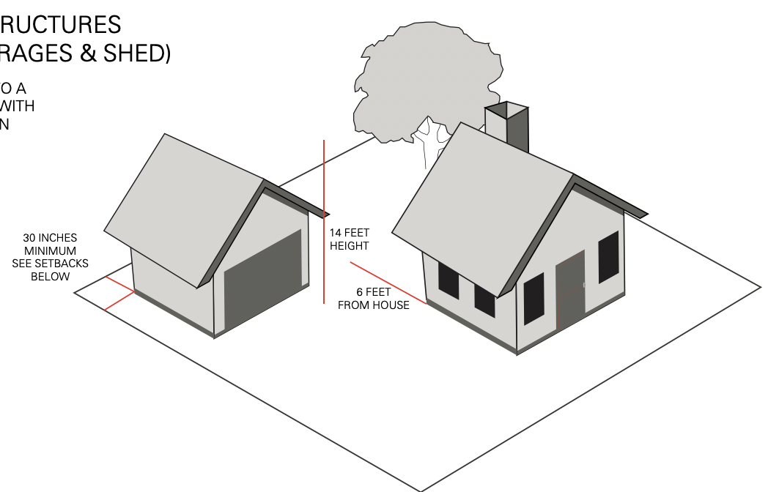
Zoning Ordinance
Zones & Overlay Zones
Approved Uses
Conditional Uses
Prohibited Uses
Densities
Setbacks
Lot coverage
Building envelope
Fence heights
Accessory buildings
Driveway widths
Summit County Development Codes

Slide 18
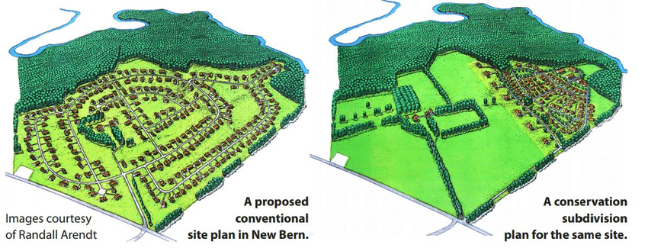
Clustered Development
Snyderville Basin 10-2-11: Incentive Density
Eastern Summit County 11-1-4: Cluster Bonus/Agriculture Preservation Incentive Subdivision
Notes:
For slides 14 and 18, participants may recall being asked their thoughts about these strategies during the visioning process.

Slide 19
Subdivision Regulations
Start Here
Used to divide a large parcel into smaller parcels, usually exclusively for residential development.
Often classified as a Minor or Major Subdivision
Street rights-of-way
Lot area
Street network
Easements
Wetlands/Slopes
Pre-Application Conference &
Sketch Plan
Plan Completion
(By Checklist)
Master Planned Development
Major Site Plan
Minor Site Plan
Preliminary Approval
Final Approval
Final Approval
You Care About Subdivision Regulations, You Just Don’t Know It (Yet).

Slide 20
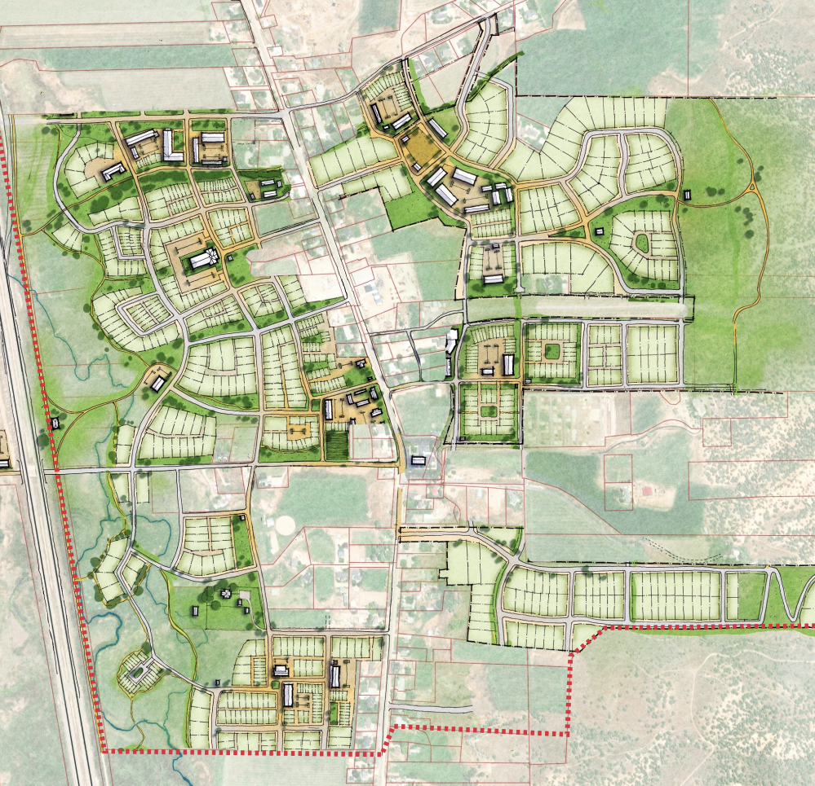
Master Planned Community
Used to divide a large parcel into smaller parcels for mix of residential and commercial uses.
Gives the County and Planning Commission more ability to negotiate with the developer.
Mix of housing types and affordability
Mandatory open space
Designated areas for schools and parks
Wastewater treatment systems
Eastern Summit County 11-4-12: Master Planned Developments
Snyderville Basin 10-3-11: Specially Planned Area

Slide 21
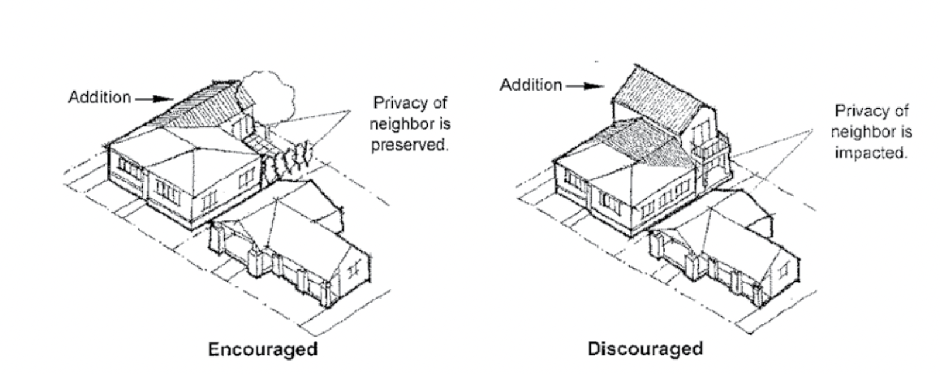
Other Tools
Dark Sky Ordinance
Regulations on lighting to minimize light pollution
Design Guidelines
Tool to ensure new development is complementary to the character of a community. e.g. Park City Historic District
No longer allowed to be applied to single- or two-family residential developments
Developer Agreements
Voluntary contract between local govt and developer
Specifies standards and conditions of the development
Binding once signed
Provides assurance to both parties that the regulations will not change mid project

Slide 22
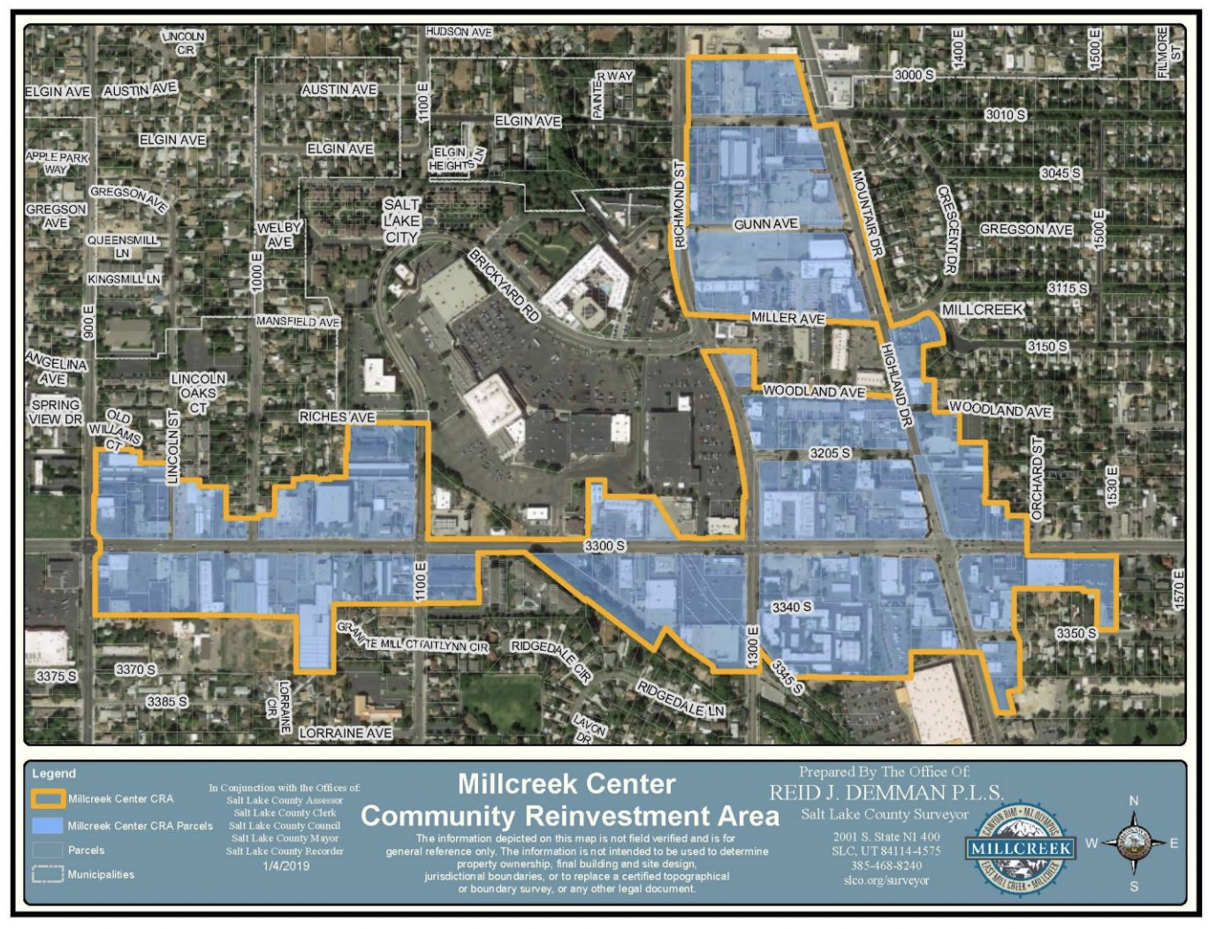
Community Reinvestment Areas & Agencies
Economic development tool to redevelop and revitalize blighted areas
Allows for Tax Increment Financing (TIF) to pay for public improvements
Administered by an agency legally separate from the municipality, but the City Council typically serves as the Board for the CRA

Slide 23
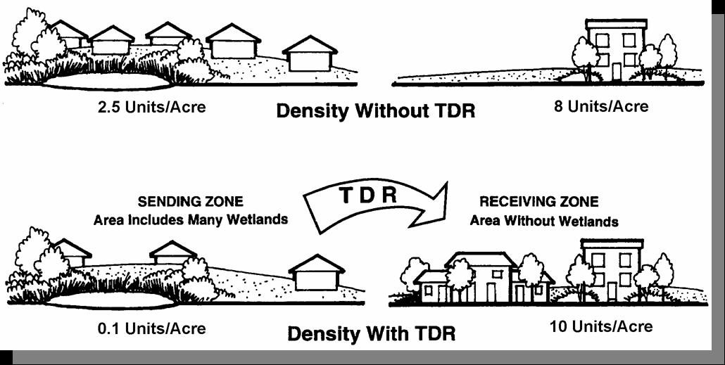
Transfer of Development Rights
Tool to preserve open space and redirect development to desired locations
Utilizes a voluntary market-based approach in which certificates are bought and sold
Only a few examples in use in Utah, but others are actively exploring it
Notes:
For slides 14 and 18, participants may recall being asked their thoughts about these strategies during the visioning process.

Slide 24
Roles and Responsibilities
Legislative Decisions
City/County Council
Take policy and and turn it into law
Adoption of general plan
Annexations
Adoption of local ordinances
Administrative Decisions
Anyone appointed by Council: often Staff or Planning Commission
Application of the law to the application
Subdivision
Conditional use permit
Building permit
Quasi-Judicial Decisions
Local Appeal Authority / Board of Adjustments
Interpret local laws when there is a dispute
Notes:
Small subdivisions can be approved administratively

Slide 25
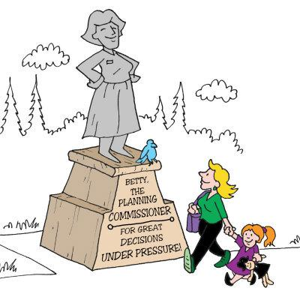
Planning Commission
Typical responsibilities of the Planning Commission include:
Prepare the General Plan
Review and make recommendations to the County Council regarding amendments to the Zoning Map
Review and make recommendations to the County Council regarding amendments to the Development Code
Hear, review, and approve or disapprove all applications for conditional uses, long term temporary uses, or certain subdivisions.
Notes:
Small subdivisions can be approved administratively

Slide 26
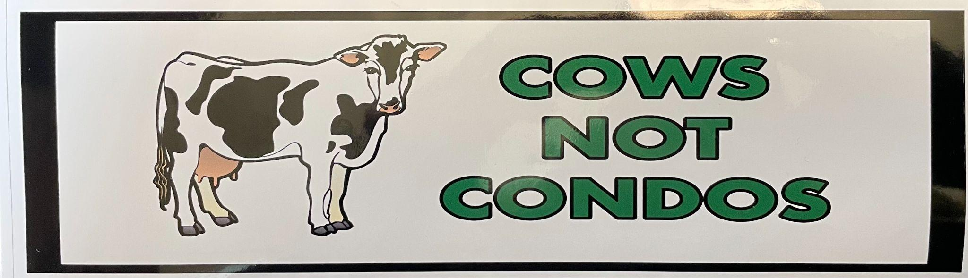
Feeling Growth Anxiety?

Slide 27

Guiding Our Growth
The Survey Results are In!
See what 28,000 of your friends and neighbors said they want their communities to look like in the future!
GuidingOurGrowth.utah.gov

Slide 28
Laura Hanson, AICP
State Planning Coordinator
Governor’s Office of Planning and Budget
laurahanson@utah.gov
801-589-8479

Slide 29


Slide 30


Slide 31
Journal
What is the difference between planning and zoning?
What is the purpose of planning?

Slide 32
Realm of Activity
Write down where you live and where you work (or spend a majority of your time)
List places where you NEED to go and where you WANT to go
Identify HOW you get to each location
Consider:
Distance is between each location.
Time it takes you to get to each place.
Then, turn your list into a “map” or “web.”

Slide 33
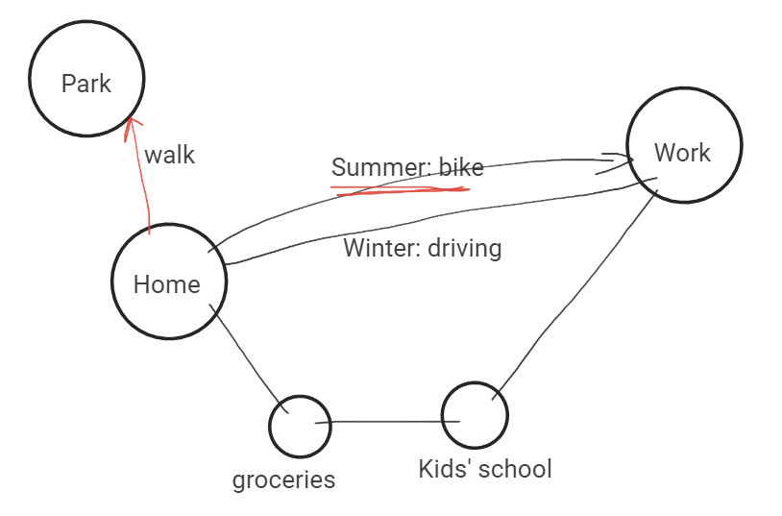
Realm of Activity - Example

Slide 34
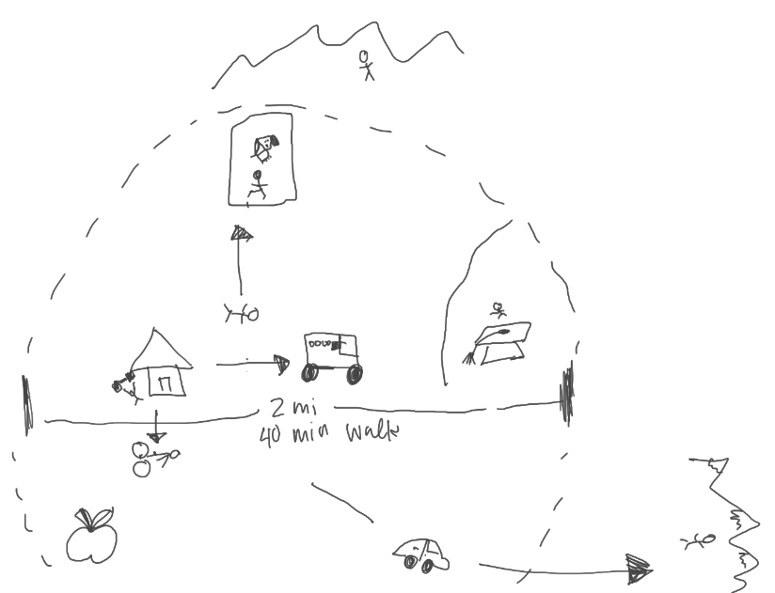
Realm of Activity - Example

Slide 35
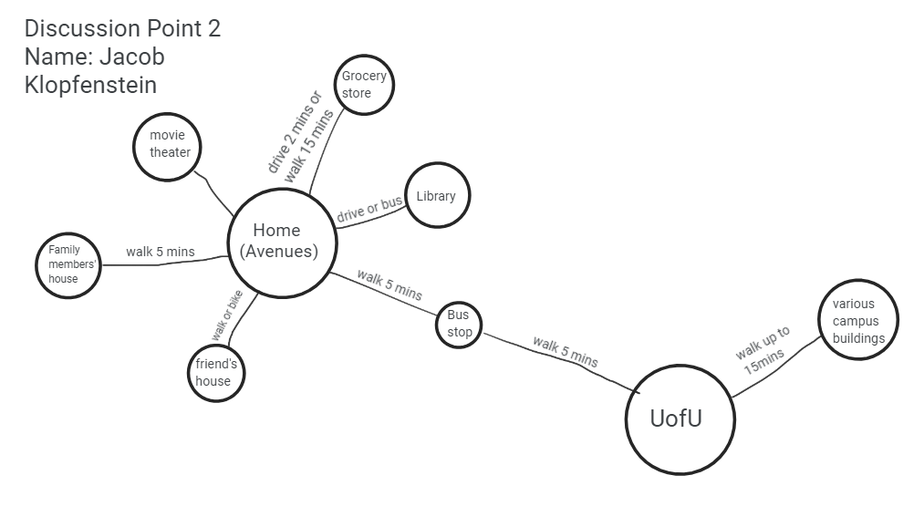
Realm of Activity - Example
errands
Work

Slide 36
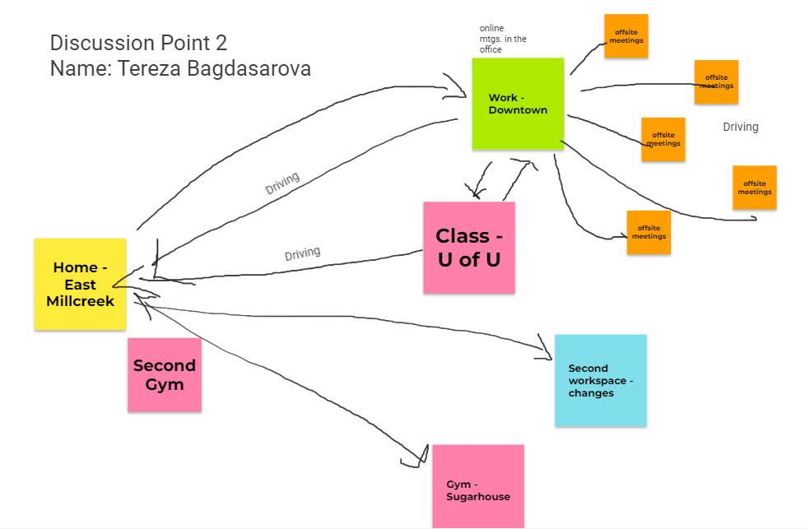
Realm of Activity - Example
bookstore
Coffee shop
Grocery store
Pottery class
Dentist

Slide 37
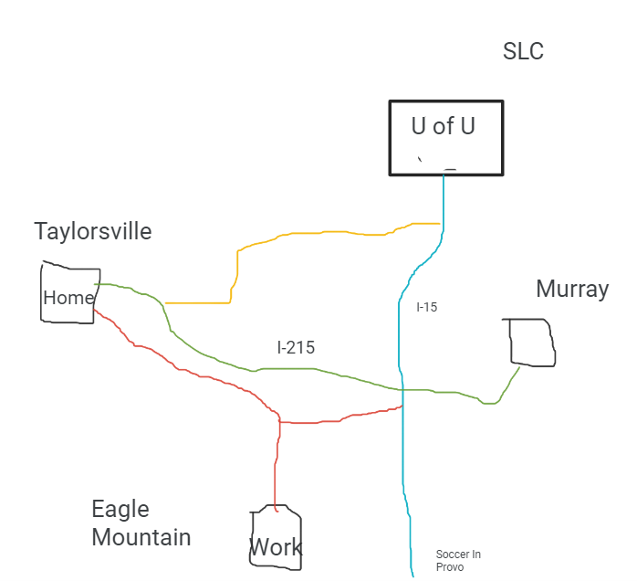
Realm of Activity - Example
Family and restaurants
Dr.’s office

Slide 38
Realm of Activity
We need to plan for all of you and all the people that aren’t represented here.
DISCUSSION QUESTIONS:
Could you add to or subtract things from the built environment to make lives easier and/or more convenient?
Planning can be challenging. What are the opportunities that planning provides?
Does the map you created fit into the Pedestrian City, Railroad City, Golden Era of Transportation, or Car City best?

Slide 39
Great Communities
With your table group, plan for a great community.
General plan
Must include:
Land Use
Transportation
Moderate Income Housing
Water Use and Conservation
May include:
Parks, Recreation, Open Space
Economic Development
Natural Resources and Hazards

Slide 40
Discussion Questions
What makes a community great?
How do you reflect the different needs and desires of community members?
If it’s not legally binding, what is the purpose of a general plan?
How does zoning impact communities?

Slide 41
Final Project
From what you read and reviewed, what is the purpose of the final project?
What planning related improvements would you like to see made in your community? The purpose of the final project is to learn more about a planning related topic and influence future planning in your community.
Identify an area of interest or concern
Explore how to gather information about that subject
Discover where decisions about that subject are made, who is responsible for that area, and how they make those decisions
Develop effective methods to communicate your idea to those decision-makers
Facilitate a connection between yourself and that agency/decision-maker

Slide 42

Final Project

Slide 43
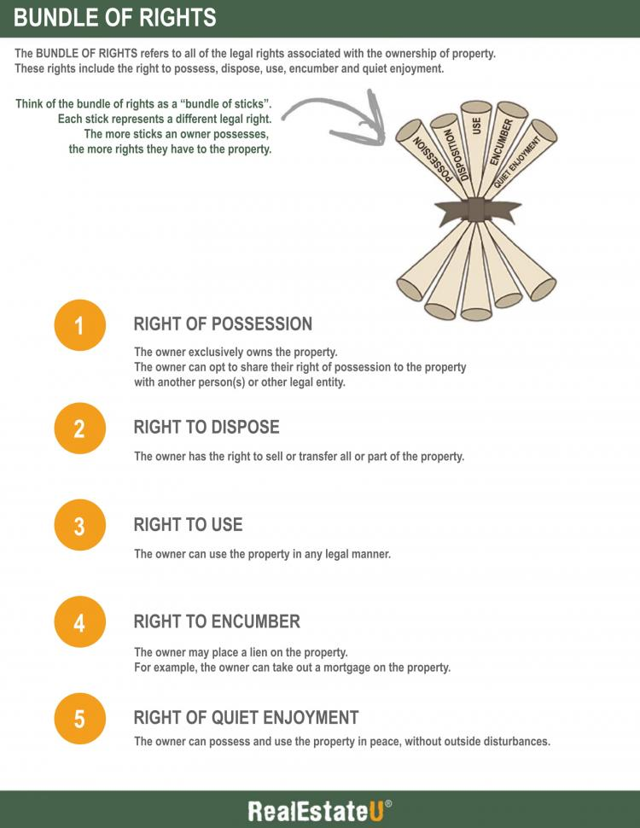
Lingering Questions
Lingering Questions
Given everything we have talked about today, what are the potential issues with development rights being granted through litigation?
How can issues with litigation be avoided moving forward?
“I was interested in the history of zoning by litigation. Perhaps a couple of examples?”
Development through litigation
Vested Rights
Scope of approval body
Right to Use, such as
Density
Height
Type of use
Example
Discovery Ridge affordable housing

Slide 44
For Next Class
PROJECT WORK: Think about what you might want to focus on for your final project.
WATCH: Great Footage of Bad Public Meetings
READ: Chapter 3: Ground Rules
REVIEW: Summit County Community Engagement Handbook
DO:
Use the “Agenda Center” on the Summit County website to identify when each of the following meet:
Snyderville Basin Planning Commission
Eastern Summit County Planning Commission
County Council
One Special Service or Special Recreation District of your choice
Schedule a time to attend four meetings virtually or in person.

Slide 45

Wrap Up
3 things that you learned
2 topics you might want to explore
for a final project
1 question you still have

