Slide 1

Summit County Community Planning Lab
Welcome, Course Orientation, & Introduction to Planning
March 4, 2024

Slide 2
Plan Your Space
Planners work collaboratively, consider feedback and research, and ultimately act. Often, there are time pressures and constraints. Working with your team, design the ideal classroom space. You have 10 minutes.

Slide 3
Plan Your Space - Debrief
What did you notice during this activity?
When planning your space, what did you consider?
Based on what you read before class and the brief activity, what is planning?
What could have made the process of planning your space or the end result even better?

Slide 4
Agenda
Session Learning Objectives
Course Overview
Welcome & Introductions
History of Planning
Break
Local Planning Structures
Activity
Wrap Up
Next course session

Slide 5
Learning Objectives
Participants will be able to…
Understand how different land uses and structures impact the built and natural environment.
Create their own definition of planning.
Understand the numerous forces that shape cities and communities, in part by identifying local Summit County planning structures.
Articulate the importance of planning.

Slide 6
Course Overview
Syllabus and schedule
www.summitcounty.org/cplclassroom
Meeting Locations and times
Can be found on syllabus
Final project
May 20 at Richins Auditorium in Kimball Junction (arrive by 5:45)
Meeting observations
AGH! WEATHER!!
The more effort you put in, the more you’ll get out of the experience.

Slide 7

Welcome & Introductions

Slide 8
Who are you?
In 90 seconds or less, please tell us the following:
Your name
Where you live
What brought you to the Community Planning Lab
IF TIME:
What song would you want to play every time you walk into a room?
OR
If you could be any animal, what would you be?

Slide 9
Set Up Your Journal!
You need, at minimum, three sections:
Session Notes
Reflections
Final Project Ideas
You may also want to include sections for:
Meeting Observations
Contact Information
Lingering Questions
Nuggets of Wisdom

Slide 10

A Brief History of Planning
Notes:
MADDY - 15 minutes

Slide 11
Use your journal!
Planning in general…
What do you Know (or think you know)? | What do you Want to know? | What did you Learn?

Slide 12
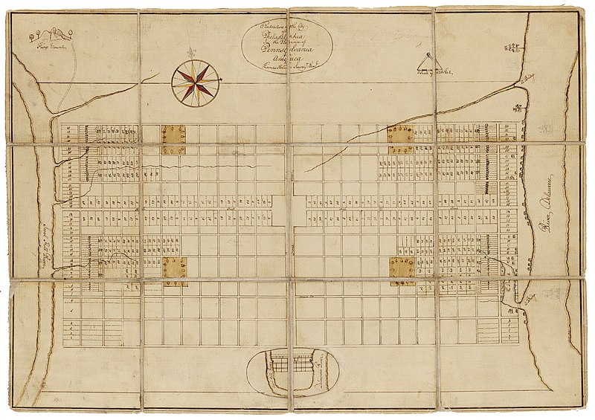
Philadelphia 1682

Slide 13
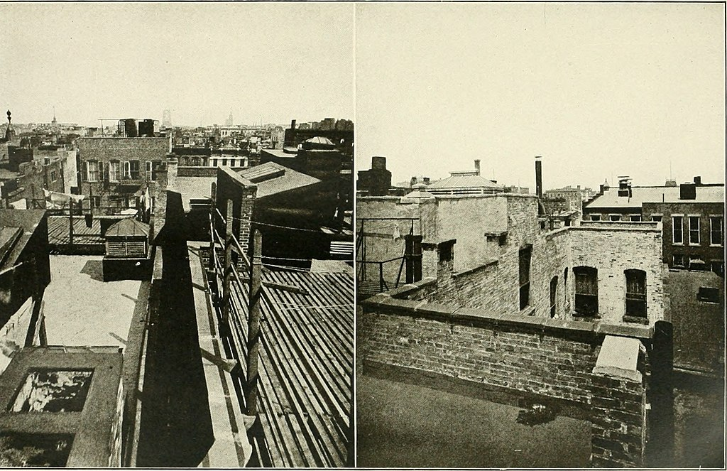
New York State Tenement House Act - 1901
NEW LAW: Among other things, the Tenement Law mandated larger courtyards for increased natural light and air circulation.
OLD LAW: 1879’s air shaft law saw little space between buildings. Units could be dark and poorly ventilated.

Slide 14
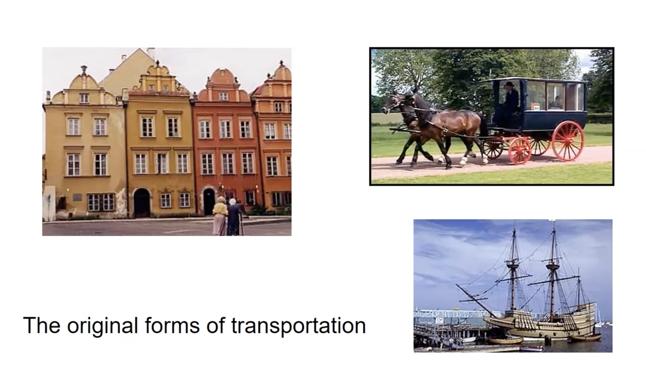
Connection of Land Development & Transportation
Notes:
Walking, use of animal power, and boats: what you can do with your feet, what you can do with an animal, what you can do with the wind

Slide 15
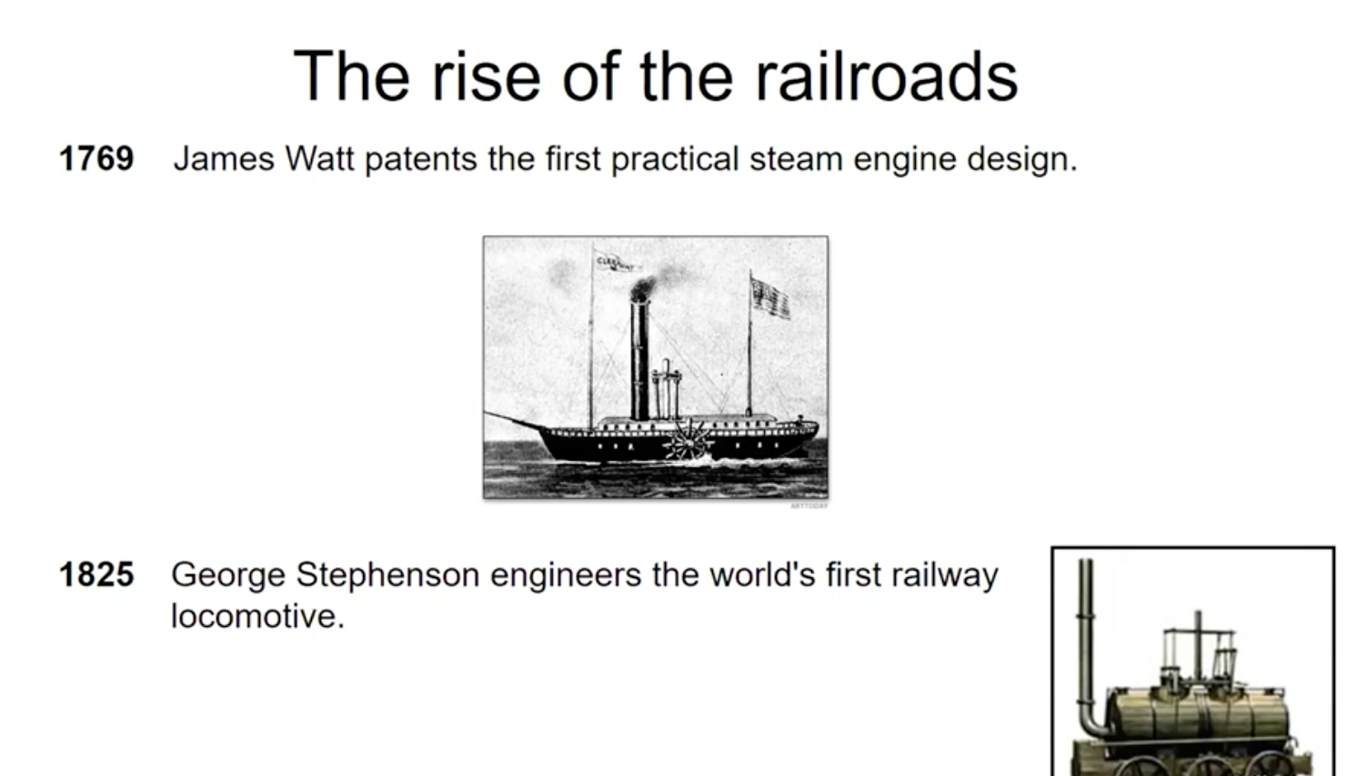
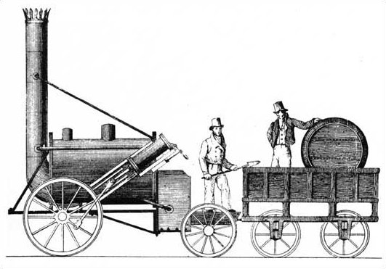

Slide 16
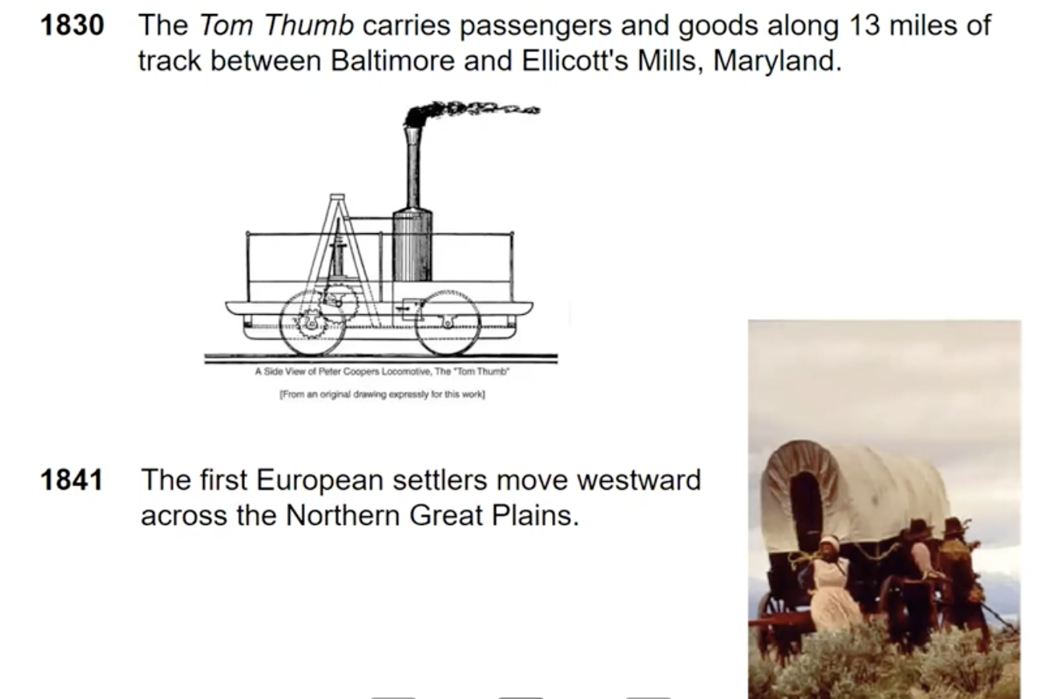


Slide 17
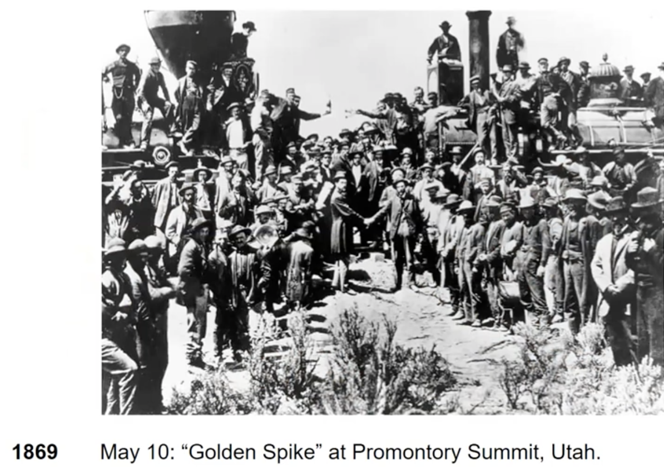
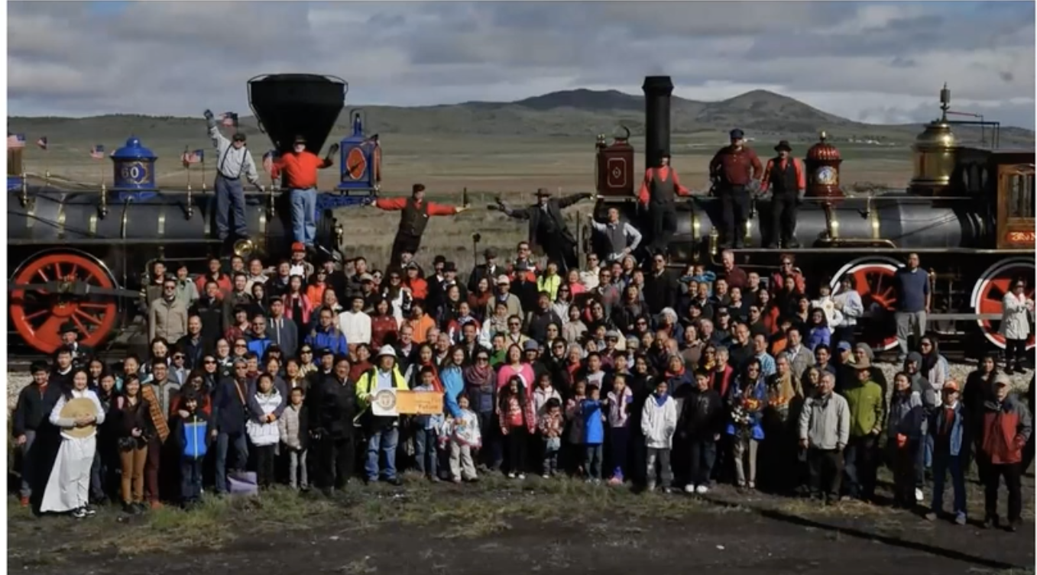

Slide 18
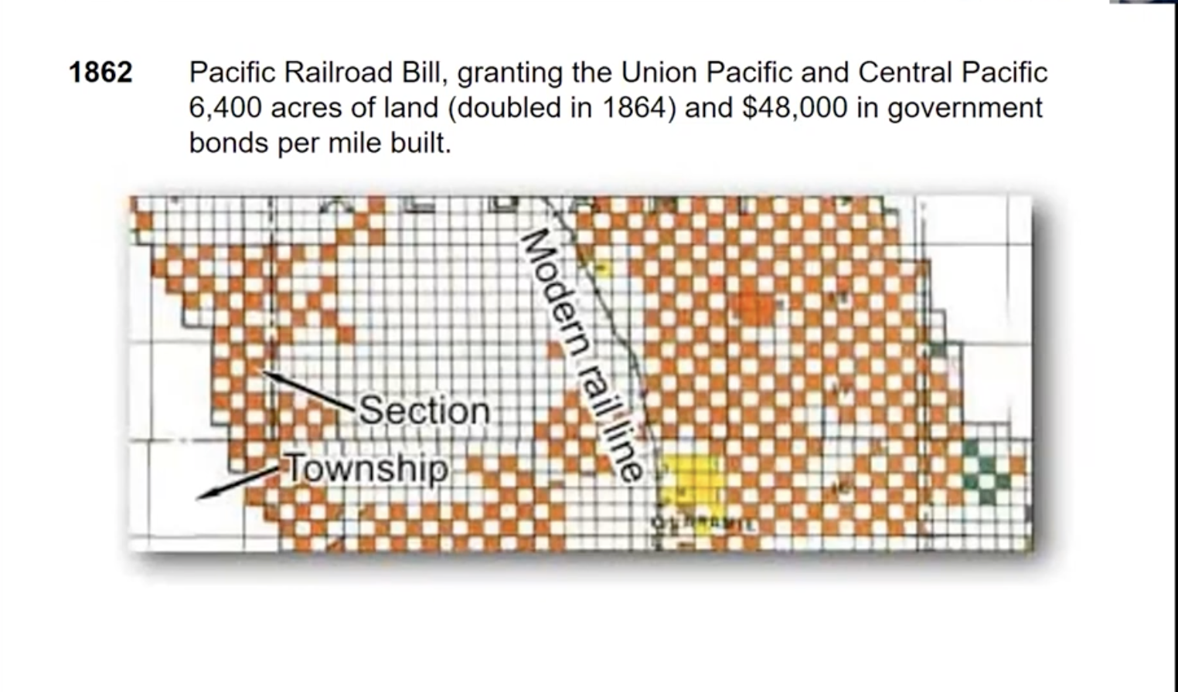

Slide 19
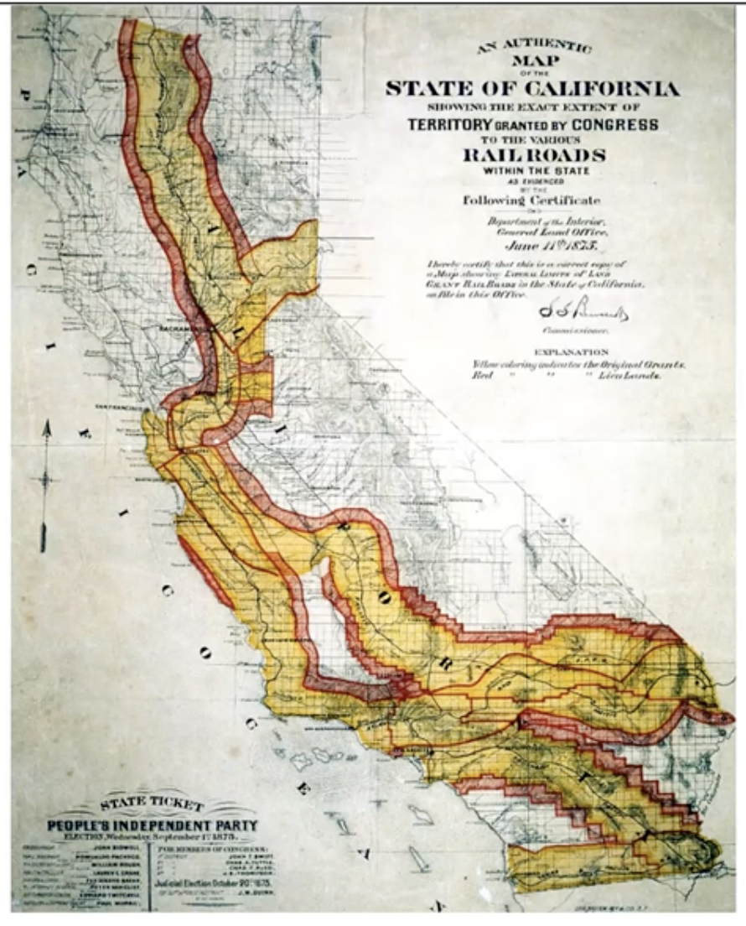

Slide 20
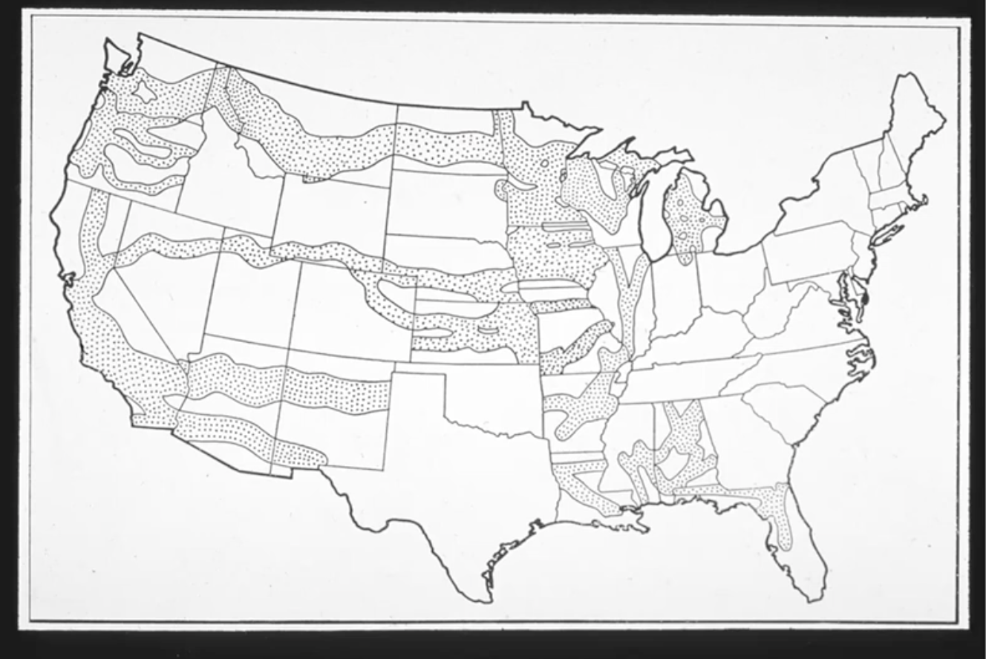

Slide 21
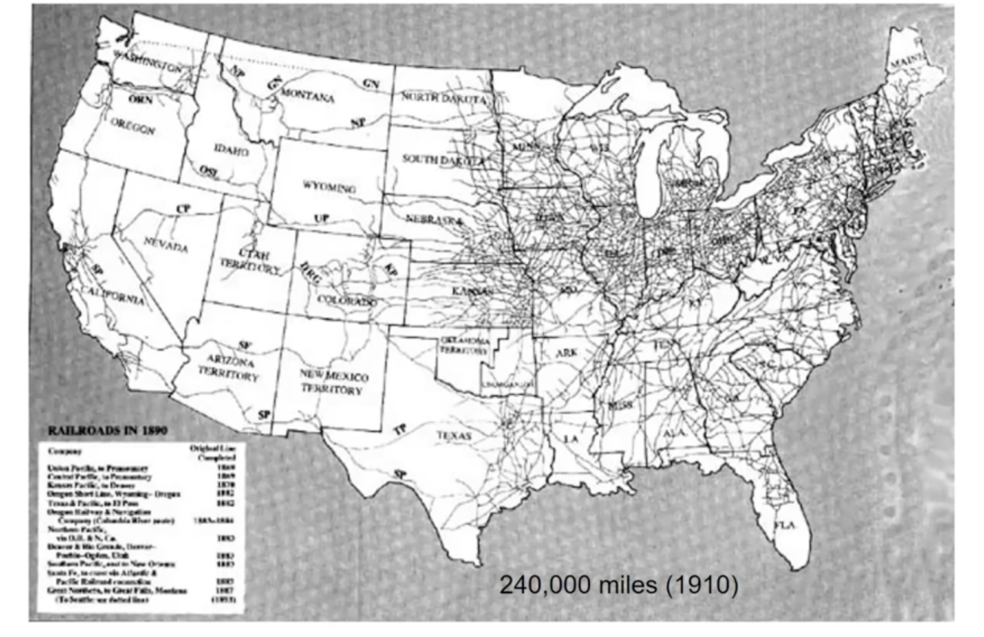
ACCESS

Slide 22
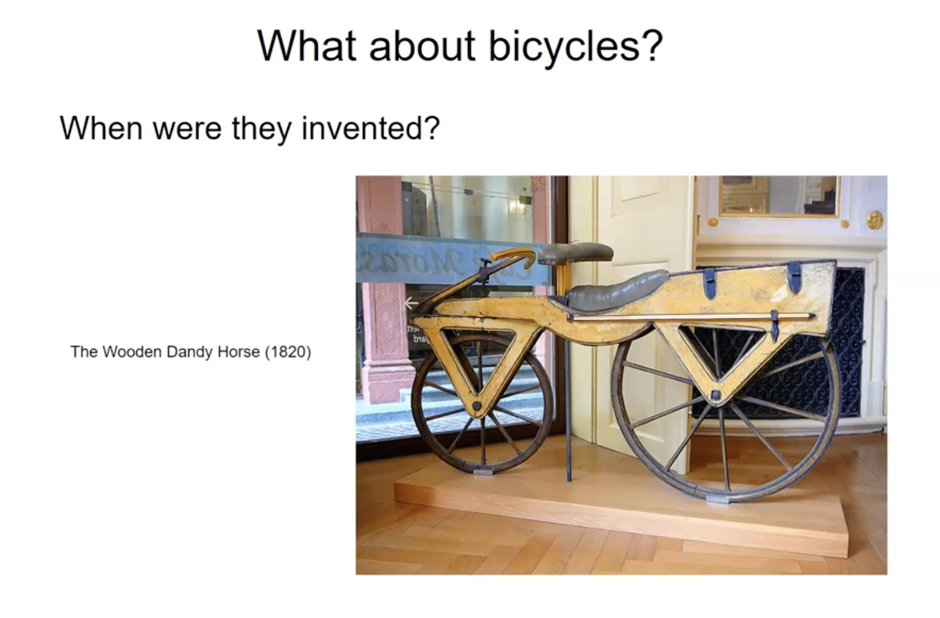

Slide 23
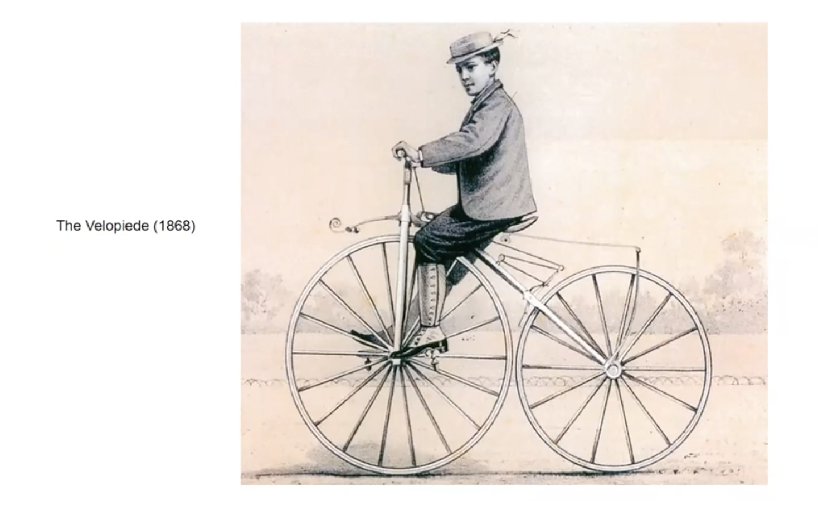

Slide 24
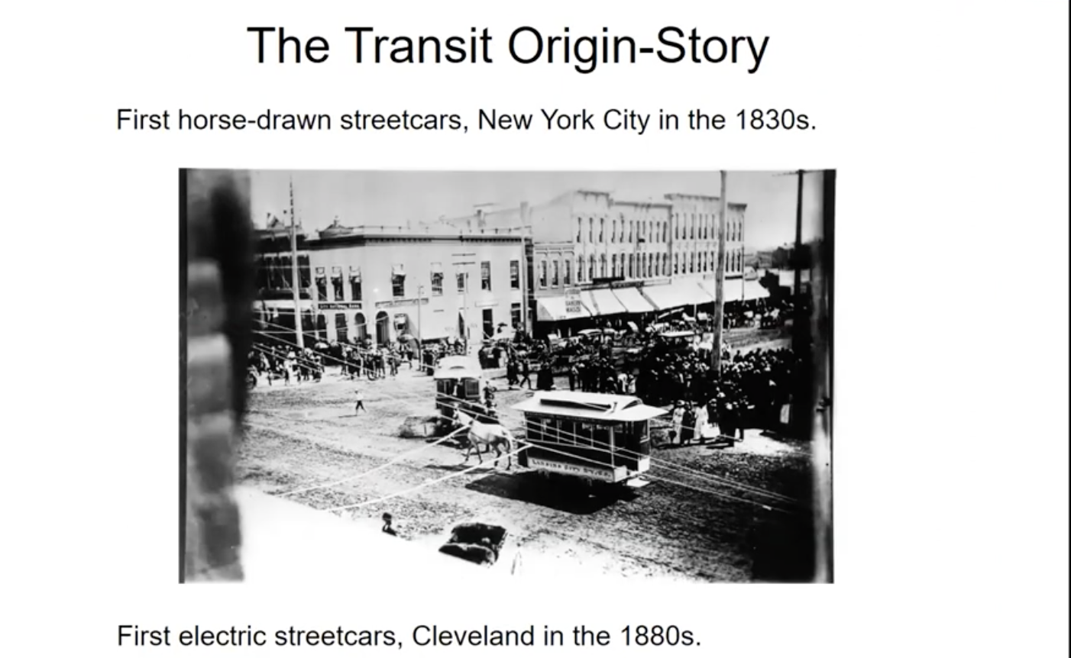

Slide 25
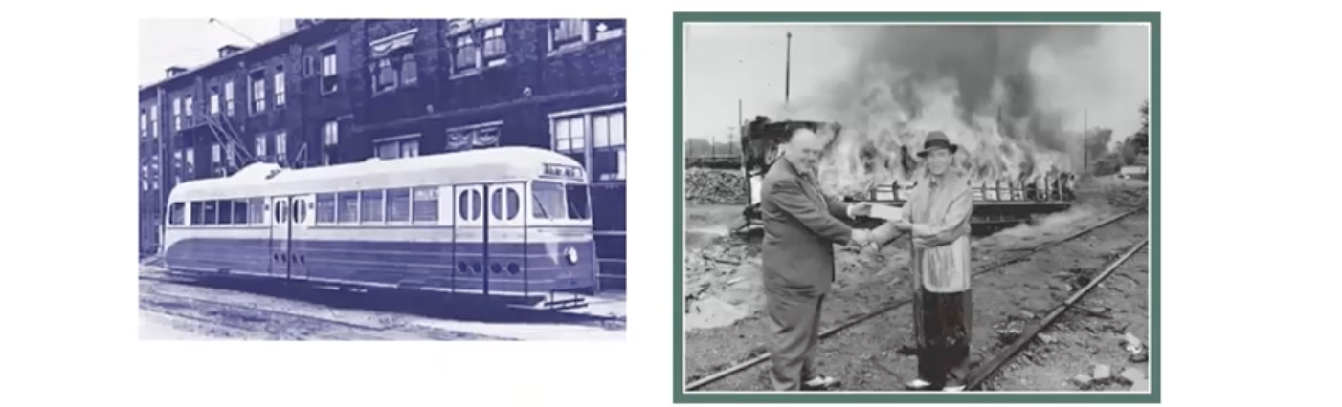
American Streetcar Scandal
Aka General Motors Streetcar Conspiracy
GM and related companies were accused of plotting to dismantle streetcar systems in many cities in order to monopolize surface transportation (largely as busses).

Slide 26
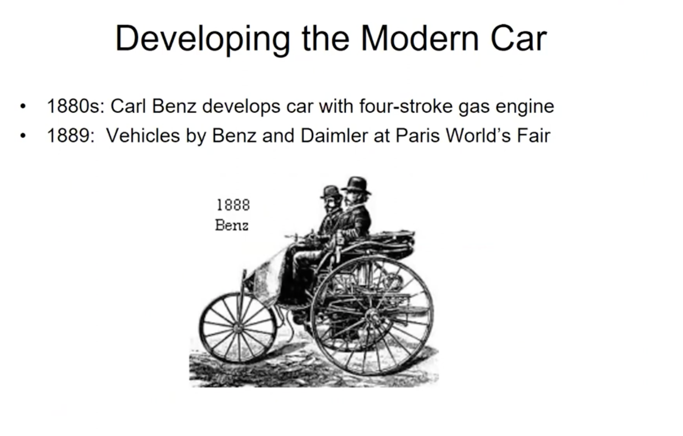

Slide 27
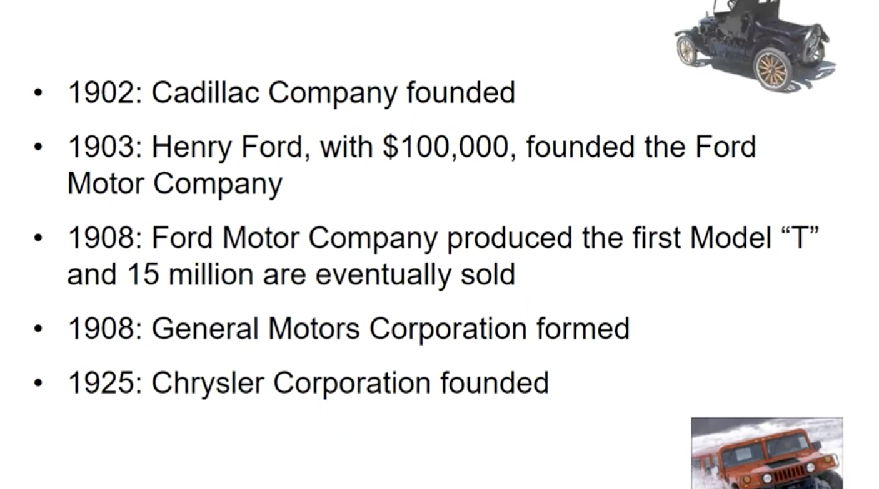

Slide 28
Year | U.S. Car Registrations
1900 | 8,000
1930 | 23,000,000
1941 | 30,000,000
1950 | 40,000,000
1995 | 128,000,000
2023
292,000,000

Slide 29
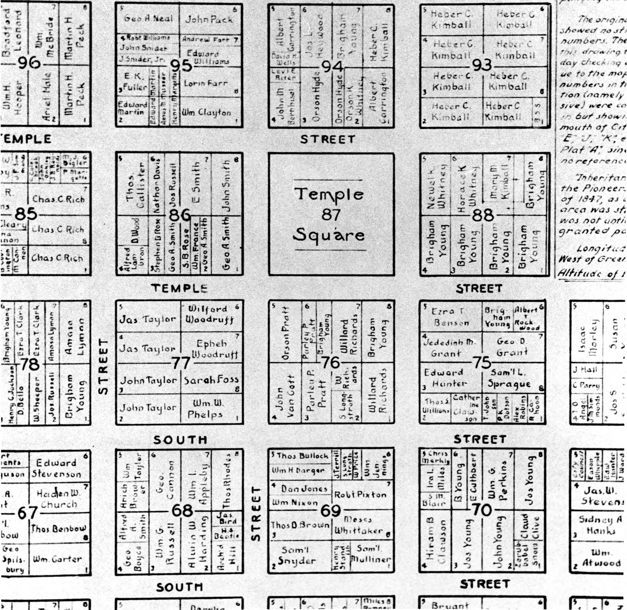
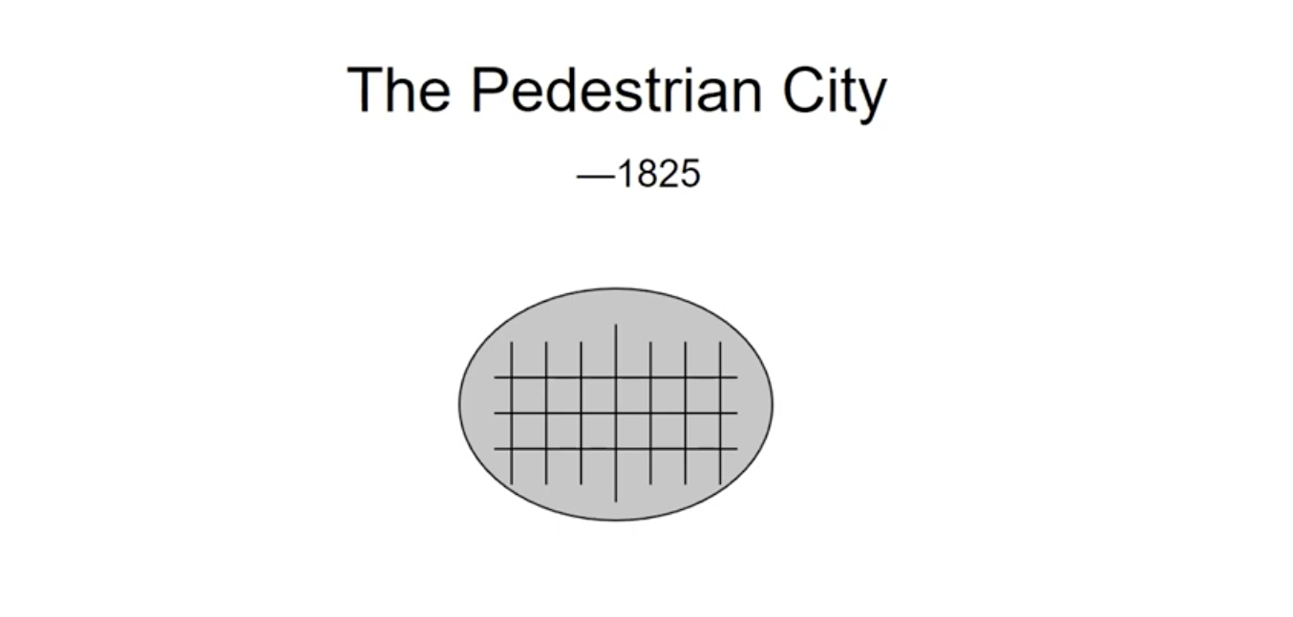
Transportation Options Impact the Built Environment

Slide 30
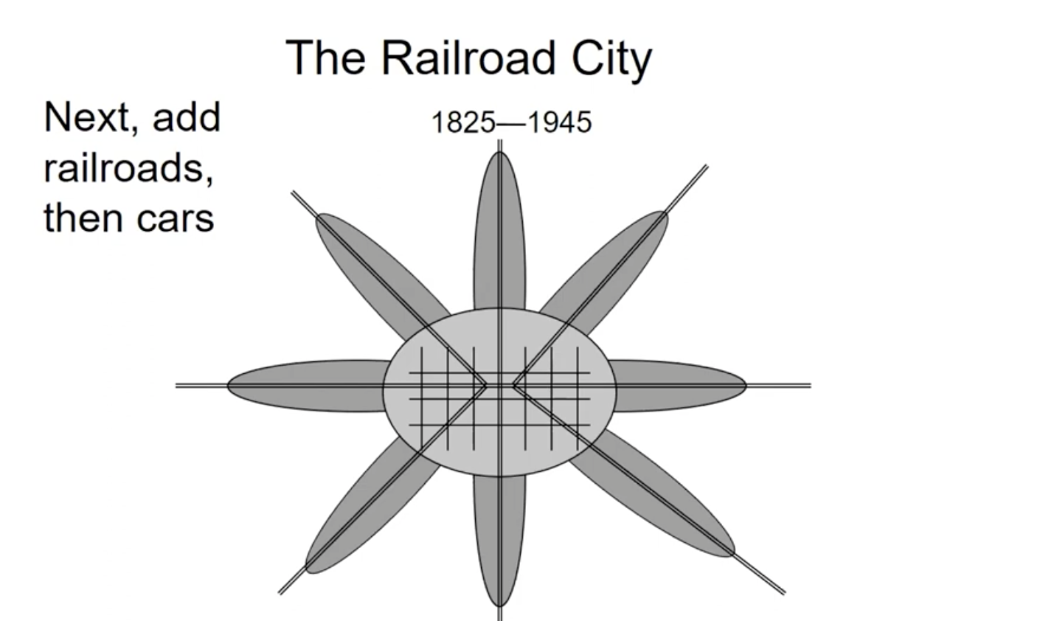

Slide 31
The Golden Era of Transportation
1900 - 1925
Characterized by options
Walking
Streetcar
Biking
Driving

Slide 32
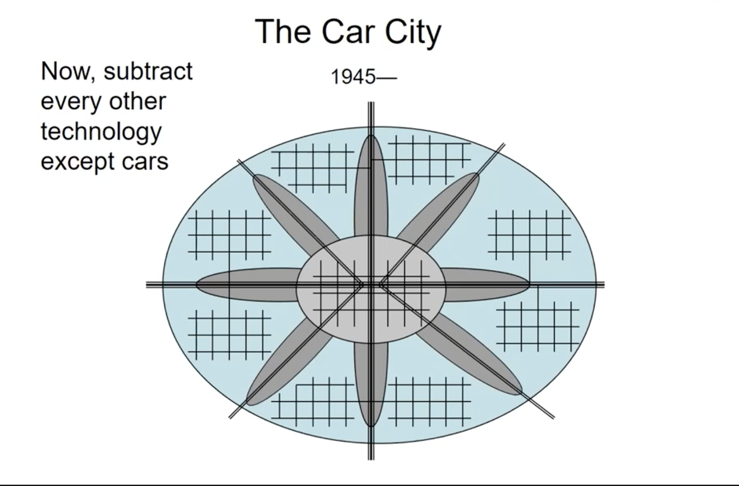

Slide 33
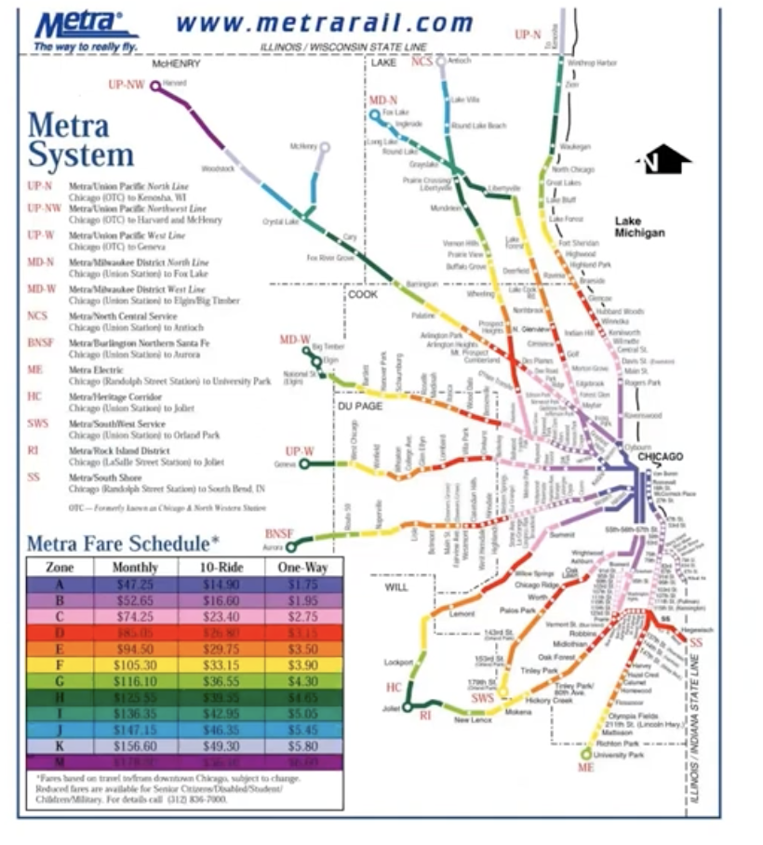

Slide 34
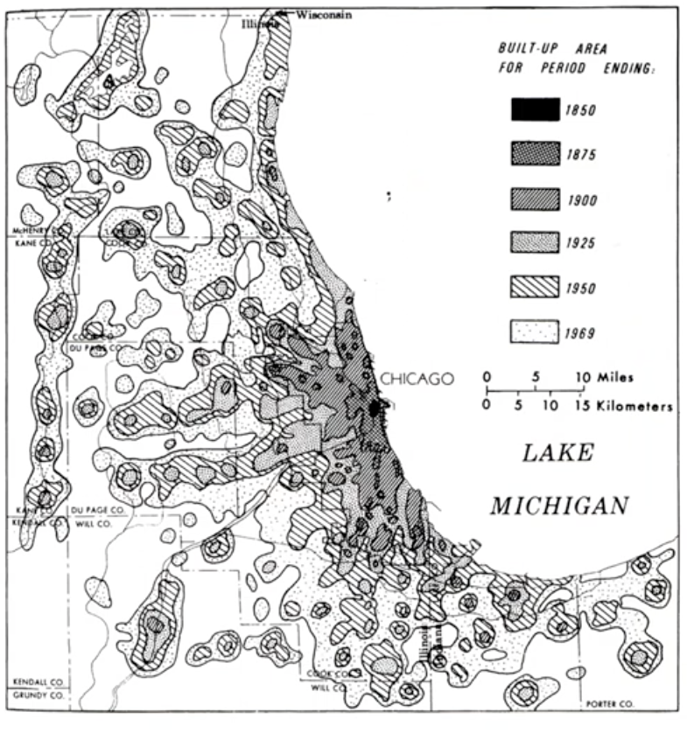

Slide 35
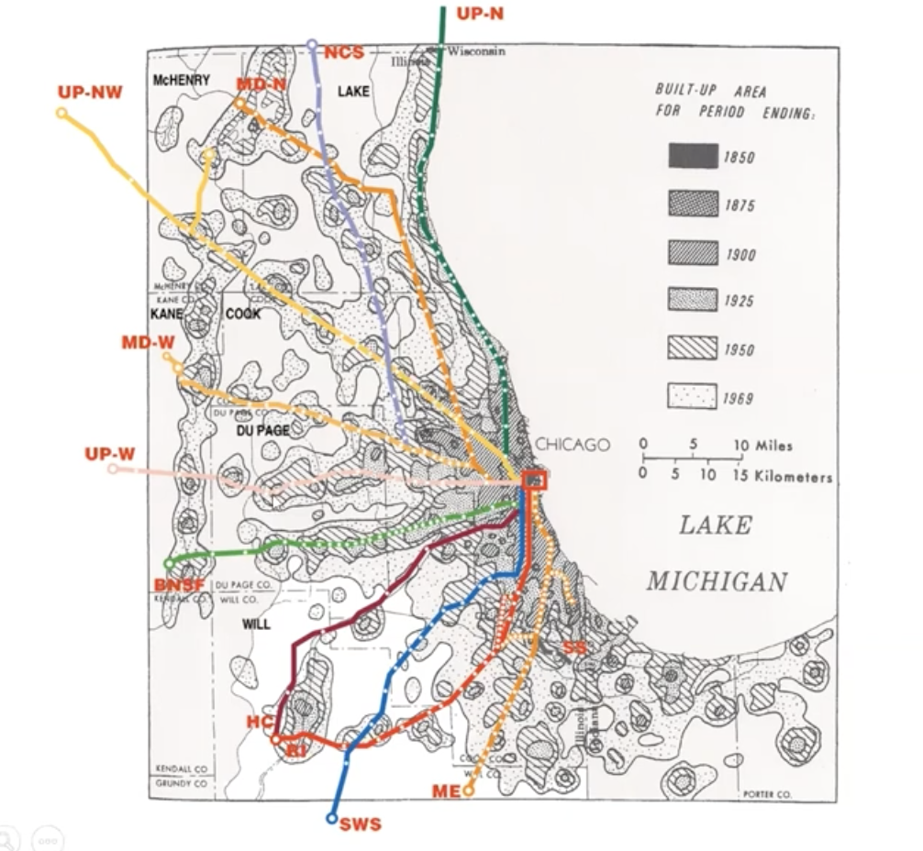

Slide 36
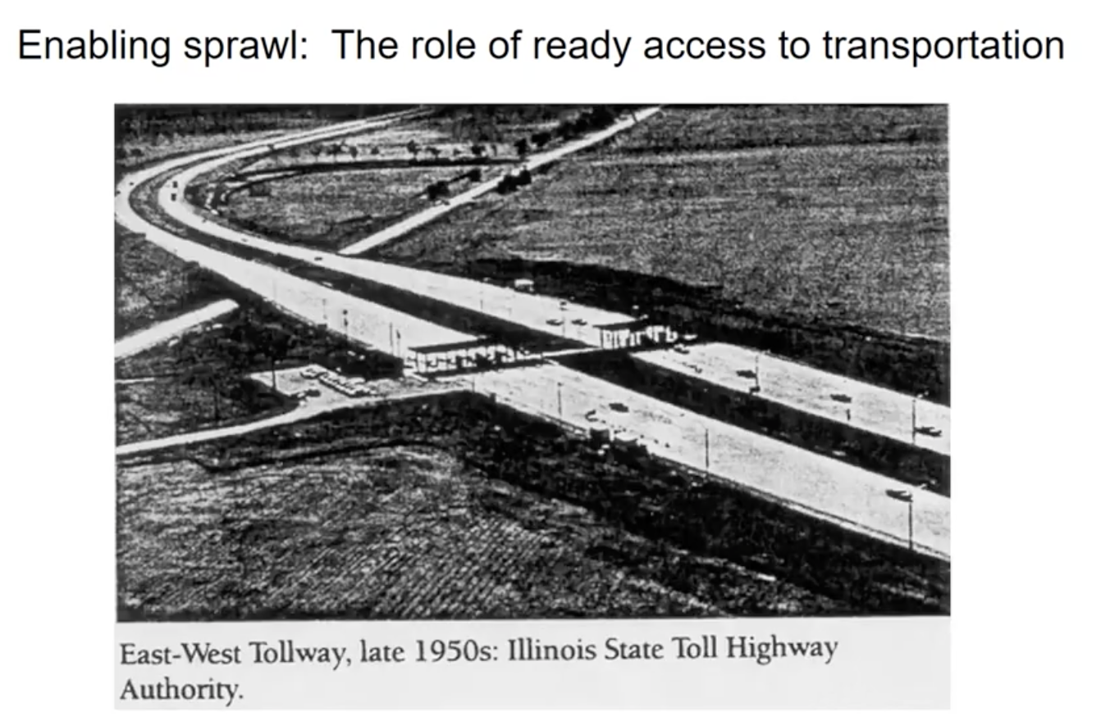

Slide 37
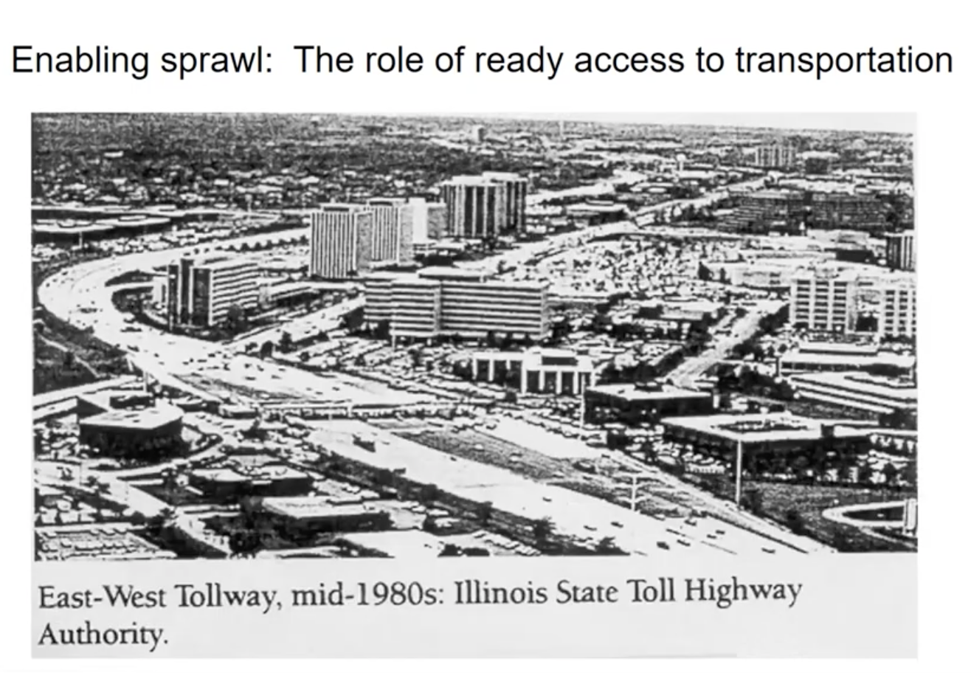

Slide 38
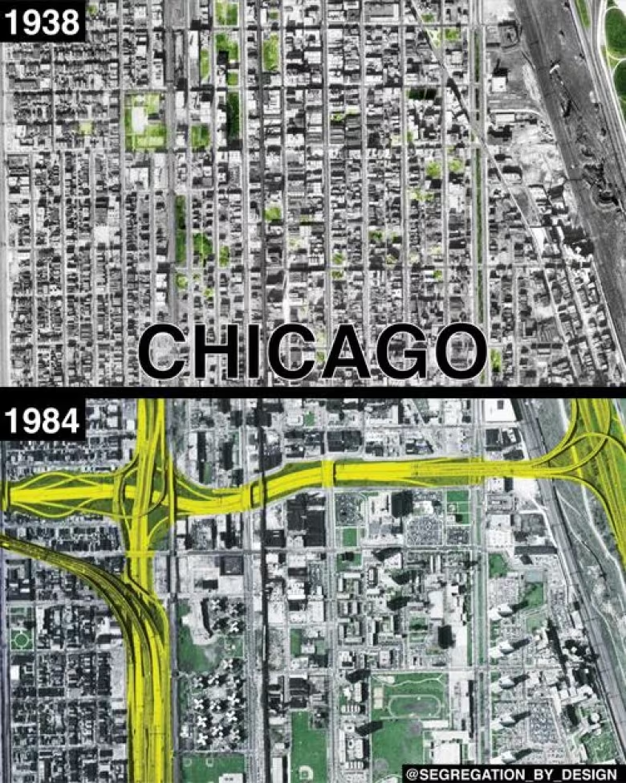
NPR Report: A Brief History of How Racism Shaped Interstate Highways

Slide 39
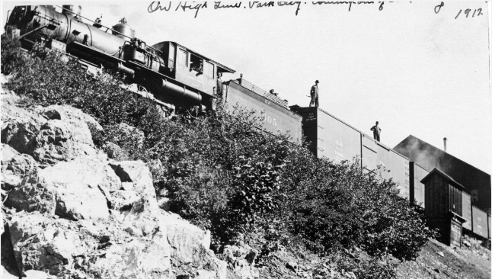
Rail in Summit County

Slide 40





In short…
Transportation options and land use decisions are linked
Access is the answer to everything
Perspective matters

Slide 41
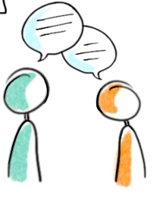
Turn to a partner
What stood out to you?
What did you learn?

Slide 42
Use your journal!
Planning in Summit County…
What do you Know (or think you know)? | What do you Want to know? | What did you Learn?

Slide 43
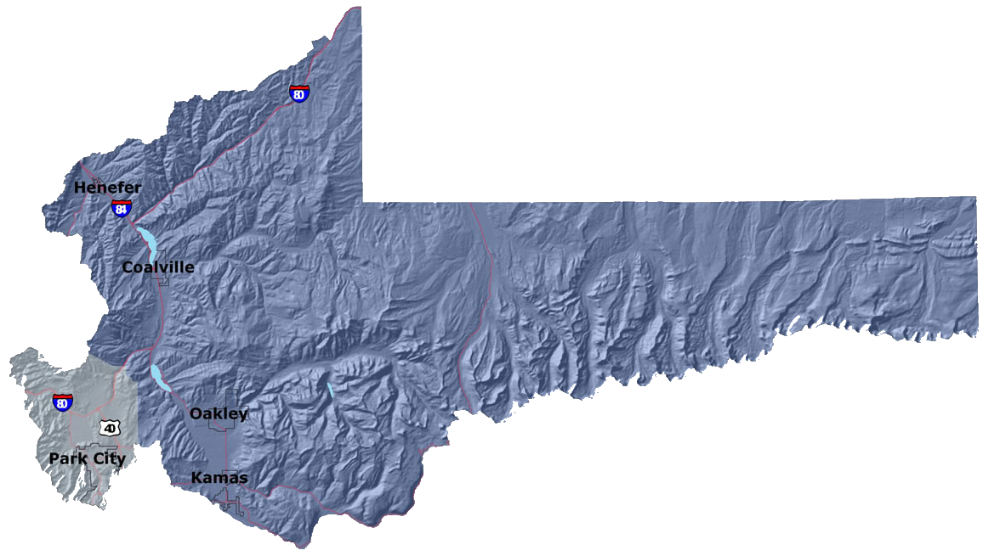
Planning in Summit County
Notes:
RAY

Slide 44
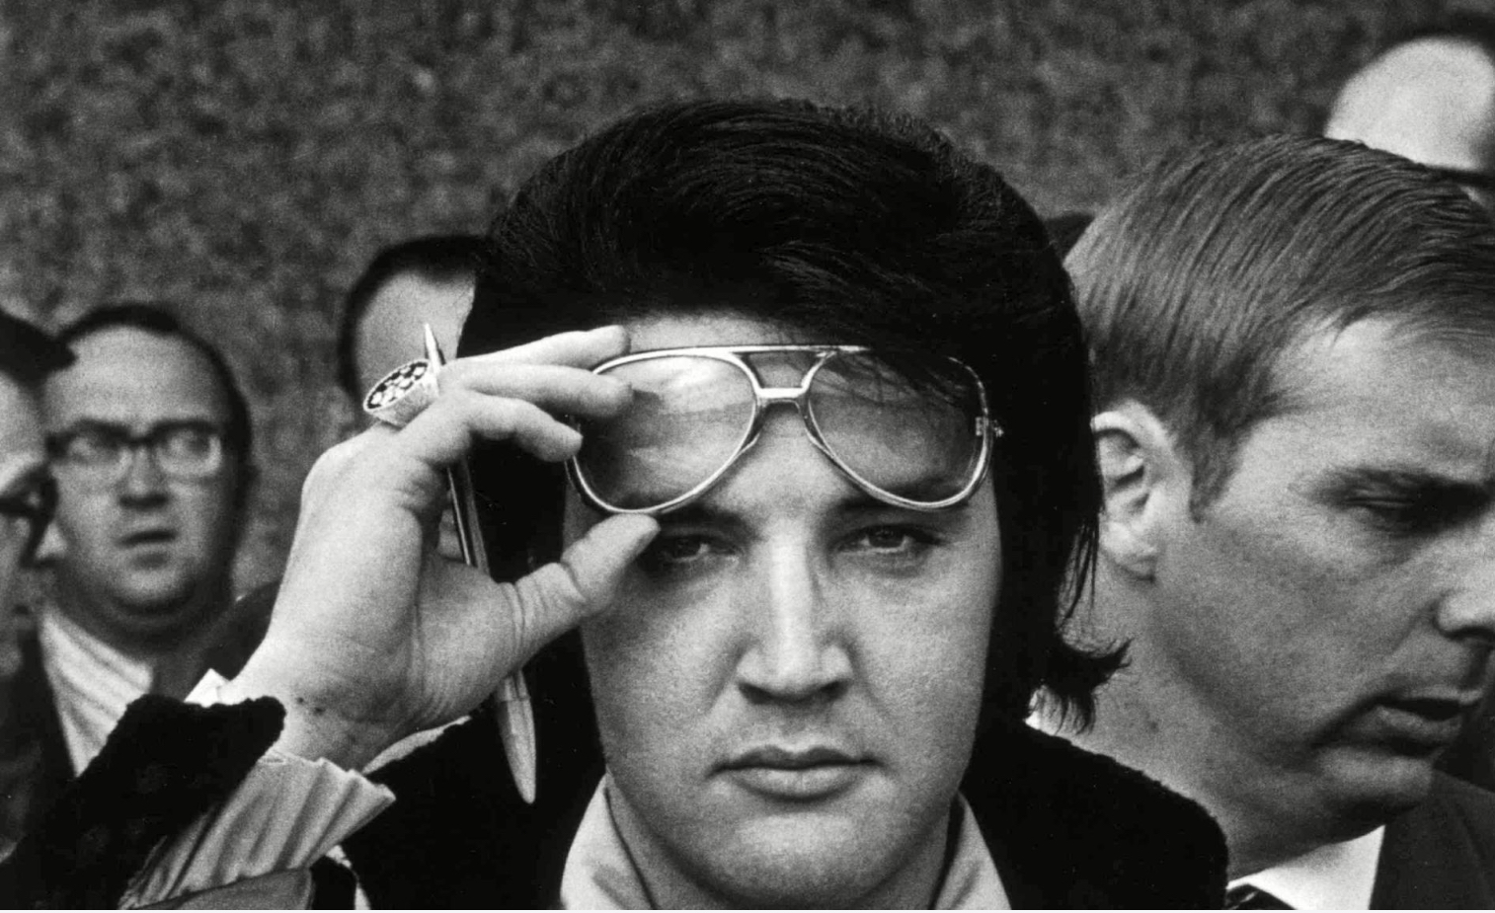
August 1977

Slide 45
Planning in Summit County
1960s Subdivision Ordinance
Led to projects including:
Summit Park
Silver Creek
Highland Estates
1977 - 1985 County-wide Zoning
Notes:
RAY

Slide 46
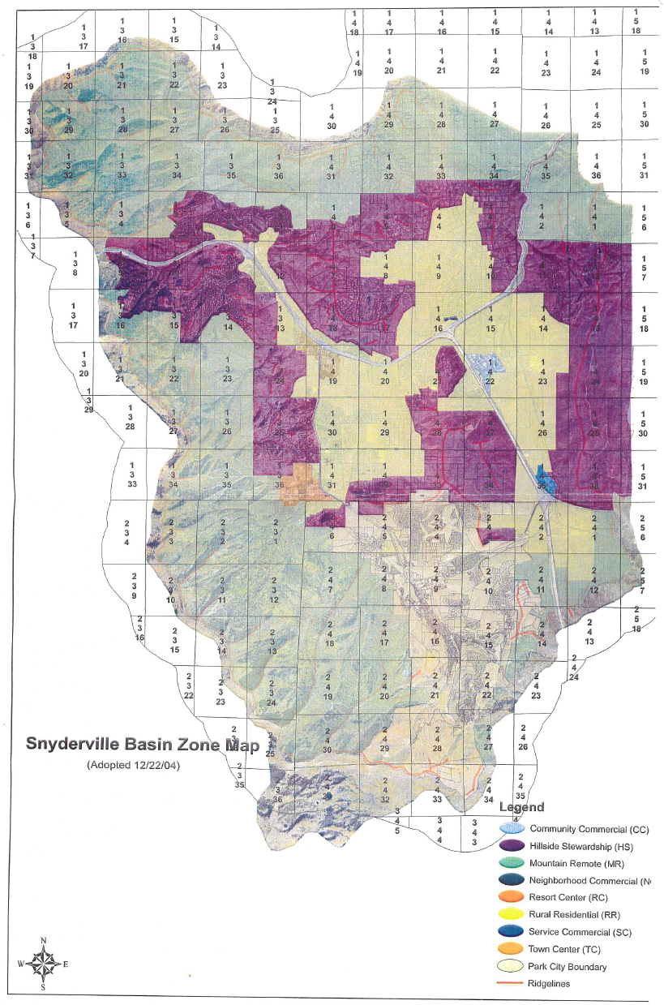
SNYDERVILLE BASIN
1998 from Euclidean to matrix-based (performance) zoning
1998 - 2008 Existing Residential or Existing Commercial 1-20 or 1-40 Do a SPA for extra density
2008 - New Zones added SPA only allowed in TC or RC
2021 NMU Master Planned Development Process created
~ 60% of developed area based on litigation
Goal: Zone our neighborhoods for what’s on the ground and what we want to see

Slide 47
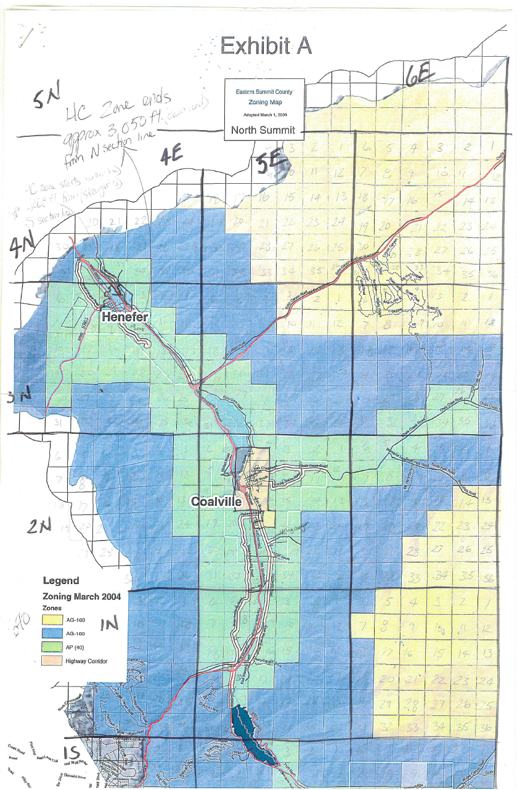
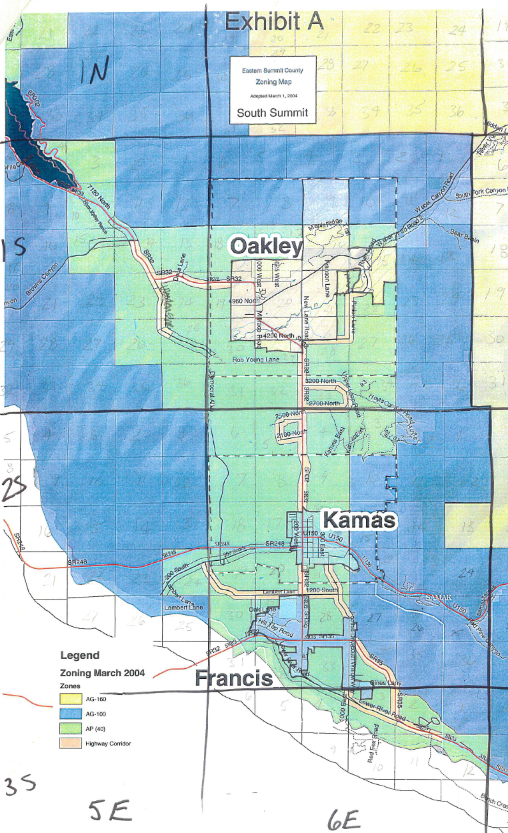
EASTERN SUMMIT COUNTY
1985 - East Side Gets its own Development Code and zoning
1996 - Eastern Summit County Planning Commission Created
2017 - Highway Corridor eliminated, new zones created Master Planned Development Process Created.
Other strategies:
Collaborate with municipalities
Village Overlay Zone

Slide 48
The Three Ps of Planning
Preservation
Profit
Pfear
Moving Forward…

Slide 49
Realm of Activity
Write down where you live and where you work (or spend a majority of your time)
List places where you NEED to go and where you WANT to go
Identify HOW you get to each location
Consider:
Distance is between each location.
Time it takes you to get to each place.
Then, turn your list into a “map” or “web.”

Slide 50
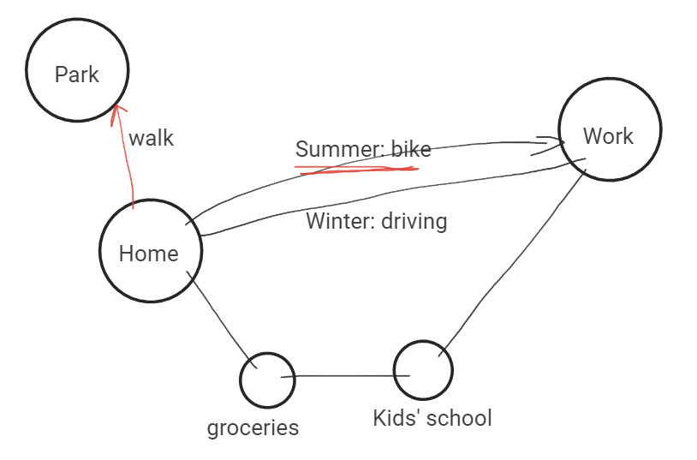
Realm of Activity - Example

Slide 51
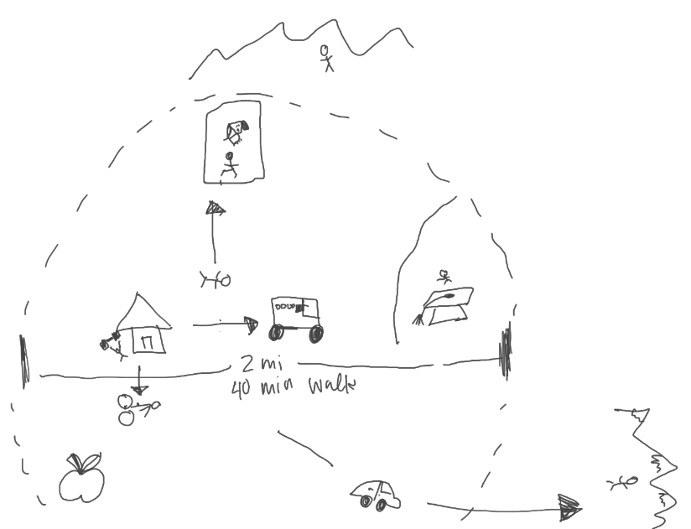
Realm of Activity - Example

Slide 52
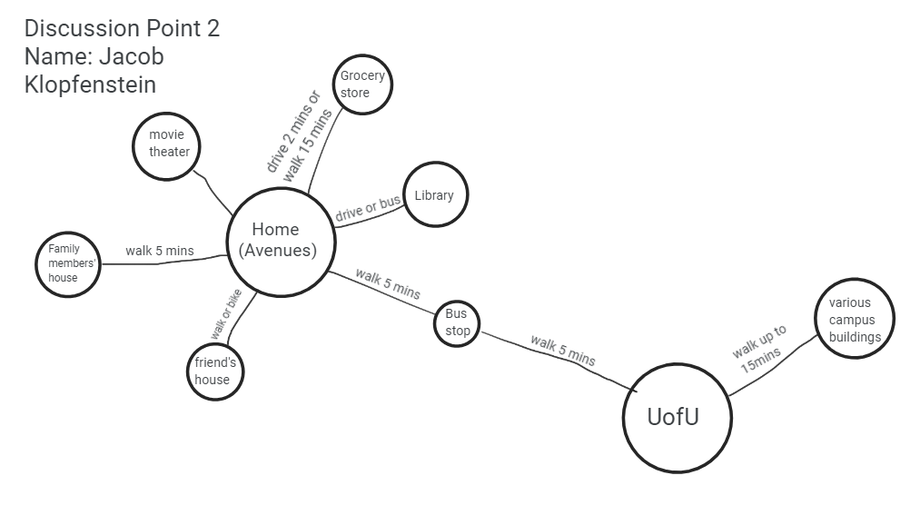
Realm of Activity - Example
errands
Work

Slide 53
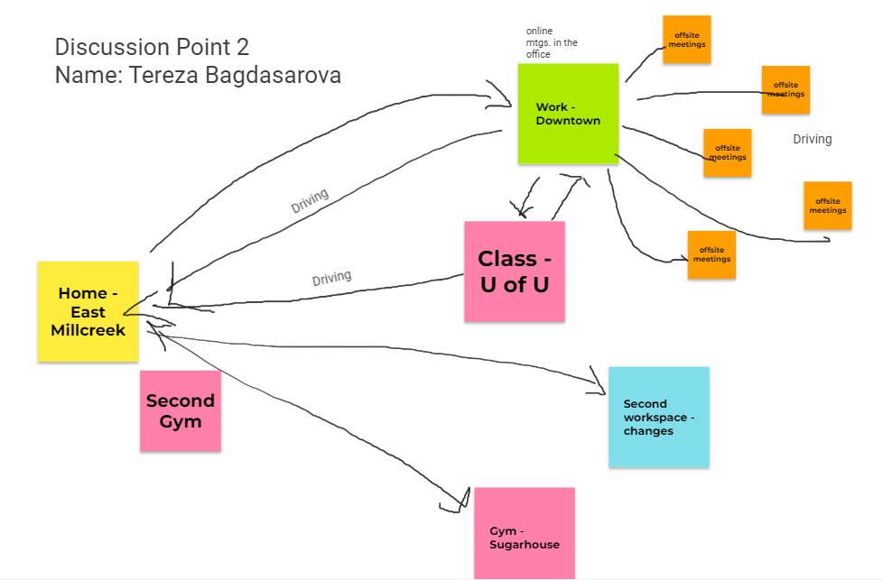
Realm of Activity - Example
bookstore
Coffee shop
Grocery store
Pottery class
Dentist

Slide 54
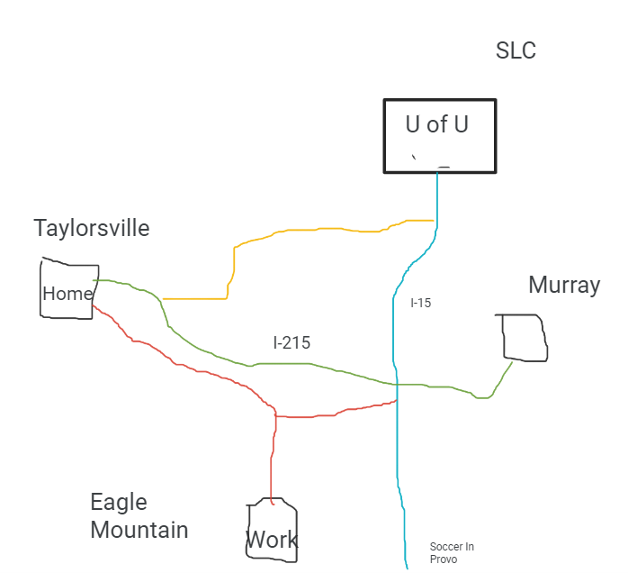
Realm of Activity - Example
Family and restaurants
Dr.’s office

Slide 55
Realm of Activity
We need to plan for all of you and all the people that aren’t represented here.
DISCUSSION QUESTIONS:
Could you add to or subtract things from the built environment to make lives easier and/or more convenient?
Planning can be challenging. What are the opportunities that planning provides?
Does the map you created fit into the Pedestrian City, Railroad City, Golden Era of Transportation, or Car City best?

Slide 56

Wrap Up
3 things that you learned
2 things you found
interesting
1 question you still have

Slide 57
For Next Class
Read:
Ground Rules chapter 1 and 2
Chapter 2 of Planning Made Easy
“How should Utah grow - when many don’t want to?”
Review: Navigate to the course website: www.summitcounty.org/cplclassroom
Review the Final Project documents and meeting observation assignment and come prepared with questions or comments
Feedback: Complete the feedback survey by March 7 at 8:00pm

Slide 58
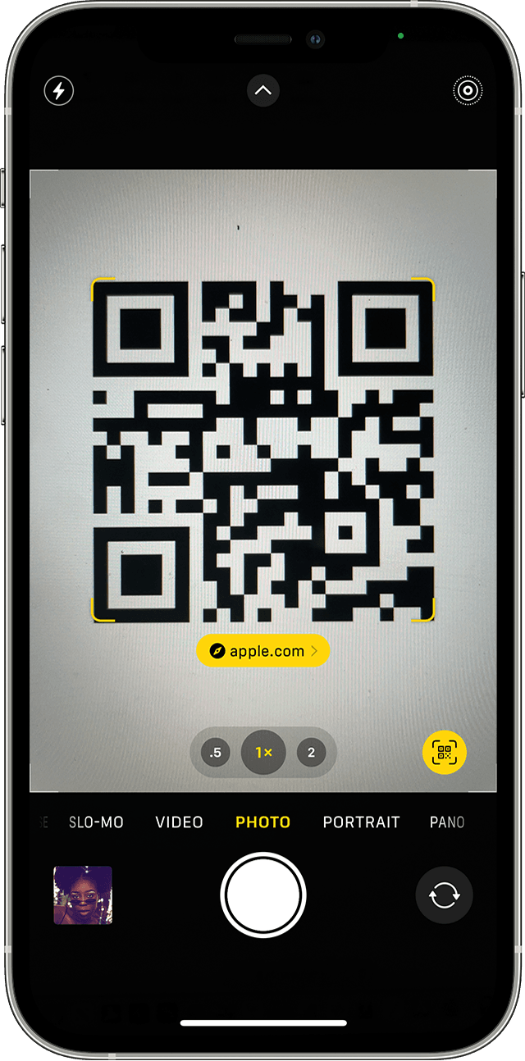
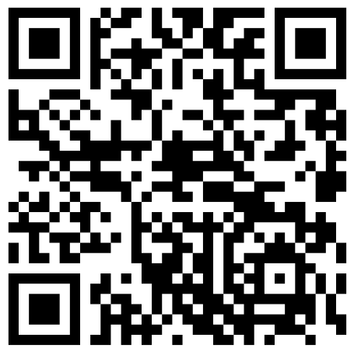
Feedback
Feedback is vital!
Please complete this short survey by March 7 at 8:00pm
Via the link: https://forms.gle/tXK7umG34FN2R72a9
Using the QR code:

