Slide 1
Nightly Rentals 2024

Slide 2
AGENDA
Why is this change being implemented?
Who made the decision to start enforcing?
How are they tracking the businesses?
If one owner owns multiple units/business licenses, is the PP combined together?
Walk through Submission process.
Walk through percent good table.
Can an extension be filed to push back the May 15th deadline?

Slide 3
What is Personal Property tax?
Utah State Constitution, Article XIII, Section 2-2
Each corporation and person in the State or doing business in the State is subject to taxation on the tangible property owned or used by the corporation or person within the boundaries of the Sate or local authority levying the tax.
Section 3-2(v) Property Tax Exemptions
Household furnishings, furniture, and equipment used exclusively by the owner of the property in maintaining the owner’s home; and (vi) tangible personal property that, if subject to property tax, would generate an inconsequential amount of revenue.
The exemption limit for 2024 is $28,400.

Slide 4

Why is this change being implemented?

Slide 5

Who made the decision to start enforcing?
In our effort to be fair and equitable to all taxpayers, the Assessor’s office decided to include all nightly rentals in personal property taxation.

Slide 6

How are we tracking the businesses?
Business Licenses
Nighty Rental Software

Slide 7
If one owner owns multiple units is the personal property combined?
It might depend on the circumstance.
When an owner owns several units in the same building, we may consolidate them into one statement for ease and convenience.
If an owner has multiple units in different areas, they will most likely be separate statements. These units may be in different tax districts which would mean that some of the tax money needs to be distributed differently.
The exemption limit is on an aggregate total of all businesses owned by the same person or entity.

Slide 8

A Walk through submission process
A signed statement of personal property will be mailed every year late February\early March.
Signed statements are due yearly on May 15th unless that date falls on the weekend. Extensions are not granted.
Filing forms include:
Filing Instructions
Schedule A (blue paper) is for the acquisitions or deletions from the prior years filing.
Class description (pink paper) gives a brief description of the class codes and items that would be in that class code.
Percent good table(yellow paper) is prepared by the State Tax Commission and depreciates the value of property by the age and class.
This Photo by Unknown Author is licensed under CC BY

Slide 9
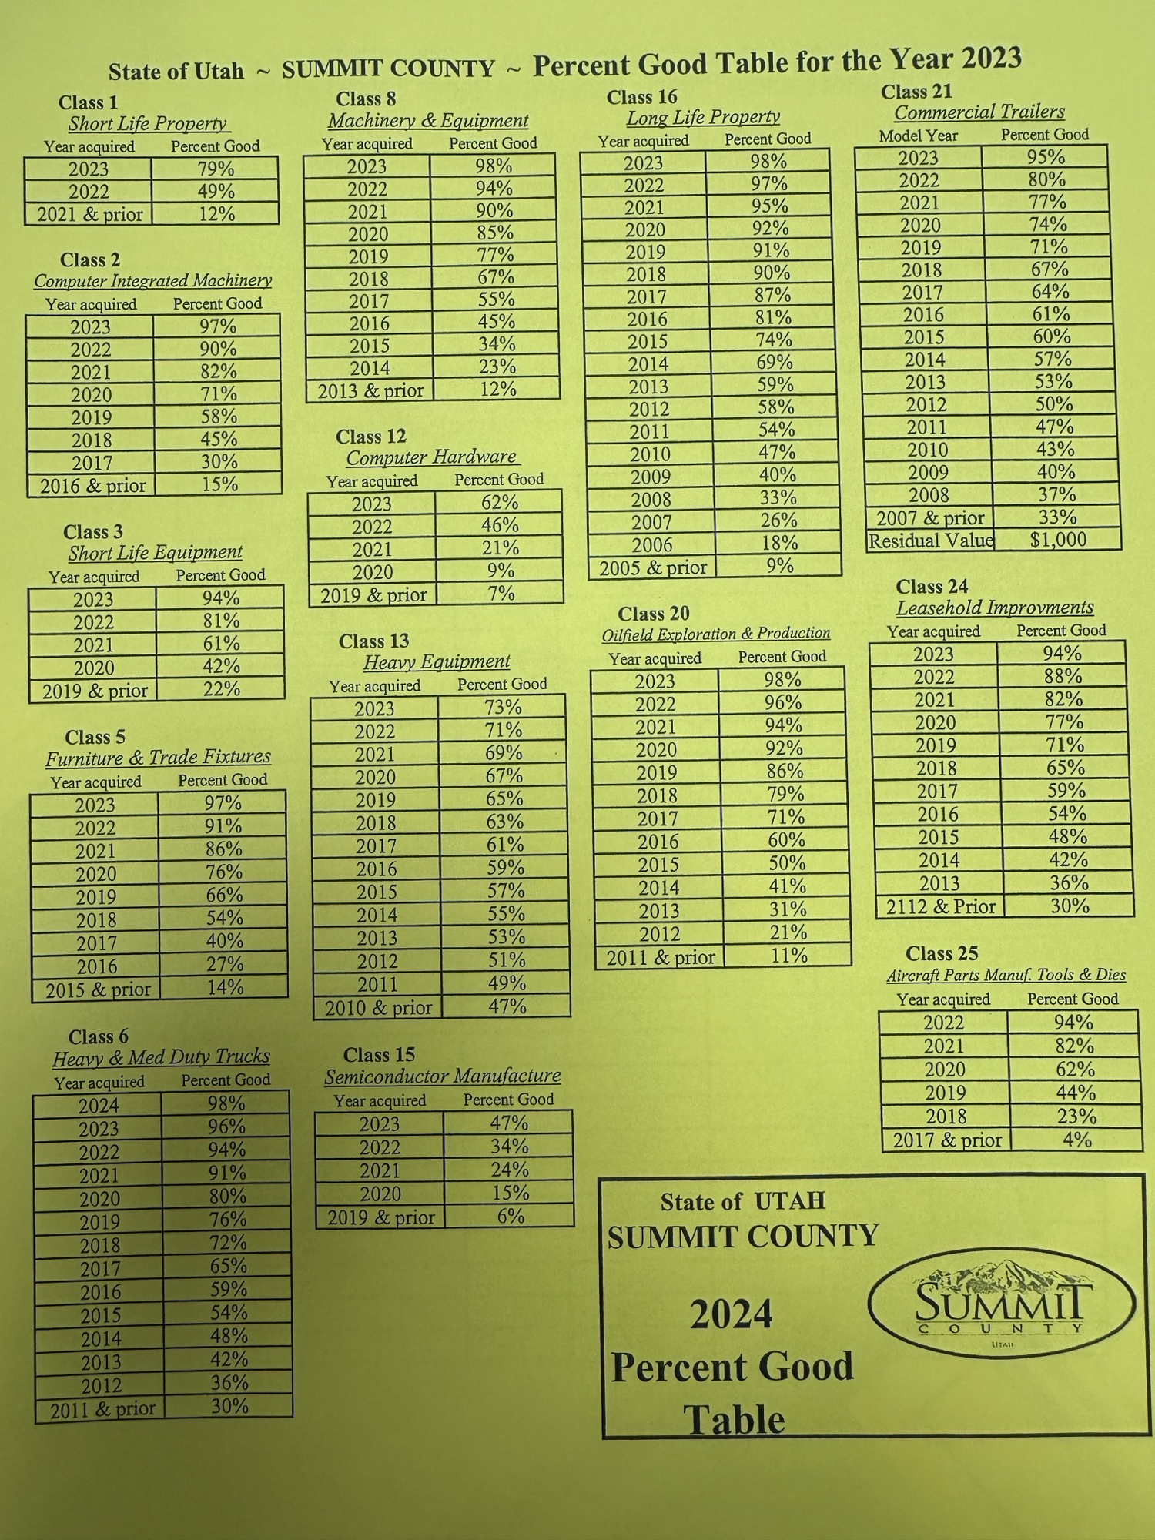
Percent Good table
Developed by the State Tax Commission.
The percent good factor is developed from IRS economic life estimates, which provide for the equivalent of straight-line depreciation to a residual value over the economic life of the property.
Appraisal depreciation is different than accounting depreciation. Appraisal depreciation is defined as the loss of value of an asset over time from all sources including physical wear and tear, functional obsolescence and economic obsolescence. Accounting depreciation is the recover of capital cost over a defined period.
Property used in the business that is fully depreciated for accounting purposes is taxable and must be reported.
If it is being used for the business, it has some value to the business.

Slide 10
Extensions
Can an extension be filed to push back the May 15th deadline?

Slide 11
THANK YOU
Summit County Assessor’s Office
Karen West, Personal Property Specialist
Stephanie Poll, Summit County Assessor
435-336-3257
kwest@summitcounty.org
www.summitcounty.org/220/assessor

